Slide 1
LITTORAL COMBAT GROUP (HEAVY)
JFMCC
LCG 1
LCG 2
LCG 3
LHA
LPD
LPD
ESB
ESB
ESB
T-ATS
T-ATS
T-ATS
FSF/SWATH
FSF/SWATH
FSF/SWATH
LCS (SW)
LCS (SW)
LCS (SW)
LCS (MW)
LCS (MW)
LCS (MW)
LCS (ASW)
LCS (ASW)
LCS (ASW)

Slide 2
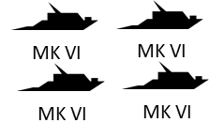
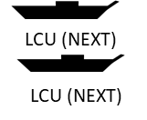
LITTORAL COMBAT GROUP (LIGHT)
JFMCC
LCG 1
LCG 2
LCG 3
ESB
ESB
ESB
T-ATS
T-ATS
LCU (NEXT)
T-ATS
LCU (NEXT)
MK VI
MK VI
FSF/SWATH
LCU (NEXT)
LCU (NEXT)
MK VI
MK VI
FSF/SWATH
FSF/SWATH
LCS (GCE)
LCS (GCE)
LCS (GCE)
LCS (SW)
LCS (SW)
LCS (SW)
LCS (MW)
LCS (MW)
LCS (MW)
LCS (ASW)
LCS (ASW)
LCS (ASW)

Slide 3
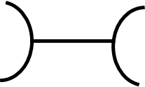
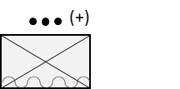
LITTORAL COMBAT TEAM
LCT 1
(+)
(+)
(+)
(+)
HQ
(+)
(+)
EW
NMCB
E
(+)
SP
MWSS

