Slide 1
UNCLASSIFIED/PREDECISIONAL
“…make it the responsibility of the regiments to place the same amount of emphasis on the Bildung [cultivation] of officers as they do on drill and discipline…”
-Scharnhorst, 1802

Slide 2
Why a Warfighting Society?
UNCLASSIFIED/PREDECISIONAL
“We have applied substantial energies to developing new concepts over the last two decades, but our “proofing” of these concepts through rigorous wargaming, experimentation, and analysis has been inadequate. Such activities are essential if we are going to translate our concepts into action.”
“For the Marine Corps, meaningful innovation is not just having great thoughts and concepts rather, it is about translating great thoughts and concepts into action.”
–38th Commandant of the Marine Corps Planning Guidance, 2019
“…Set the groundwork firmly in adult learning methodology with an emphasis on teamwork, problem solving and enabling all our Marines to cycle through the OODA loop faster than any opponent we may face… We cannot replace the unique value of formal PME experiences, but not everyone is able to go to school on-site or in seminar…self-study is the most important aspect of any PME-system…”
- TECOM Commander’s Guidance, 2018
.

Slide 3

Organization
UNCLASSIFIED/PREDECISIONAL
Sponsored by CG TECOM
Board Members:
  Director: LtCol Nathan Dmochowski
  Secretary General: Col Chris Woodbridge (ret)
  Information Officer: LtCol Roy Draa
  Wargame Officer: Dr. Ben Jensen
  Elected by members per TWC Charter
TWC Membership
  Voluntary, rotational
  Expansion to virtual membership via online platforms
  Inclusive across the Total Force and academia

Slide 4
Organization
UNCLASSIFIED/PREDECISIONAL
TECOM Warfighting Society Chapters
Hawaii Chapter: GO Sponsor: Vacant
  Director: Maj Ryan Pallas
  Secretary General: Col Nathan Nastase (ret)
  Information Officer: Vacant
  Wargame Officer: Vacant
  Elected by members per TWS Charter
Okinawa Chapter: GO Sponsor: Vacant
  Director: Maj Tyler Quinn
  Secretary General: Vacant
  Information Officer: Vacant
  Wargame Officer: Vacant
CLNC CDET Chapter: GO Sponsor: Vacant
  Director: Mr. Mark Riccio
  Secretary General: Vacant
  Information Officer: Vacant
  Wargame Officer: Vacant

Slide 5
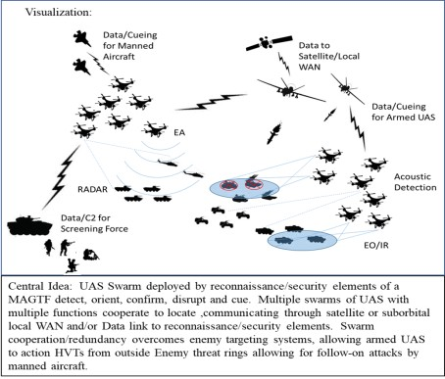
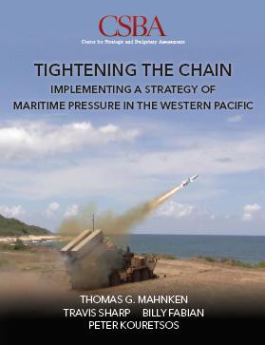
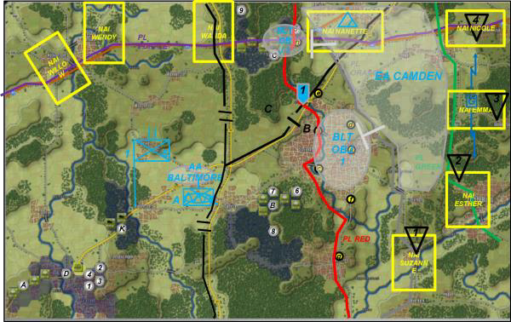
Function
UNCLASSIFIED/PREDECISIONAL
-Create a venue for discussion of “…subjects on the art of war that deserve particular vigilance in our
times, and that concern the performance of the officer in wartime…”
Coordinate with USMC stakeholders to move ideas forward
Wargame 21st Century threat dynamics
“Red Cell” current concepts based upon strategic tasking/priorities
Guest speakers (SMEs, industry,
academia, authors, military leadership, etc.)
Announcement and review of military books, monographs, research
Staff rides
Free exchange of ideas
Trusted mentorship and networking

Slide 6










Concept
UNCLASSIFIED/PREDECISIONAL
PARTNERED WITH KRULAK CENTER, SUPPORTED BY MCAF, EXPORTABLE TO THE TOTAL FORCE
WARGAME CURRENT CONCEPTS: STAND-IN FORCES, EABO, MUMT, AI, EW, SWARMING
OPEN TO ALL OFFICERS ANDSNCOS
PME
RELEVANT EMERGENT ISSUES
BILDUNG
FOSTER TACTIAL AND OPERATIONAL JUDGMENT
CO-MAGTF/JTF
CHOWDER
SOCIETY
MILITÄRICHE GESELLSCHAFT
PROFESSIONAL DEVELOPMENT MICROLEARNING DECISION-FORCING GUEST SPEAKERS GREAT BOOKS SERIES
VALUE TO THE SERVICE
NEXUS FOR IDEAS
“THE NEXT BIG THING”
ORGANIZATIONAL COMMITTEE CHARTER CORRESPONDING MEMBERS
CSC SAW EWS NPS
MAGTF-TC
NAVY
FMF
CDET

Slide 7
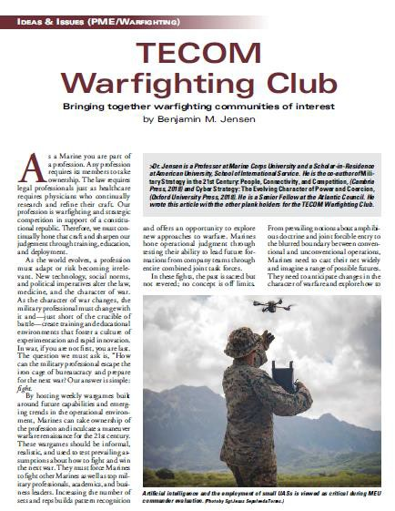
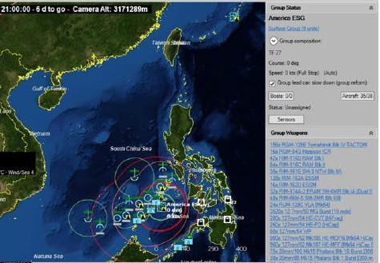
TECOM Warfighting Society
2019
UNCLASSIFIED/PREDECISIONAL
Nov 2018 – May 2019, TWC established
  How applicable is current force/doctrine with respect to emergent/pacing threats?
  How can AI, MUMT and Swarming Tactics increase “Inside Force” lethality and gain time/create interior lines for the MAGTF?
May 2019
  South China Sea Simulation
  Initial Gazette Article Published
Jun 2019
  Inside Force Concept Development
  South China Sea Article Published
Way Ahead
  Meets Fridays 1200-1400 at MCA&F
  White papers/articles on EABO/Inside Forces
  Virtual participation via Concept Board App
  Webinars/Discussions/Wargaming

Slide 8
TECOM Warfighting Society
2019
UNCLASSIFIED/PREDECISIONAL
Sept 2019:
  30 Sept: Final Inside Forces/EABO white paper and article complete, primary authors from TWS are Maj Brian Kerg (USMC) and LT Joe Hanacek (USN)
Oct 2019
  Submitted Inside Forces/EABO white paper for GO review, publish in Gazette/Proceedings
  Finalize Inside Forces/EABO support white paper/article
  Begin discussion framing of EABO C2 paper
Nov 2019
  “Winning Sea Control: Transforming Naval Expeditionary Forces” published
  “The Next Stand of the Tin Can Navy” published in CIMSEC
  TWS members invited to speak at US Army Future Force Command
  EWS/12th Marines War Game using a littoral combat group and littoral combat teams
  SAW War Games (1 & 2) using current capabilities for a Joint Maritime Campaign
Dec 2019
  SAW War Games (3 & 4 ) using future capabilities linked to DARPA’s proteus/mosaic concept for a Joint Maritime Campaign
  DRAFT of “Command and Control Considerations for Expeditionary Advance Base Forces”
  Working draft of Concept for Logistical Support of EABO paper

Slide 9
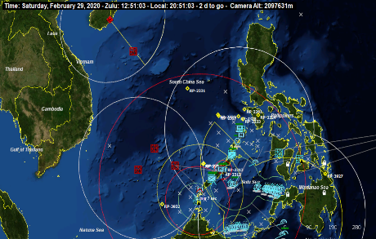
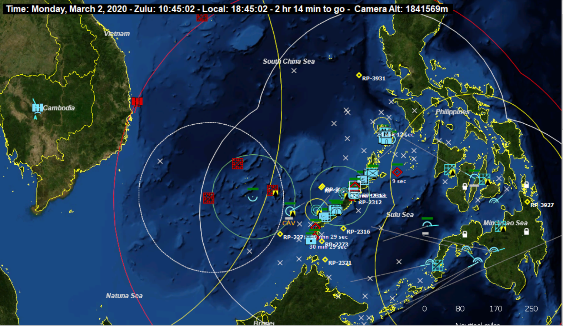
Sample SAW War Game Results
UNCLASSIFIED/PREDECISIONAL
Game 2 (Current Force)
Songs at north and south of Palawan; large number of H-6s still taking off and firing on surface combatants (air contested over SCS, controlled over Palawan)
Lost LCG to Type 22 and subs – AND early connector launch failed (J-10s shot down MV-22, subs hit LCACs)
Lost LHA, LPD to ASBM
MDTF seizes airfield; unlikely to hold
Game 4 (Mosaic Force)
ESG (DDG, CG, supply, LCS) and ARG/MEU transition to West of Palawan (conduct sea control)
Sub forward in SCS
Control Sulu, SCS (air)
Airfield seized (AH-1Zs, MDTF, assault support)

Slide 10
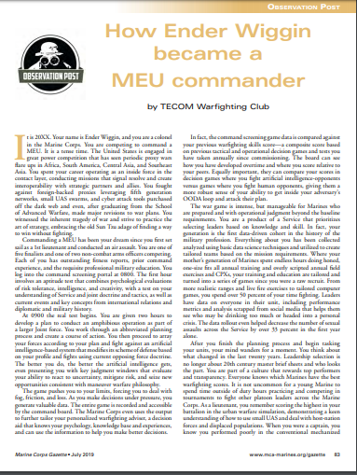
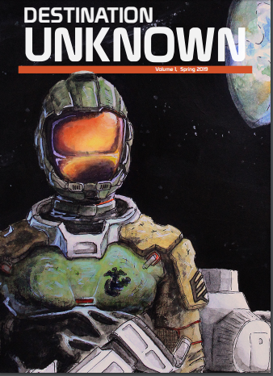
TECOM Warfighting Society
2020
UNCLASSIFIED/PREDECISIONAL
Jan-Feb 2019:
  TAD: NWC Wargame Design Seminar
  TWS/CIMSEC “Sea Denial” Podcast
  Begin EABO wargames with a focus on C2 construct
  Publish EABO C2 paper/article
  Publish EABO Concept of Logistics paper/article
  Potential guest speakers: Chris Brose, MajGen Bob Scales (ret), Bryce Hoffman (Red Teaming author)
  Establish GO sponsors for Hawaii, CLNC, Okinawa chapters
  TWS website FOC
  Publish EWS/SAW war games in Gazette in a Defense of Duffer’s Drift Format
Propose story for “Destination Unknown” volume III

Slide 11
UNCLASSIFIED/PREDECISIONAL
“…make it the responsibility of the regiments to place the same amount of emphasis on the Bildung [cultivation] of officers as they do on drill and discipline…”
-Scharnhorst, 1802

