Slide 1
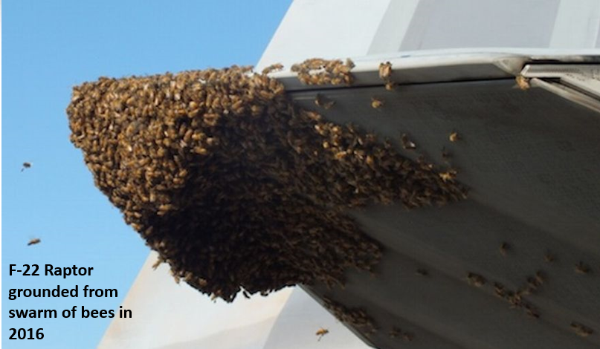
Swarming Primer
Swarming Defined
Engaging an adversary from multiple directions and domains simultaneously through lethal and non-lethal means in a manner that maximizes cognitive paralysis, confusion, uncertainty and matches cheap, often disposable systems vs. enemy critical systems (asymmetry).
Historical Examples
Battle of Hattin (1187)
Mongol Campaigns
St. Clair’s Defeat (1791)
Mole Cricket 19 (1982)
Benjamin Jensen, PhD Marine Corps University
benjamin.jensen@usmcu.edu
Notes:
Capt Olivia A. Garad (USMC) made many of the contributions to this brief as part a larger study
Historical examples based on: https://www.rand.org/pubs/rgs_dissertations/RGSD189.html

Slide 2
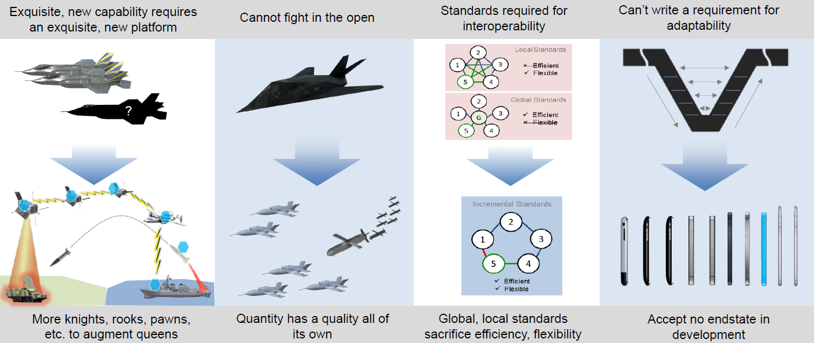
Central Idea: One Ferrari vs. Many Pickup Trucks
One Ferrari
The Old Approach: use expensive & exquisite new technologies to counter large enemy formations in specific missions.
Many Pickup Trucks
A New Approach: use creative combinations of cheap & modular systems to put the enemy on the horns of a dilemma. These systems are less capable in any one mission but able to perform many missions.

Slide 3
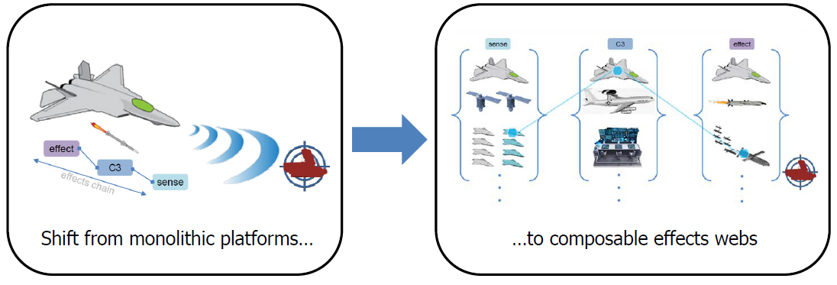
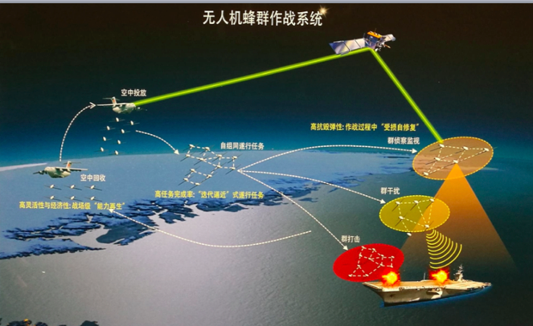
What Do Swarms Look Like?
Creative combinations of smaller systems to achieve an emergent effect. These combinations should put the adversary on the horns of a dilemma and shift cost curves.

Slide 4
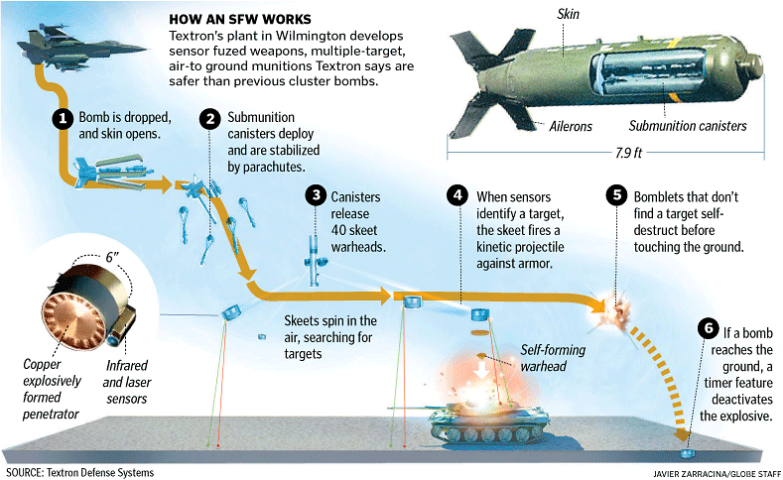
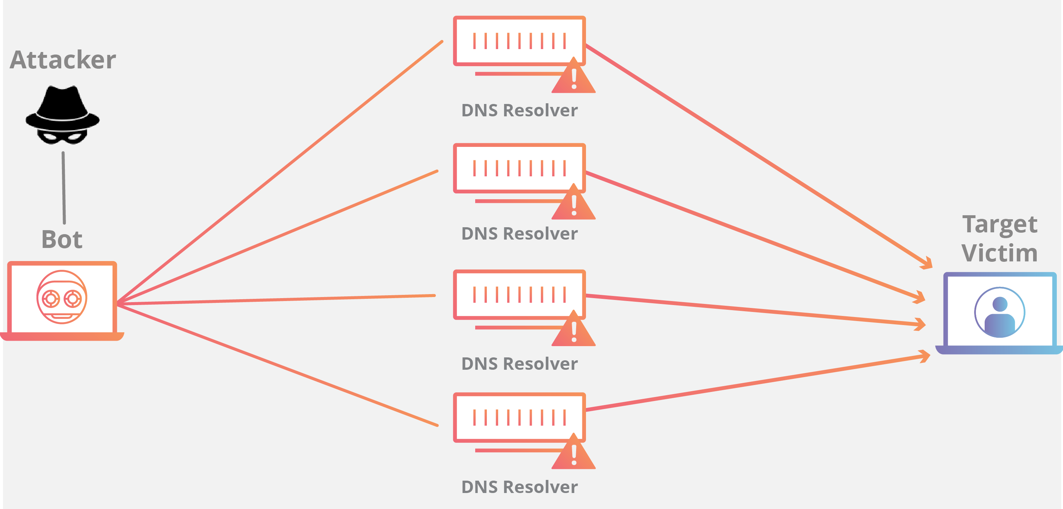
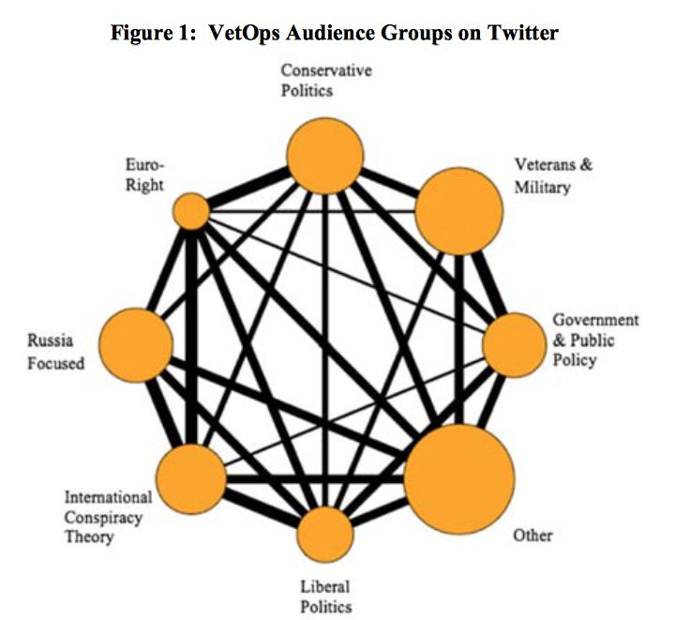
Types of Swarm Formations
“Massed Organic”
A massed swarm emerges from one unit to achieve an effect on another unit
“Dispersed Party”
A swarm emerges from multiple units and points in time and space, coordinating based on simple rules.
“Swarm of Swarms”
Multiple swarms, either organic or dispersed, coordinate through simple rules and replicate other swarm effects.
Example
Smart Cluster Munitions
Example
Distributed Denial of Service Attack
Example
Russian Influence Operations

Slide 5
Swarming Defeat Mechanisms
Physical Effects
The enemy does not have enough effects to counter each swarming element (e.g. there is more targets than ammo).
The optimal swarm combines physical and cognitive effects
Destroy: render the target combat ineffective through combined effects such that the target unit must be reconstituted, C2 systems recalibrated, and/or trust and confidence re-established in command relationships.
Dislocate: obtain positional advantage through combined effects that decrease the enemy’s expected gains from their current disposition and leaves them with a series of bad options (i.e., place them on the horns of dilemma).
Isolate: target the links between key nodes in the enemy system in order to limit – both physically and psychology - the enemy’s ability to generate power. Deny the enemy capabilities they need to maneuver at will in time and space.
Cognitive Effects
The human, machine, or human-machine interface cannot process the complexity, mass, or multidimensional maneuver to effectively counter.

Slide 6
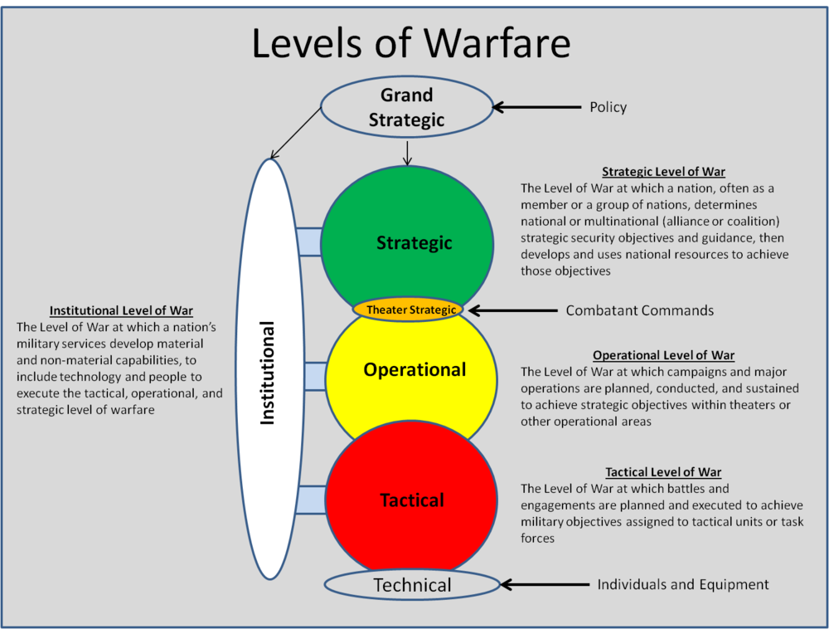
Swarming Across the Levels of War
Examples
Strategic: not new (e.g., NATO), build interoperable alliance networks.
Operational: not new (e.g., current U.S. military theory of victory), create the ability to conduct expeditionary coalition joint operations in multiple domains.
Tactical: new efforts to create creative combinations at echelon that increase maneuver options and lethality. Swarm tactics create emergent complexity.
Institutional: new efforts like DIUx, MD5, Service Innovation Challenges and rapid capability offices, Army Futures Command, and the Joint AI Center to challenge legacy combat development processes and create new public-private partnerships that produce disruptive innovations while lowering the costs and timelines to field new concepts and capabilities.
Notes:
Graphic: https://thestrategybridge.org/the-bridge/2016/5/5/the-institutional-level-of-war

Slide 7
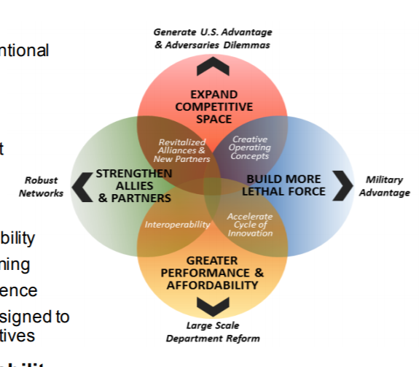
Swarming and the New National Defense Strategy
Competitive space
Develop swarm concepts and capabilities for the contact, blunt, and surge layers
Compete short of armed conflict in multiple domains (i.e., gray zones, political warfare)
Strengthen Allies & Partners
Rely on simple, commercial technology to ensure allied interoperability
Performance and Affordability
Swarms should be cheap
Prove they work
Lethality
Swarm at echelon in multiple domains to present multiple dilemmas
Notes:
Graphic taken from: https://www.ausa.org/sites/default/files/lanpac-2018/lanpac-2018-hypercompetition-forum.pdf
(clearly based on the new NDS)

Slide 8
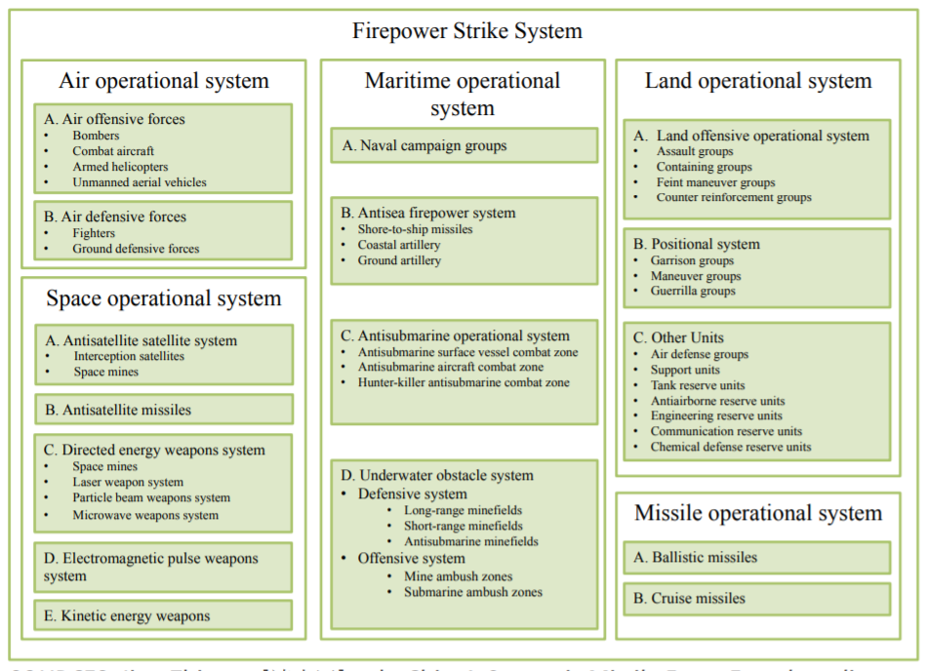
Possible Risks
New arms race?
Security dilemma
Offense-Defense Balance
Conflict spirals
New stability-instability paradox; great power competition will most likely take place through proxies on the periphery or predominately online
Inadvertent escalation
Nth domain problem: more competitive domains, more risk of miscalculation
Recon-strike complex; low-level lethality increases the use-or-lose decision in great power conflict
How will human-machine interfaces calculate risk
Institutions and Technology
Can old bureaucracy adapt?
FCS trap: you will never have enough secure bandwidth to make this work
PLA Operational Systems Construct: Firepower Strike System
(link together multiple packages – Joint combined arms)
Notes:
Graphic taken from: https://www.rand.org/content/dam/rand/pubs/research_reports/RR1700/RR1708/RAND_RR1708.pdf

