Slide 1
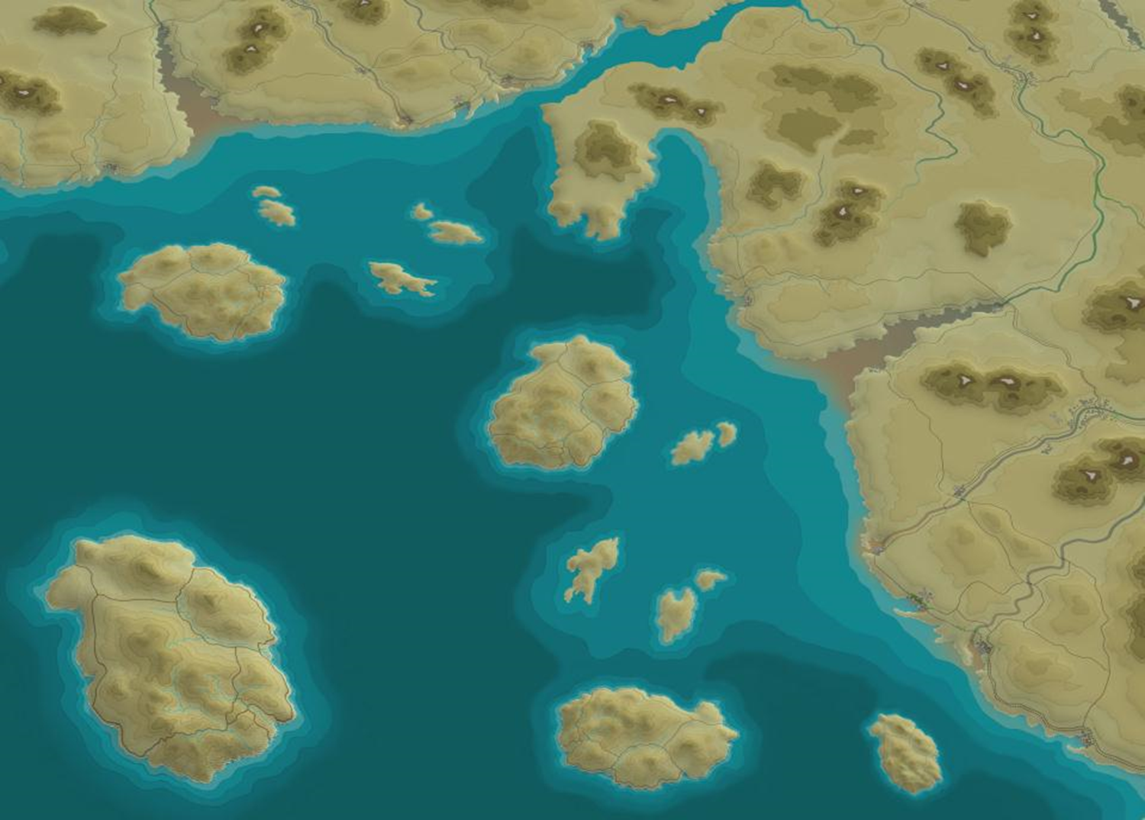
EABO and Stand In Forces A Discussion on Innovation in Strategy and Concepts
Art Corbett
Marine & Naval Concepts
Concepts and Plans Div.
MCWL / CD&I

Slide 2
Future Naval Operational Concepts
Future: Requires force development
Naval: Supports a joint campaign that is naval in character. Integrates naval forces to achieve operational objectives.
Integration is distinct from de-confliction based on high water mark & CATF / CLF
Operational: Connects tactical actions and capabilities to strategic ends . . . lest we win every battle and still lose the war. . .
Conceptual Ambition: To employ new tactical means in new ways to provide future decision makers with better options.
Next Paradigm requires Revolutionary vice Evolutionary Change. Current paradigm is at an evolutionary dead end.

Slide 3
Adversary Strategy
Adversaries have credible strategies that incorporate high and low end forces:
Incremental fait accompli gambits to achieve territorial objectives and diminish US credibility and influence
Create de facto facts on the ground to substantiate hegemonic claims
Counter intervention strategies that seek to minimize US influence
Potential adversaries have attacked the assumptions upon which the legacy joint force has been built: Presumptive sea control, air control and assured communications
Negate US eroding advantage in capability with overwhelming capacity
Generate prohibitive cost imposition
Close capability gap while generating a decisive capacity mismatch
Forces range from Ballistic Missiles to maritime militia providing many rungs in the escalatory ladder

Slide 4
Consequences of A2AD on the US Joint Force
US forward basing infrastructure, large runways, deep water ports and large platforms are now self-optimized target sets
Difficult to partner if you cannot remain present
US high value capabilities are located in highly vulnerable forward bases and locations
Withdrawal upon I&W not a favorable deterrence option
Loss of presumptive or easily achieved sea control, air control, and assured communications
The joint force is rendered brittle and risk averse

Slide 5
Strategic Ennui
Current Strategy. The absence of a credible strategy in the western Pacific results from a lack of combat credible forces appropriately matched to engage both malign behavior below the threshold of war and to persist and in major combat operations. Changes in the overall correlation of military force in the Western Pacific have resulted in the following unstated but de facto strategic options:
Observe and protest/discuss PRC hegemonic gambits and malign behavior in SCS
Lament vulnerable force posture in Western Pacific
Acknowledge, accept and accede to PRC A2AD capabilities
Destruction or Withdrawal in event of MCO

Slide 6
Restoring the Strategic Initiative
A2AD capabilities represent adversary ambitions to wrest and exploit the strategic initiative.
Adversaries have studied the American Way of War, discerned the Achilles heel of our joint expeditionary capability and directed their A2AD investments to compel inelegant dilemmas on the US joint force.
The democratization of technology makes enduring material solutions to regaining the initiative problematic—and expensive.
To restore the initiative the US must initiate the next paradigm for the conduct of joint expeditionary operations
The structure of the evolved Joint Force and the American model of expeditionary operations are founded on the fundamental assumption that US Forces have, or can readily achieve, sea and air control.
Potential adversary’s ‘counter intervention’ capabilities provide ample reason to question those fundamental assumptions.
Consequently, we must re-think our force posture, structure, platforms, capabilities and operational concepts in light of new vulnerabilities and a realistic appraisal of current and anticipated adversary capability, capacity, activities and intentions.

Slide 7
Desired Future Force Operational Characteristics
Get critical infrastructure and vulnerable capabilities ‘off the X’
Establish mobile and low signature forward presence conventional forces
Develop distributed, low signature, lethal, networked, persistent, risk worthy, joint expeditionary capabilities that can persist and operate within the arc of enemy long range fires--Rebalance force structure at the lower end
Introduce uncertainty into enemy risk calculus with more amorphous bases, distribute low signature, operationally relevant capabilities and infrastructure
Maintain persistent, forward inside force with high lethality, low signature expeditionary forces
Reassure allies, preclude fait accompli aggression
Keep foot in door to avoid need to kick in the door
Joint forces support JFMCC in the sea control fight
Forward forces provide resilience with relative economy
Requirements must reflect need for greater capacity vice exquisite capability
Counter cost imposition
Capitalize on TSC activities and relationships to support O-Plans
Train, man, equip and forward position participants in competition Phase to conduct TSC activities to support O-Plan requirements
Capable of coherent action in comm degraded conditions. LPI/LPD comms essential to winning hider finder competition.

Slide 8
Better Strategic Options
The Stand-in Forces Concept, in accord with the tenets of JAM-GC and EABO, assumes a more resilient force posture, upon which to base a new force structure with requisite capacity to be combat credible and enable the following better strategic options at affordable cost within 5 years.
Meet mutual defense treaty commitments.
Maintain expeditionary capability on more resilient posture.
Deter with combat capable and credible forces.
Contest malign behavior and fait accompli gambits with proportionate response.
Assure allies with continuous presence and partnership.
Expand US capacity with partner capability. Exploit regional geography to advantage.
In event of war, generate adequately coercive, but not vertically escalatory military conditions.
.
A credible future operational concept should
present better strategic options to future decision makers

Slide 9
Generating new and better options for future NCA
How does war with a ‘peer competitor’ end well? What should be our military strategic objective? How do we win?
Proper Military Objective: Create adequately coercive conditions that do not promote vertical escalation
Ability to turn adversary near seas into mutually denied space fits our requirement
Take advantage of the stronger form of contemporary battle—the tactical defense
Think Like Longstreet—not Lee. . .
The Strategic Initiative / Offense combined with the tactical defense enables naval and joint forces to secure advantage from the stronger form of battle—the integrated maritime defense.
Generates high deterrence with credible forces at minimal cost
High probability of success
Disproportionately advantageous in battle
New and better options depend on ability of naval forces to create an integrated maritime defense in depth in the vicinity of key maritime terrain within the arc of adversary long range precision fires to selectively deny access to close and confined seas with largely ‘stand-in’ forces.
What capabilities and tactics do we have to create these conditions?
Time to get busy. . .

Slide 10
Strategic Ambitions
The Stand-in Force is designed to achieve the following:
Restore the initiative.
Deter war
Generate innovative and disruptive concepts and capabilities.
Off-set adversary capacity.
Persist forward.
Invert cost imposition.
Create new competitive space.
Contest malign behavior
Restore confident warfighting culture.
Control escalation

Slide 11
The Nature of the Naval Challenge
US Navy can beat any two other navies in the open ocean fight
But. . .the challenge is in close and confined seas, where it is the US Navy vs. adversary joint force
Our great naval challenges are all associated with close and confined seas that we would do well to avoid were it not for treaty allies that draw us there or we are compelled to transit.
“A ship is a fool to fight a fort” --Admiral Horatio Nelson
The asymmetrical advantage between land and ship has grown as land based ISR, weapon systems and aircraft have greatly increased range and capacity vs current ships
The hider finder competition greatly favors the land based defender
Ultimately we must deny or control seas to project power or coerce adversaries
Advantage has shifted to the tactical defensive in maritime operations

Slide 12
Sea Control and Denial
To control the sea, the naval commander must control the sea surface, sub surface, air and space above and those contiguous land masses that enable control of the sea.
Our treaty allies and economic partners afford proximity and enable persistent presence astride the contested close and confined seas that currently vex joint and naval operations
Naval forces can exercise and support sea control and denial activities from key maritime terrain adjacent to close seas.
Key maritime terrain, such as Gibraltar and the 1st Island Chain, enable integrated and persistent naval forces to readily control commerce in close seas
EABO is dependent upon future force development to create inside forces capable of ‘stand-in’ engagements.

Slide 13
The Role of Marines
For over 70 years Marines have fought with the luxury of US Navy insured sea control, and consequently optimized our organization, kit and ships for offensive power projection operations from the sea. . .
But now that the seas are contested space, Marines must develop a new line of operations for how we support JFMCC and fleet commanders in the fight for sea control.
Marines are essential to successful sea control and denial missions in close and confined seas. Marines fight for and from those contiguous land masses that enable control of the sea—especially close and confined seas.
Marines are Fleet Marine Forces—an integral naval asset in fleet operations
As Marines return to our naval roots, we must not go back to being the naval force we were before we went into the desert—our most agile enemies have moved on and invalidated the fundamental assumptions upon which that force was built. Marines must move forward to become the new expeditionary naval force the nation and the Navy need.

Slide 14
The Role of the Navy
To persist within the WEZ the USN requires SOME regionally aligned forces.
Current USN warships are all ‘trans-oceanic’
Capable of being massed at any point on the globe
To be trans-oceanic they must be ‘ships’ and any platform large enough to range the globe is now a self –optimized target within the WEZ
The USN requires some platforms that are capable of persisting and operating within the WEZ (in addition to nuclear submarines)
Risk accepting (Minimally manned and autonomous)
Capable of winning the hider finder competition (Smaller, semi-submersible, etc.)
More numerous (because they are cheaper)
Lethal (emphasis on payload vice platform)
Navy has unique ability to create vertical concentrations of capabilities

Slide 15
Inside Force and EABO
EABO enables the forces and capabilities envisioned as the “inside force.”
Dual-postured inside and outside force enables new combinations of joint force capabilities and characteristics to achieve advantage and defeat adversary strategy
Inside Force is designed to persist forward within range of adversary long range fires, accept risk, be more passively defended, take advantage of partner proximity, provide ISR for outside force, be inherently resilient, invert cost imposition, buy time, create enemy uncertainty, etc.
Generate an integrated maritime defense in depth
Engage with both ‘stand-off’ and ‘stand-in’ forces
Shape battlespace
Cover withdrawal
Outside Force builds on legacy structure and posture to place enemy interests outside the WEZ at risk in order to deter during competition phase or exercise controlled escalation in MCO. Outside forces are outside the WEZ not outside the fight. Can create immediate consequences and highly coercive conditions during MCO.

Slide 16
New Joint Paradigm for Expeditionary Campaigns
Emphasis on operational (vice systems) approach in a campaign to create adequately coercive conditions and defeat enemy strategy
Employ Naval & Joint operational art to achieve disproportionate result
Balance the joint force at the lower end with an operationally significant number of risk worthy, less expensive, adequately capable but lethal platforms and payloads
Develop a more amorphous forward basing infrastructure that clouds rather than clarifies enemy situational awareness, expands capacity and supports distributed expeditionary capabilities forward
Fully leverage joint & combined capabilities in the sea control fight
Assure regional partners with persistent presence and partnership
Acquire capabilities that enable naval forces to take advantage of the relative strength of the tactical defense
Disrupt the evolved character of the competition with Stand-in Forces and engagements

Slide 17
The Four Naval Warfighter Challenges
The Persistent Inside Force Must:
Generate the virtues of mass without the vulnerabilities of concentration
Create a more dispersed, resilient and hard to target forward basing infrastructure
Create a more resilient CONUS / seabase to shore sustainment infrastructure capable of supporting distributed operations
Win the hider / finder competition
These generic imperatives must guide future naval force development

Slide 18
Stand-in Naval Forces
Reverse the historic trend toward greater stand-off distance capability
Composed of many, smaller, cheaper and more risk-worthy platforms that proliferate adequately lethal payloads and create close in engagements
Generate new competitive space
Asymmetric and disruptive—meets Boyd’s ambition for ‘fast transient maneuver’
Creates new dilemmas for adversaries
Shape the character of future war toward ‘innovation base’
New tactical capabilities to generate better strategic options
Complement stand-off forces and deepen enemy dilemmas
Can concentrate vertically to mass fires or effects
Increase payloads with many small cheap and cost effective platforms
Optimize for partnership
Better optimized for dealing with malign behavior
Provide the common objective for naval innovation—innovate to do what?
Are designed to be ‘network optional’ anticipating a communications denied environment

Slide 19
21st Century Joint/Naval Operational Art :
Persistent Inside Force
Weighted Outside Force
Optimized to persist, partner and deter
Maintains persistent SA through hosted ISR
Passive missile defenses preferred—restore CDD
Resilient, numerous, minimal signature forces
Distributed / mobile / resilient forward basing infrastructure
Makes a virtue of austerity
Lethal long range AA and ASCM fires
Exploits partner proximity to host more smaller lethal platforms
Tactical actions shape battlespace
Conducts integrated maritime defense in depth to close straits and exploit geography to advantage
Contests malign behavior with stand-in forces
Compose largely of regionally aligned forces
Predominantly composed of ‘stand-in’ capabilities
Threatens enemy interests outside the WEZ
Optimized for episodic MCO engagements
Emphasis on mass and maneuver for advantage
Capable of massed fires and forces
Requires traditional basing—long runways and deep water ports
Composed of improved Legacy force
Exploits opportunity and SA generated by Inside Force
Exploits inside force proximity for forward sustainment, battle damage repair, SAR, etc.
Fleet actions for operational result
Backstops forward ‘inside’ forces
Complements ‘stand-in’ capabilities with ‘stand-off’ fires
Composed largely of trans-oceanic ‘stand-off’ forces
JFC/JFMCC synergizes the distinct but complementary capabilities of inside and outside forces to achieve advantage and generate coercive conditions

Slide 20
Expeditionary Advance Base Operations
EABO is an inherently naval concept to support joint operations by advancing naval and joint sensors, shooters and sustainment capabilities to achieve sea control and denial.
EABO supports the operational method by which Marine and joint expeditionary forces and capabilities can contribute to JFMCC efforts to gain and maintain sea control / denial
EABO expands the USMC lines of effort to include sea control / denial in naval & joint expeditionary operations
Sea control and power projection are complementary but distinct lines of effort within a joint campaign that is naval in character
EABO enables a forward, persistent integrated maritime defense in depth to selectively deny access to close and confined seas and create strategically coercive conditions
EAB hosted forces optimized for both stand-off and stand-in engagements

Slide 21
Expeditionary Advance Base Operations
Naval Expeditionary Forces advance and extend the joint line of operations by securing advantageous islands, archipelagos and key maritime terrain in proximity to the JOA to support JFMCC sea control and sea denial missions. Example missions and characteristics:
Naval expeditionary forces secure (seize or occupy) land bases to advance and distribute joint sensors, shooters and sustainment.
Maximize use of permissive terrain and passive defense / force protection. (Mobility, cover, concealment, decoy and deception)
When practical, establish mutually supporting strong points in close and confined seas.
Establish rotating FARP sites for fixed wing, rotary & UAV operations
Lend resiliency to the joint force by proliferating mobile land based ASCM, AA, ABM, and BM missiles that are difficult to target by long range systems
Integrate landward sensor and fires systems with Cooperative Engagement Concept (CEC) under JFMCC C2. Close coordination to advantage fleet with land based capability.
Provide secure advance locations for basing of missile / torpedo boat flotillas, UUS & USS systems, and other future Navy inside forces and force requirements.
EABO enables persistent Scouting, Fires, Protection and Sustainment
For the Confined Seas Fight

Slide 22
Persistent Presence & Partnering
EAB OPS enables naval and joint forces to persist forward within reach of adversary A2AD long range fires
Presence engenders confidence, assurance and trust with regional partners
Proximity matters in thwarting fait accompli gambits with stand-in forces
Balancing the joint force at the lower end will afford greater peer to peer partnering opportunities.
Greater commonality of equipment
Mutual maintenance and logistics
TSC objectives and exercises can contribute to both partnership and preparation
Partnership enables regional readiness and prepositioning
Return to POMCUS (Prepositioning Of Materiel Configured in Unit Sets)??

Slide 23
EABs and EAB Operations
Expeditionary Advance Bases
An EAB is designed to secure, support and sustain warriors and their weapons/machines within range of adversary long range fires.
An EAB may be mobile, using trucks, barges, ferries, etc. to provide mobility and continuity of mission support.
An EAB might be established in a broad area to support several different missions or functions
EABs are designed to PERSIST forward and enable HOSTED forces and capabilities to accomplish missions or create conditions
An EAB is designed to provide only the essential functions of a traditional base with a far less vulnerable and more resilient support infrastructure
EABs can be created today
Expeditionary Advance Base Operations
EABO are the operations and operational support activities conducted by forces hosted on EABs
EABO are conducted in support of the JFMCC scheme of maneuver, defense of partner territory or to control or exploit the control of key maritime terrain.
Preferably, EABO are conducted by capabilities that are designed, optimized or adapted to operate within the arc of adversary long range fires.
EABO are dependent upon advancing sensor, shooter and sustainment, capabilities that are operationally relevant to fleet commanders, JFMCC and the JFC
EABO requires future force development

Slide 24
Contact Information
Art Corbett
Marine Corps Warfighting Lab
Concepts and Plans Division
Marine and Naval Concepts
703-432-8565
703-784-4540

Slide 25
Backup Slides

Slide 26
EABO Summary
EABO places emphasis on operations enabled by a force postured to persist within the arc of adversary long range precision fires.
EABs provide an alternative force posture that enables persistence, fosters partnering and provides proximity to contested battlespace.
EABs provide a more amorphous, distributed, resilient, and difficult to target forward basing infrastructure designed to support and sustain new and legacy naval and joint capabilities
EABs take advantage of partner proximity to advance and support naval and joint sensor, shooter and sustainment capabilities
EABs support and sustain what JAM-GC calls the “Inside Force” to conduct ‘stand-in’ and ‘stand-off’ engagements
EABO is an inherently naval concept to support joint operations by advancing naval and joint sensors, shooters and sustainment capabilities to achieve sea control and denial.

Slide 27
EAB Hosting Considerations
Security – Marine Infantry units and Host Nation forces
Food – MREs, contracted or purchased from Host Nation
Water – ROWPU, contracted or purchased from Host Nation
Shelter – Tents to local billeting
Fuel – Aircraft, vehicles, prime movers, generators
Power – For basic equipment
Medical – First-Aid, stabilization, and evacuation
C2 – Intra EAB comms for coordination, external comms for COP
Mobility – All EABs must be mobile and therefore must have the proper mobility to move assets
CCD – Cover Concealment and Decoys will manage signature
Contracting – 21st Century Foraging

Slide 28
Future Expeditionary Force (A2AD Peer Scenario)
INSIDE WEZ FORCES
OUTSIDE WEZ FORCES
STAND-IN FORCES
Integrated maritime defense/deter
Sea denial
Stand-in engagements
Network optional – AI as required
EAB force posture
New force structure
Regionally-aligned Navy platforms
Non-lethal tools – “gray zone” competition
Ultimately coercive (blockade)
Logistics: infiltrated, demand reduction
LINEBACKER? OVERWATCH? FORCE
Mobile reserve
Reinforces integrated maritime defense (fires + forces)
Stand-off engagements
Synergizes stand-in & stand-off capabilities
Need LXX + new platforms
Sea denial + sea control hybrid
GLOBAL ENGAGEMENT FORCE
Immediately coercive
Threatens/reduces enemy global interests
Outside the WEZ, NOT outside the fight
Enhanced legacy capabilities
Exploits sea control and exterior lines
Conducts offensive amphibious & strike operations
STAND-OFF FORCES
Integrated maritime defense/deter
Augment + extend outside forces’ stand-off engagements
Network enabled

Slide 29
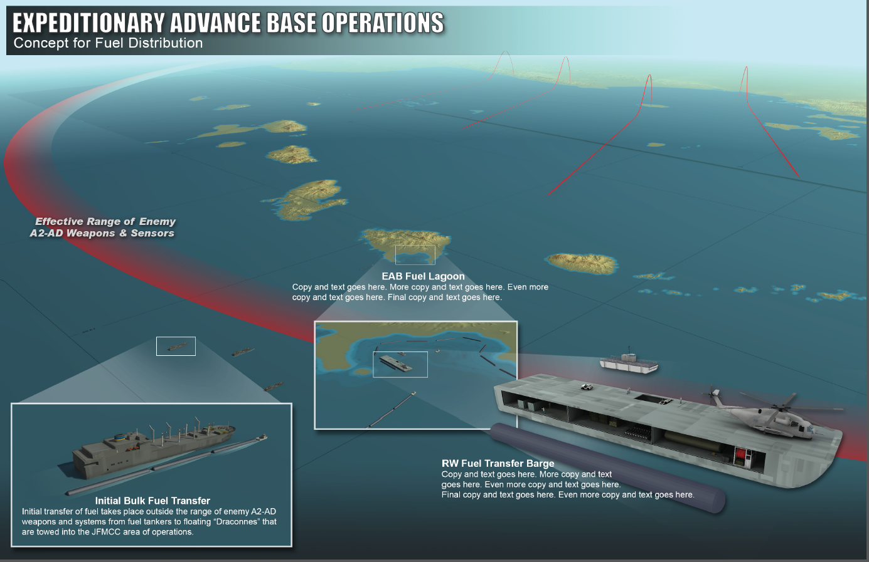
Mobile Distributed Logistics

