Slide 1
During an NSC meeting, POTUS stresses that she wants viable military options for countering Chinese aggression that [T] demonstrate US capability and resolve, [T] reassures treaty partners [L] in the region and avoids nuclear escalation.
Following the meeting SECDEF contacts INDOPACOM Commander. In consultation with the Joint Chiefs, they determine that countering the Chinese through [L] conventional operations in and around Palawan is the only viable military option to manage escalation. They stress that the operation [L] must involve limited military objectives that (L) do not signal a threat against mainland China and [L] avoids striking dual use nuclear facilities.
INDOPACOM Commander works with the J55 and adapts portions of a key contingency plan. The plan calls for using flexible response options – with an emphasis on diplomacy to build the counter-China coalition and economic pressure – while [L] conducting a limited military operation to demonstrate capability and resolve and signal the risk of further conventional military escalation. [L] With multiple carrier strike groups and larger portions of the USAF tied up with separate plans to defend Japan and Taiwan, the task falls on JTF 77. INDOPACOM orders JTF 77 to [T]support Filipino forces clearing Palawan of Chinese military forces. [P] The purpose is to ensure the Chinese forces don’t use Palawan as a lodgment to threaten the Sulu Sea and other islands in the Philippines, that the conflict is contained and China has crisis offramp options while US treaty commitments are upheld. INDOPACOM orders JTF 77 to:
Seize the Palawan International Airfield in order to establish a secure lodgment for follow-on forces
Establish sea control at least 100 km west of Palawan in order to secure SLOCs in the Sulu Sea
Scout
FP
C2
Mission: O/O, JTF 77 establishes sea control in order to dislodge Chinese forces from Palawan.
Commander’s Intent: JTF 77 will conduct sequential joint, multi-domain operations to degrade the Chinese kill chain in the South China Sea. The operation will be begin with anti-scouting operations to destroy enemy assets that can track and target JTF 77 maritime assets before focusing on the enemy’s firepower. End state: Chinese forces no longer occupy positions in Palawan. South China Seas controlled. Allies are reassured.

Slide 2
During an NSC meeting, POTUS stresses that she wants viable military options for countering Chinese aggression that [T] demonstrate US capability and resolve, [T] reassures treaty partners [L] in the region and avoids nuclear escalation.
Following the meeting SECDEF contacts INDOPACOM Commander. In consultation with the Joint Chiefs, they determine that countering the Chinese through [L] conventional operations in and around Palawan is the only viable military option to manage escalation. They stress that the operation [L] must involve limited military objectives that (L) do not signal a threat against mainland China and [L] avoids striking dual use nuclear facilities.
INDOPACOM Commander works with the J55 and adapts portions of a key contingency plan. The plan calls for using flexible response options – with an emphasis on diplomacy to build the counter-China coalition and economic pressure – while [L] conducting a limited military operation to demonstrate capability and resolve and signal the risk of further conventional military escalation. [L] With multiple carrier strike groups and larger portions of the USAF tied up with separate plans to defend Japan and Taiwan, the task falls on JTF 77. INDOPACOM orders JTF 77 to [T]support Filipino forces clearing Palawan of Chinese military forces. [P] The purpose is to ensure the Chinese forces don’t use Palawan as a lodgment to threaten the Sulu Sea and other islands in the Philippines, that the conflict is contained and China has crisis offramp options while US treaty commitments are upheld. INDOPACOM orders JTF 77 to:
Seize the Palawan International Airfield in order to establish a secure lodgment for follow-on forces
Establish sea control at least 100 km west of Palawan in order to secure SLOCs in the Sulu Sea
Scout
FP
C2
Mission: O/O, JTF 77 establishes sea control in order to dislodge Chinese forces from Palawan.
Commander’s Intent: JTF 77 will conduct sequential joint, multi-domain operations to degrade the Chinese kill chain in the South China Sea. The operation will be begin with anti-scouting operations to destroy enemy assets that can track and target JTF 77 maritime assets before focusing on the enemy’s firepower. End state: Chinese forces no longer occupy positions in Palawan. South China Seas controlled. Allies are reassured.

Slide 3
Strategic & Theater
Husband additional joint resources to deter Chinese task forces operating near Taiwan and Japan
Defend space-based assets and conduct counter-space activities
Disrupt 4x DF-26 BNs during key periods of vulnerability (JTF 77 request)
Time Sensitive Targets
6+ fast attack (Type 21)
4+ attack subs (Kilo, Yuan)
JPITL
( HPT || HVT)
OTH Radar (Woody)
3+ Radar sites (air, surface) – SCS island
2+ Soar Dragon
20+ TACAIR (J-10, J-11, JH-7)
1 CG (Type 55)
2-4 Frigates (Type 54)
2-4 Destroyers (Type 52, 54)
5+ SAM BN (HQ-9) – SCS islands
2+ SSM BN (YJ-62)
SCS island10+ H-6M
2
3
Phase II – DON’T SEE
1
Gain Sea Control
Phase III -
THINK
Hold ground units at risk
Phase I - SEE
DO
Seize airfield
Support allies
Disrupt EN sea control
ivo SCS
Friendly COG = LHA
Enemy COG = Firepower
Information Environment
Can we break into the Chinese Great Firewall?
3d (Russia, France??) party neutral actors evacuate Chinese tourist from the Philippines to ensure they are not harmed as a result of their the Chinese political leaderships rash and belligerent actions
Social media posts highlight the miserable living conditions of the landing forces and Chinese inability to resupply or linkup?

Slide 4
Transition Criteria | If | And | Then
Phase I (disrupt sea control) to Phase II (gain sea control) | Radar and sonar destroyed 1x Frigate remaining 1x Destroyer remaining 50% Red TACAir remaining | TACAir overmatch Ammunition = yellow Strategic suppression of DF-26 effective | Order ESG to waters east of Palawan
Phase II (gain sea control to Phase III (seize terrain) | Sub threat neutralized | Sea control established east Palawan Strategic suppression of DF-26 effective | Establish sea control 100 NM west of Palawan Island
Reframing | Enemy has sea control | The LHA is non-mission capable | Attrite with CFACC And Request support from adjacent naval assets
1
2
3
Blue Takeaways
Protect friendly COG
Emissions control is not binary, on or off
Blue counter-firepower v. red firepower
Surface, subsurface, air, and space
CFACC airpower in support of sea denial
Time, space, and purpose of joint assets

Slide 5
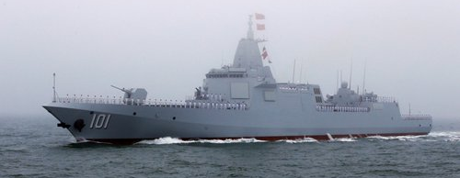
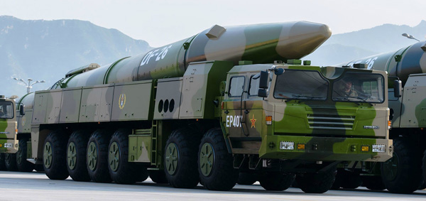
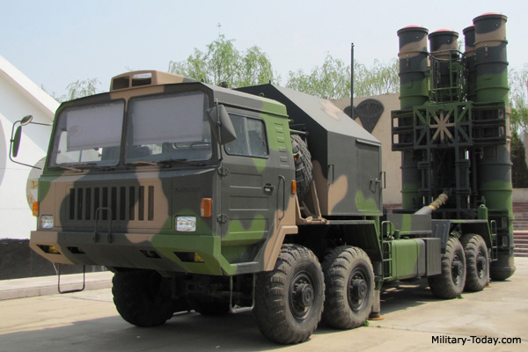
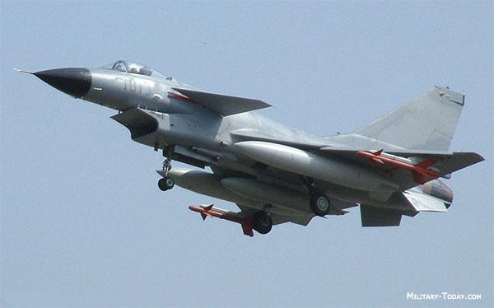
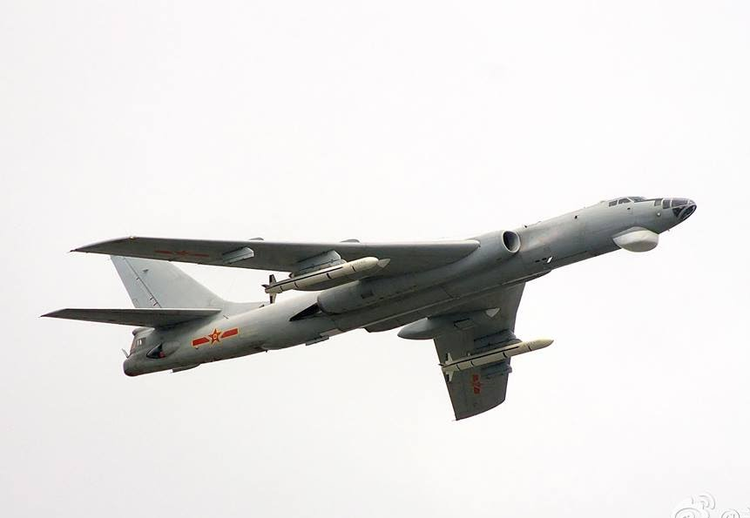
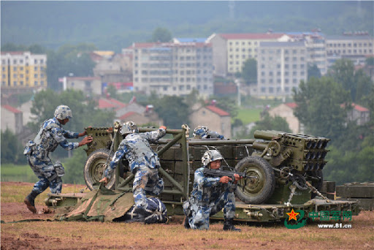
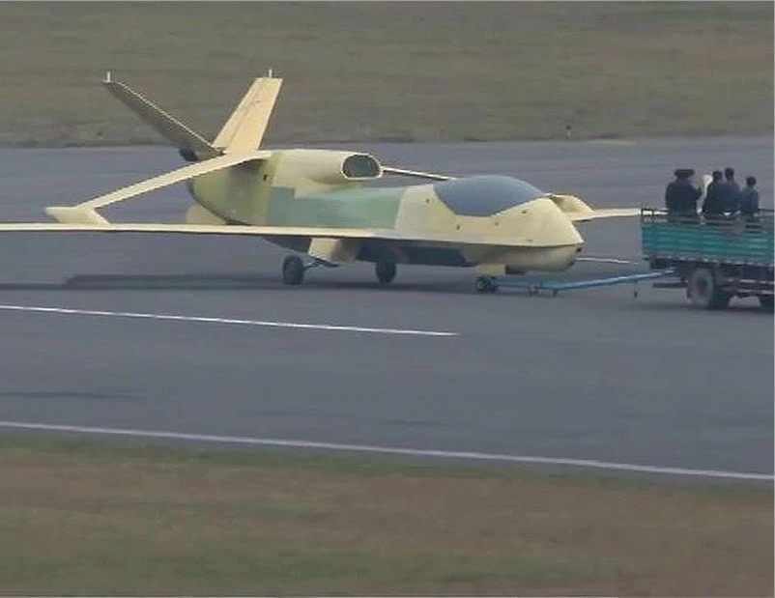
PLA Assessment
PLAN (SCS)
2-4 Frigates (Type 54)
2-4 Destroyers (Type 52, 54)
1 CG (Type 55)
6+ fast attack (Type 21)
5+ SAM BN (HQ-9) – SCS islands
2+ SSM BN (YJ-62) - SCS islands
3+ Radar sites (air, surface) – SCS islands
4+ attack subs (Kilo, Yuan)
1-2 supply (Type 93)
PLAAF (SCS, Woody Island airbases)
20+ TACAIR (J-10, J-11, JH-7)
10+ H-6M
OTH Radar (Woody)
2+ Soar Dragon
PLA (Palawan)
Airborne Company Team (1 x Armor PLT ZTQ, 2 x INF PLTs, 1 x artillery platoon, AAA section)
Rocket Forces (Mainland)
4+ DF-26 BNs
SSF
Use of OECM from SCS Islands
Limited use of cyber to support targeting
Type 55
DF-26
HQ-9
J-10
H-6M
PLA ABN
Soar Dragon
MLECOA: (PH 1) SAG will conduct sea control vic SCS IOT to secure the area and support an amphibious assault on Palawan. After PLA forces deploy 2x Marine Battalions to reinforce PLA airborne units holding Palawan airport, (PH2) the SAG and supporting PLAAF forces will transition to conduct sea control in the Sulu Sea IOT deny CJTF forces access to Palawan. Denying US forces access is the main effort. PLA/CCP leaders view limiting US forces as the best path to producing a fait accompli.

Slide 6
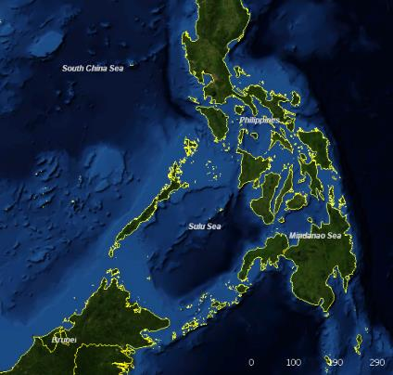
Phase 1 Mission: SAG will conduct sea control vic SCS IOT to secure the area and support an amphibious assault on Palawan. After PLA forces deploy 2x Marine Battalions to reinforce PLA airborne units holding Palawan airport,
Turn Concept ECOG/CV: CC: Ability to C2, Ability to Deliver Forces and Fires, Ability to Scout, Ability Anti-Scout; CR: Comms, Log Nodes, ISR platforms, EMSO, PGM platforms, ARG offload capability; COG: DDGs; CV: Comms, Log reload/Magazine Depth, Radars FCOG/CV: CC: Ability to C2, Ability to Deliver Forces and Fires, Ability to Scout, Ability Anti-Scout; CR: Comms, Log Nodes, ISR platforms, EMSO, PGM platforms; COG: H-6 Badgers w/ associated Radar and LRASM; CV: Comms, Magazine Depth, Air bases, Air Defense umbrella HVT: C2 Systems, Unmanned ISR platforms, ARG shipping, Radar, EABs, Ports/AFs HPT: C2 Systems, Unmanned ISR platforms, ARG shipping
Decisions: Strike once US breaches screening force and enters contact layer. Risks/Opportunities: Strategic Risk: International Escalation (draw in support from other US partners); Opportunities: Place US in land grab fait accompli (Ex: Russia in Ukraine); Striking Japan, Guam, and Hawaii too escalatory as it risks drawing in more partners
C
C
G
G
C
C
G
G
G
G
C
C
S
S
S
S
OP Box | Mission | WEAPONS (tight, free) | EMCON (emit, no emit) | COORDINATING INSTRUCTIONS
PLAN -SAGs -Subs -Maritime Militia (MM) | T: SAG-Guard Chinese Interests, Missile Boats- Attack, Subs-Screen and Cover, MM- Disrupt P: Deny key terrain, attrite US forces, and disrupt US ability to seize Palawan. | free | SAG-no emit, Missile Boats-emit, Subs-no emit; MM-ambiguous | -Missile boats attack connectors; SAGs attack ISR and Radars, BPT to strike ARG/DDG at first opportunity; Subs attack ISR and Radars, BPT to strike ARG/DDG at first opportunity.
PLAAF -Bombers -Fighters -ISR | T: Bombers: Strike DDG, ARG, Log nodes, ports/AFs; Fighters-CAP and Air Interdiction; ISR: Surveillance locates HVTs and HPTs P: Defend, Destroy, and Neutralize. US Navy and Aviation assets. Collect on US forces. | free | Emit | -Offensive Strike, CAP, and Air Interdiction: Maintain local air superiority, C2, and disrupt EABs.
PLA, SOF & PLAARF | T: PLA & SOF: Guard Chinese interests; PLAARF: Prosecute targets according to HVT, HPT. P: PLA & SOF: Defend against US attacks; secure Air Port; PLAARF: Destroy, and Neutralize HVT/HPTs | free | Emit | -Prosecute targets according to HVT and HPT.

Slide 7
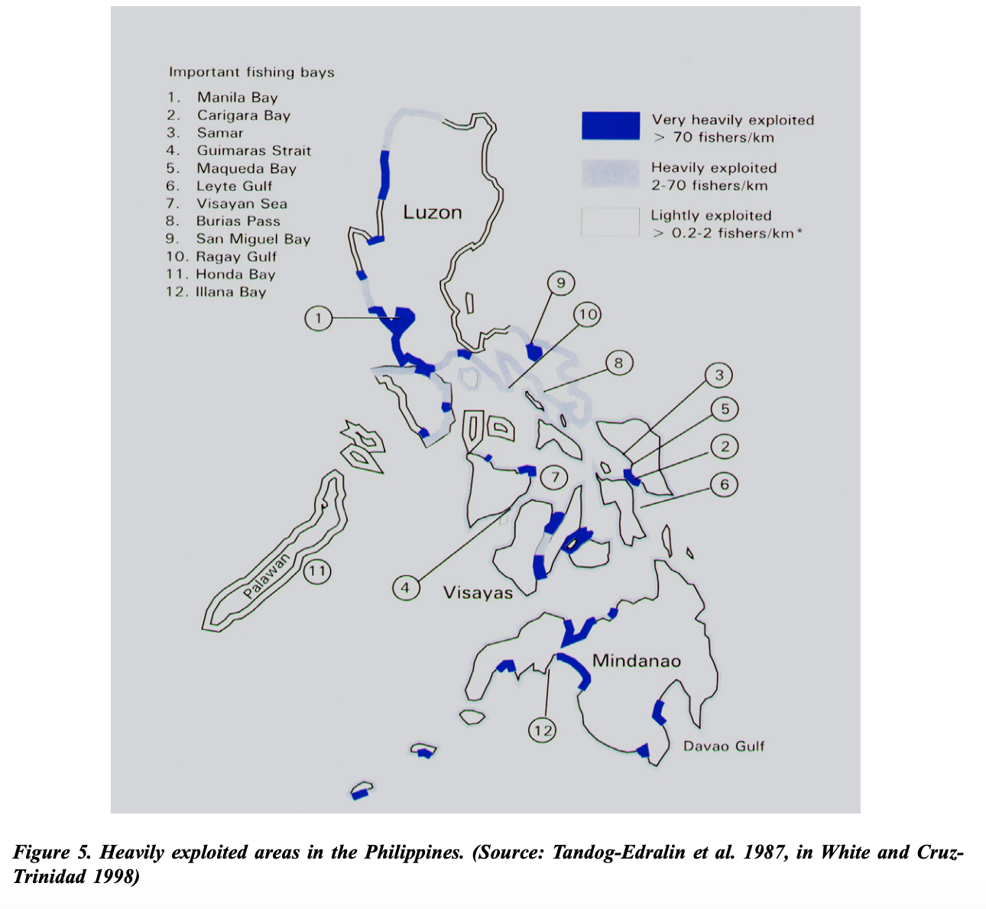

Slide 8
HVT List
C2 Systems
Jamming
Cyber Intrusions
Spoofing and Deception
Unmanned ISR platforms
LHA, other ARG Ships, DDGs
EABs
Key airfields
Key ports
Underway Replenishment ships
Fuel storage tanks (aviation and ship)
HPT List
C2 Systems
Unmanned ISR platforms
LHA, other ARG Ships, DDGs
EABs
Key ports
Key airfields

Slide 9
PLA Wargame Findings
U.S. Anti-Scouting operations against Soar Dragon high-altitude/long-duration ISR severed and impeded Chinese kill chain
U.S. Counterforce operations against radar sites disrupted accuracy and precision of PGMs
U.S. Counterforce decoys effective; PLA expended resources on what appeared to be an LPD on JPG2, while also illuminating position
PLA underestimated the effectiveness of U.S. airpower and LRASM to sea control
U.S. fighters superior to Chinese fighters when sequenced
Massing Tomahawk salvos effective against PLA defenses

Slide 10
Further Look:
-Naval Reserve: PGM
-Ground Based Sea-Control
-Seat of Purpose
-Decisive Blow on the Maritime Maginot
Scout
FP
C2

Slide 11
Phase 1: Essential Task: Disrupt scouting
Turn Concept ECOG/CV: Firepower FCOG/CV: LHA P/M/E: Find and Fix enemy fire support systems that enable sea control || Using EMCOM and decoy for make the enemy to cue its high value target acquisition systems || The scout and target acquisition asset degraded to enable systematic destruction of the firepower asset TST: submarines HVT: Tact aviation HPT: Radar, sonar, and Airborne ISR
Decisions: Attack ground units on Palawan to entice the enemy into reinforcing isolated forces. Risks/Opportunities: R1 – Husband assets for phase II and III. R2 – Enemy DF-21 decision point. O1 – Use neutral 3d party to evacuate Chinese tourists
OP Box | Forces | WEAPONS (tight, free) | EMCON (emit, no emit) | COORDINATING INSTRUCTIONS
Yellow | 1a. Decoy LHA |  | emit | SEE
Orange | 2a. 1x DDG | Free | Limited | Think the fire power provided by these assets represent a larger force. DO – Illuminate high value assets in response to perceived threat
 | 2b. 1x FFG | Free | Limited
Green | 3a. Ground forces on Palawan (MDTF, ODA, Phil MAR, EABs) | tight | No emit | Identify enemy ground fore locations on Palawan in order to hold them at risk and force Chinese to respond
 | 3b. 3x Coyote decoys | NA | Emit | SEE
 | 3c. 2x EAB | NA | Emit | SEE
Purple | 4a. 3x Global Hawks | Free | Limited | Counter-scouting
 | 4b. 1x P8 |  | Limited | Counter-scouting
Notes:
Command by Negation (JP 3-32, NWP-3-56)
OTC pre-planned responses delegated to subordinate commanders.
Subordinates takes action, keeping the OTC informed
Allows control of different capabilities on a single platform by multiple commanders
Only one commander may exercise TACON for the ship’s movements and maneuver.
The OTC and/or assigning commander retains the power to negate any particular action.

Slide 12
Phase 2 Mission: Gain sea control eastward from 100 km west of Palawan IOT secure SLOC IVO Sulu Sea
Turn Concept ECOG/CV: anti-ship missiles/C2 FCOG/CV: P/M/E: P. Secure SLOC IVO Sulu Sea. M. Unmanned patrol boat and decoy LPD transit south of Palawan to west of Palawan. ESG establishes sea control north of Palawan and north Sulu Sea. LCG establishes sea control in south Sulu Sea. ACE atks SCS airfields and interdicts maritime targets. E-2D provides early warning from rear. E. Sea control established eastward from 100 km west of Palawan. TST: submarines HVT: Type 71s, FW A/C HPT: ships that carry anti-ship missiles
Decisions: Phase II – Tipping point achieved. The effects of joint force strikes overmatch anticipated countermeasures and husbanded r Risks/Opportunities:
OP Box | Forces | WEAPONS (tight, free) | EMCON (emit, no emit) | COORDINATING INSTRUCTIONS
Yellow | 1a ESG |  |  | Establish sea control
Orange | 2a 1 x unmanned patrol boat w/ swarming munitions | Free | emit | Transit from orange to green west of Palawan
 | 2b decoy LPD |  | emit | Patrol IVO strait south of Palawan
 | 2c LCG | Free | No emit | Establish sea control
Green | 3a 1 x unmanned patrol boat w/ swarming munitions | free | emit | Launch swarming munitions to disrupt PLAN/PLAAF targeting C2
 | 3b ACE | Free | No emit | Interdict maritime targets; attack SCS airfields
 | 3c SSN | Free | No emit | Interdict maritime targets
 | 3d Ground forces on Palawan (MDTF, ODA, Phil MAR, EABs) | Free | No emit | Interdict air and maritime resupply targets
Purple | E-2D |  | Emit | Provide early warning
Notes:
Command by Negation (JP 3-32, NWP-3-56)
OTC pre-planned responses delegated to subordinate commanders.
Subordinates takes action, keeping the OTC informed
Allows control of different capabilities on a single platform by multiple commanders
Only one commander may exercise TACON for the ship’s movements and maneuver.
The OTC and/or assigning commander retains the power to negate any particular action.

Slide 13
 | PLAN | PLAAF | PL Army | PLAARF | SSF
Task | -SAG: Guard Chinese interests IVO Woody, Subi, Mischief, Fiery Cross, and Palawan. Posture OPBOX on the W. side of Palawan at the N. and S. ends of the Island. Prosecute HVT/HPT. -Missile Boats: Guard and attack all landing craft, and prosecute HVT/HPT. -Submarines: 2 x Subs Screen and Cover E. side of Palawan S. to Sulu Sea; 2 x Subs screen on NW side of Palawan. Prosecute HVT/HPT. -MM: Guard and Disrupt US forces/operations IVO Sula Sea. -Supply Ship supports PLA/SOF on Palwan, and conduct anti-Ship denial. -4 x PLAN ships operate along NW coast of Palawan conduct sea and air denial missions (anti-air and anti-ship). | -Bombers: Offensive Strike DDG, ARG shipping, Log nodes, and Ports/Airfields; Air Interdiction operations from HPT. -Fighters: CAP, Air Interdiction, and recce operations. -ISR: Recon and surveil IOT confirm/deny PIRs and isolate US forces by observation. | -SOF: Conduct FID and unconventional warfare IVO Palawan -Security Forces: Defend Island bases. Guard Chinese Interests. | -DF-21 and DF-26: Defend against US attacks; secure Air Port; Guard Chinese interests IVO Woody, Subi, Mischief, Fiery Cross, and Palawan. -Destroy, and Neutralize HVT/HPTs. | -Conduct propaganda, cyber, influence operations, and EMSO.
Purpose | Deny key terrain IVO Palawan, attrite US forces, and disrupt US operations and ability to seize Palawan. | -Maintain local air superiority, C2, and disrupt EABs. -Defend, Destroy, and Neutralize HVU (LHA/LHD), ARG shipping, and DDGs. airfields and US Navy and Aviation assets. Collect on US forces. | Defend against US attacks; secure island bases. Neutralize HVTs/HPTs. | -Defend, Destroy, and Neutralize HVT/HPTs. | -Degrade US influence in region; delay US decision-making and disrupt US C2.
Method | Guard, cover, and attack US targets. | Offensive Strike, CAP, and Air Interdiction. Intel collection. | Recon, FID, and sabotage ops. | Prosecute targets with BM strikes. | Propaganda, jamming, deception.
End State | Restrict US ability to maneuver and project power. Escalation dominance. | Escalation dominance against US forces. | Escalation dominance; US unable to seize Palawan. | Escalation dominance against US forces. | Degrade US influence and C2.

