Slide 1
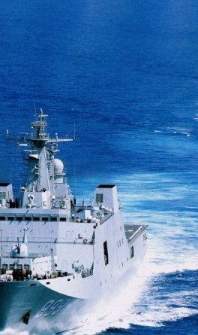
January 2028
During a diplomatic standoff over maritime boundaries, Chinese fishing vessels and maritime militia crowd the area. In response, a Filipino P-1 maritime patrol aircraft donated by the Japanese Maritime Self Defense Forces (JMSDF), attacks two maritime militia vessels. The Philippines claim they were acting in self-defense. Chinese news reports the attack was unprovoked, leading to a social media protests and spiraling unrest. A wave of cyber-attacks hits the Philippines. In addition, mobs attack the Filipino embassy in China and rival mobs attacked ethnic Chinese citizens in Manilla. Chinese media outlets blame the Philippines and countries supporting Manilla’s armed forces including the United States, Japan, and Taiwan.
China deploys two surface action groups (SAG) into the South China Sea (SCS) and begins conducting anti-surface/anti-air drills at facilities in Subi, Mischief and Cross Reefs and establishes a large air defense identification zone. Using YJ-9 anti-ship missiles fired from the militarized reefs, Chinese forces sink Filipino Navy PS-15 and 16 (both modernized Hamilton class cutters from the USCG) and three multi-purpose attack craft (all built in Taiwan) while enforcing the ADIZ with combat air patrols. On the diplomatic and economic front, China is using debt obligations across the region linked to the Belt Road Initiative (BRI) to keep Southeast Asian countries on the sidelines.
Notes:
Students can read “The Crisis” in The Marine Corps Gazette February 2020.

Slide 2
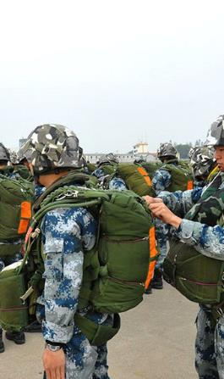
February 2028
In response, the INDOPACOM stands up JTF 77, consisting of a Littoral Combat Group (LCG) already forward deployed in Palawan, an ESG, a PACAF ACE and Army Multi-Domain Task Force (MDTF). There are additional TSOC elements in Palawan. No additional forces are available given additional Chinese task forces operating near Taiwan and Japan and the threat of a larger “Pacific war.”
In the early hours of February 28, 2025 power goes out at the main international airport in Palawan and a series of cyber attacks disrupt local communications. There are initial reports that a PLA Airborne TF seized the airfield. The ODAs report interdicting Chinese SOF forces surveying sites along Nagtabon Beach Filipino. Social media reports Chinese military vehicles vicinity Urugan Bay. China has not declared war and reports "sympathetic elements" may be conducting a NEO to save Chinese tourists.
There is no change to Chinese nuclear posture and their road mobile missiles and subs remain at a low alert level. Intelligence reports indicate this posture is signaling a desire to avoid nuclear escalation. Chinese forces have not attacked space-based assets and there is no change in the posture of facilities associated with counter-space activity. At the same time, there are indications and warnings of strategic mobilization activities indicative of a possible large-scale attack against Taiwan.
Global stock markets plunge and the price of gold skyrockets.

Slide 3
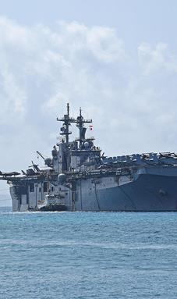
Crisis Management
During an NSC meeting, POTUS stresses that he/she wants viable military options for countering Chinese aggression that demonstrate US capability and resolve, reassures treaty partners in the region and avoids nuclear escalation. Following the meeting SECDEF contacts INDOPACOM Commander. In consultation with the Joint Chiefs, they determine that countering the Chinese through conventional operations in and around Palawan is the only viable military option to manage escalation. They stress that the operation must involve limited military objectives that do not signal a threat against mainland China and avoids striking dual use nuclear facilities.
INDOPACOM Commander works with the J55 and adapts portions of a key contingency plan. The plan calls for using flexible response options – with an emphasis on diplomacy to build the counter-China coalition and economic pressure – while conducting a limited military operation to demonstrate capability and resolve and signal the risk of further conventional military escalation. With multiple carrier strike groups and larger portions of the USAF tied up with separate plans to defend Japan and Taiwan, the task falls on JTF 77. INDOPACOM orders JTF 77 to support Filipino forces clearing Palawan of Chinese military forces. The purpose is to ensure the Chinese forces don’t use Palawan as a lodgment to threaten the Sulu Sea and other islands in the Philippines, that the conflict is contained and China has crisis offramp options while US treaty commitments are upheld. INDOPACOM orders JTF 77 to:
Seize the Palawan International Airfield in order to establish a secure lodgment for follow-on forces
Establish sea control at least 100 km west of Palawan in order to secure SLOCs in the Sulu Sea

Slide 4
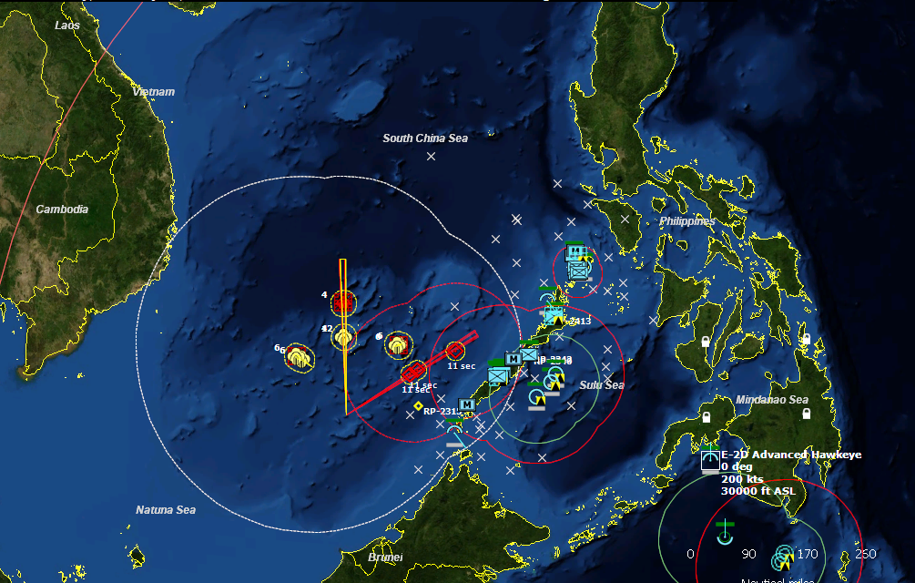
750 km (H-6M 1-2 hrs)
Flight Time to Guam 3 hrs
Active Airbases
4
3
PLAN SAG
2
1
Seized Airfield
1
2
LCG
4
Suspected
Sub Locations
SSN
ESG
Hawaii (ACE package) | Australia (Darwin Base) | Japan (Multiple Bases)
1 = ODAs; 2 = EAB (HMH, HIMARs, LAAD); 3 = EAB (VMU, MWSS, FILMAR); (MDTF); 4 = RQ-180s
Treatment B = Less strike and more enablers & bases (decoys included); Mosaic
Notes:
TREATMENT B = 12 ashore modified 3a25nov19test (1)
PACAF ACE
6 x F-22
6 x F-15C
6 x B-1
ADVANCED BASE ASSETS (think red horse)
2 x E3
8 x KC
4 x Global Hawk
2 x RQ-180
6 x C-17
MDTF (3)
Patriot Battery
IFPC (hellfire, SHORAD)
Stryker Company (-)
IFPC section (hellfire, SHORAD, 50K)
EW Assets
MLRS PLT
2 x LRPF PLT (so post INF long-range)
LCU (ship-to-shore; connector – Runnymede – or - JHSV)
JFMCC
ESG (LHA, LST, CG, DDG, LCS)
LCG (LPD, LCS, DDG, 2 x unmanned RHIB with swarming munitions - coyote)
LPD air det = 2 x MV-22
HMH (4 x CH-53K)
VMU (4 x MQ-9, 4 x RQ-180)
2 x HIMARs PLTs (but with coyote/rogue and NSM as well)
4 x MWSS (think teams constructing and moving EABs)
1 x Recon Team
1 Infantry Company (LPD)
2 HIMARs PLT (LPD)
FARP TEAMS
2 x Unmanned RHIBs (coyote/rogue)
Deception Package (2 x fake EAB, 2 x fake LPD signatures)
UGF at EAB (can hold some aircraft, ammunition, fuel, troops)
2 x F-35B at one (with 1 platoon infantry)
4 x CH-53K at another (with 1 platoon infantry)
EMSO capabilities at EAB (so EA, jamming as well)
AD at EABs (SLAMRAMs, Iron Dome, 50k laser)
1 x attack sub
4 x P8
2 x E-2D
TSOC
2 x ODAs (partnered with HN SOF PLTs)
1 x MSOR
FILMAR
2 companies
1 x artillery battery

Slide 5
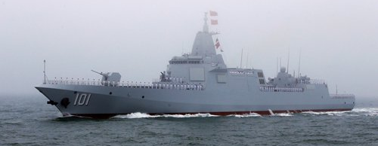
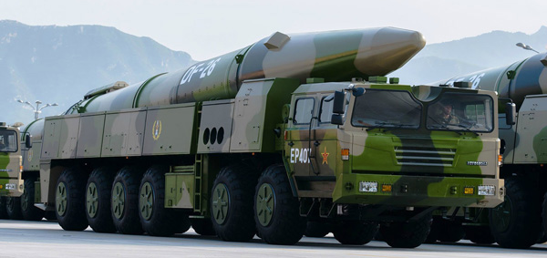
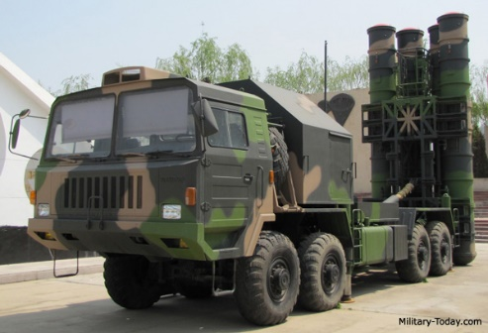
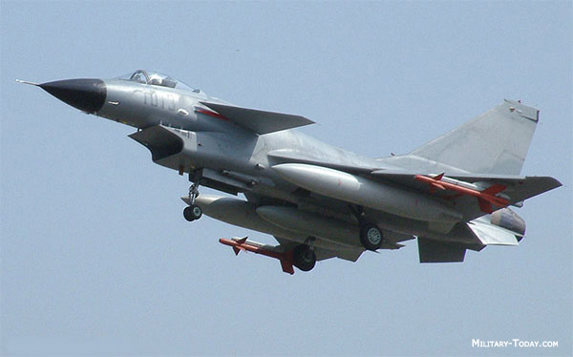
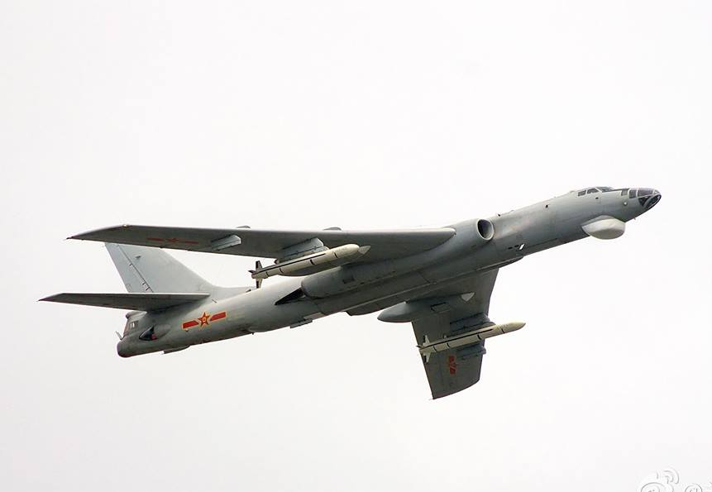
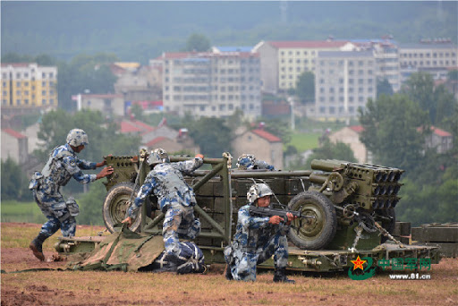
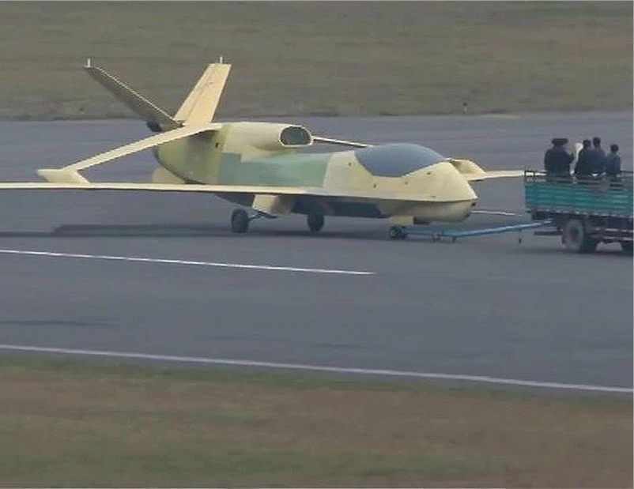
PLA Assessment
PLAN (SCS)
2-4 Frigates (Type 54)
2-4 Destroyers (Type 52, 54)
1 CG (Type 55)
6+ fast attack (Type 21)
5+ SAM BN (HQ-9) – SCS islands
2+ SSM BN (YJ-62) - SCS islands
3+ Radar sites (air, surface) – SCS islands
4+ attack subs (Kilo, Yuan)
1-2 supply (Type 93)
PLAAF (SCS, Woody Island airbases)
20+ TACAIR (J-10, J-11, JH-7)
10+ H-6M
OTH Radar (Woody)
2+ Soar Dragon
PLA (Palawan)
Airborne Company Team (1 x Armor PLT ZTQ, 2 x INF PLTs, 1 x artillery platoon, AAA section)
Rocket Forces (Mainland)
4 DF-26 BNs
SSF
Use of OECM from SCS Islands
Limited use of cyber to support targeting
Type 55
DF-26
HQ-9
J-10
H-6M
PLA ABN
Soar Dragon
MLECOA: (PH 1) SAG will conduct sea control vic SCS IOT to secure the area and support an amphibious assault on Palawan. After PLA forces deploy 2x Marine Battalions to reinforce PLA airborne units holding Palawan airport, (PH2) the SAG and supporting PLAAF forces will transition to conduct sea control in the Sulu Sea IOT deny CJTF forces access to Palawan. Denying US forces access is the main effort. PLA/CCP leaders view limiting US forces as the best path to producing a fait accompli.

Slide 6
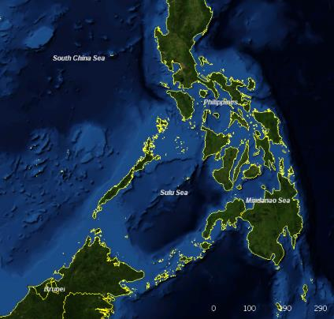
Phase 1 Mission:
Turn Concept ECOG/CV: FCOG/CV: P/M/E: HVT: HPT:
Decisions: Risks/Opportunities:
OP Box | Forces | WEAPONS (tight, free) | EMCON (emit, no emit) | COORDINATING INSTRUCTIONS
1.Surface | 1a
 | 1b
2. Subsurface | 2a
 | 2b
3. Strike | 3a
 | 3b
4. Air | 4a
 | 4b
5. Info | 5a
 | 5b
Notes:
Command by Negation (JP 3-32, NWP-3-56)
OTC pre-planned responses delegated to subordinate commanders.
Subordinates takes action, keeping the OTC informed
Allows control of different capabilities on a single platform by multiple commanders
Only one commander may exercise TACON for the ship’s movements and maneuver.
The OTC and/or assigning commander retains the power to negate any particular action.

Slide 7
Phase 2 Mission:
Turn Concept ECOG/CV: FCOG/CV: P/M/E: HVT: HPT:
Decisions: Risks/Opportunities:
OP Box | Forces | WEAPONS (tight, free) | EMCON (emit, no emit) | COORDINATING INSTRUCTIONS
1.Surface | 1a
 | 1b
2. Subsurface | 2a
 | 2b
3. Strike | 3a
 | 3b
4. Air | 4a
 | 4b
5. Info | 5a
 | 5b
Notes:
Command by Negation (JP 3-32, NWP-3-56)
OTC pre-planned responses delegated to subordinate commanders.
Subordinates takes action, keeping the OTC informed
Allows control of different capabilities on a single platform by multiple commanders
Only one commander may exercise TACON for the ship’s movements and maneuver.
The OTC and/or assigning commander retains the power to negate any particular action.

Slide 8
Examples

Slide 9
Phase 1 Mission: write the phase 1 mission statement
Turn Concept ECOG/CV: identify the enemy COG and CV (what you can target) FCOG/CV: identify your COG and CV (what you should protect) Example = ECOG = long-range fires (ASBM, LACM) CV = ability to target (so attack ISR platforms). P/M/E: State the purpose, method, and end state. For example P: set the conditions for an amphibious assault on the airfield. M: establish air superiority and clear sub threat while destroying PLA ISR capabilities. E: At the conclusion of phase 1 CJTC is postured to seize the airfield and no PLAN forces are within 50 KM of the Sulu Sea. Deny PLA use of surface-to-surface and air-to-surface capabilities vic SCS. HVT: state the HVTs (for example Type 71s, HALE ISR, ASBM\ALCM) HPT: state the HPTs (for example Type 71s, HALE ISR)
Decisions: state key decisions (for example, when to transition) Risks/Opportunities: state major risks (mission, force) and opportunities Use the note for additional text
3a, 3B
4a
1b
2
1b
1a
5b
4b
OP Box | Forces | WEAPONS (tight, free) | EMCON (emit, no emit) | COORDINATING INSTRUCTIONS
1.Surface | 1a. ESG, LCG | free | no emit | Consolidate surface combatants until est. localized air superiority and neutralize enemy sub threat; 1 x DDG emit; HIMARS attack HPT
 | 1b. HIMARS. MDTF, RQ-180 | free | no emit
2. Subsurface | 2a. MH-60R, P-8s | free | emit | Establish air superiority before conducting ASW.
 | 2b.SSN | free | emit | Conduct ASW patrol until air superiority established
3. Strike | 3a. DDG (TLAM) | tight | no emit | Attack radar/SAM installations vic SCS
 | 3b. B-1, 6 x F-22 (escort) | free | no emit | SPT base attack vic SCS, BPT to attack PLAN.
4. Air | 4a. TACAIR | free | emit | Establish air local superiority
 | 4b. Refuelers, E-3 | free | emit | Establish C2 and refueling
5. Info | 5a. Decoys | free | emit | Deceive PLA sensors/shooters
 | 5b. OECOM | free | emit | OECM at EABs disrupt PLA sensors/C2
Notes:
Same OP boxes assign forces

Slide 10
Phase 2 Mission:
Turn Concept ECOG/CV: FCOG/CV: P/M/E: HVT: HPT:
Decisions: Risks/Opportunities:
4
1a, 5b
4b
2
1b
5
OP Box | Forces | WEAPONS (tight, free) | EMCON (emit, no emit) | COORDINATING INSTRUCTIONS
1.Surface | 1a. B-1, 4 x F-35 | free | no emit | B-1 support sea control; F-35 escort and ISR
 | 1b. ESG, LCG, SSN | free | No emit | Amphibious assault seized the airfield (3); B-1s support sea control
2. Subsurface | 2a. MH-60, P-8 | free | Emit | Conduct ASW
3. Strike | 3a. MDTF | tight | No emit | Support Amph Assault
4. Air | 4a. TACAIR | free | emit | Establish air superiority
 | 4b. Refuelers, E-3 | free | Emit | Establish C2 and refueling
5. Info | 5a. Decoys | Free | Emit | Deceive PLA sensors/shooters
 | 5b. OECM |  |  | Disrupt C2 and sensors for PLA

