Slide 1
Marine Corps Association Foundation
Board of Directors Meeting
Feb 2025

Slide 2
2024 Program Delivery
Over 54,000 Marines supported
Excellence Awards:3,525 presented across the Corps
The majority to Enlisted Marines (~94%)
Commanders’ Forums: 125
Battlefield tours, staff rides, seminars, etc.
~9,000 Marine leaders
Wargaming (but less requests)
~1,250 Marines
Writing Awards: 33
Unit Libraries: 127
~39,000 Marines
Decision Forcing Cases: 25
~600 Marines
Total Force Premium Memberships
4,024 (~10,000 Associate)
~$185,000

Slide 3
2025 Fundraising Events
Easy ways for Board members to introduce donors to MCAF
Giving Day, Tuesday, June 10th
Virtual Challenges throughout the year
Golf For the Marines Tournament, Monday, July 21st
End of year direct mail matching gift campaign (Nov/Dec)
Estate planning

Slide 4
Giving Day 2024 Results
Total Raised $57,177
Total Number of Gifts 261 Total Number of Unique Donors 253
# of Current Donors 131 # of Lapsed Donors (prior to 2023) 37
# of New Donors 85 # of New Recurring Donors 3
# of Board Members 14 # of MCA Staff 4
Total Raised from MCA/MCAF Board Members $19,450*
(* includes a Board member gift of $10,000)
Giving Day is a great opportunity to connect prospective donors. The website provides examples of MCA programs and the impact they have on Marines

Slide 5
Honoring 250 Years of the Marine Corps Virtual Run Series
Assault on Nassau Run 5K
Completed
Fort Fisher Victory Run 10K
5 April
Guadalcanal Offensive Run 10K
21 June
Battle of Huế Run 6.8 miles
23 August
Fallujah Freedom Run 5K
11 October

Slide 6
Additional Virtual Runs in 2025
From March 6 to November 10, 2025, participants will have 250 days to complete 250 miles in this virtual challenge.
Every registrant will receive an exclusive 250 Miles for 250 Years Challenge Coin, featuring MCA's commemorative 250th logo
On July 22, 2025, honor the memory of LtCol Mario “Sugar Bear” Carazo who made the ultimate sacrifice on July 22, 2010 when his AH-1W Cobra was shot down while supporting Marines engaged in a firefight.
Proceeds are split between MCAF and the Sugar Bear Foundation. Participants will receive an exclusive race pin with this year’s image.

Slide 7
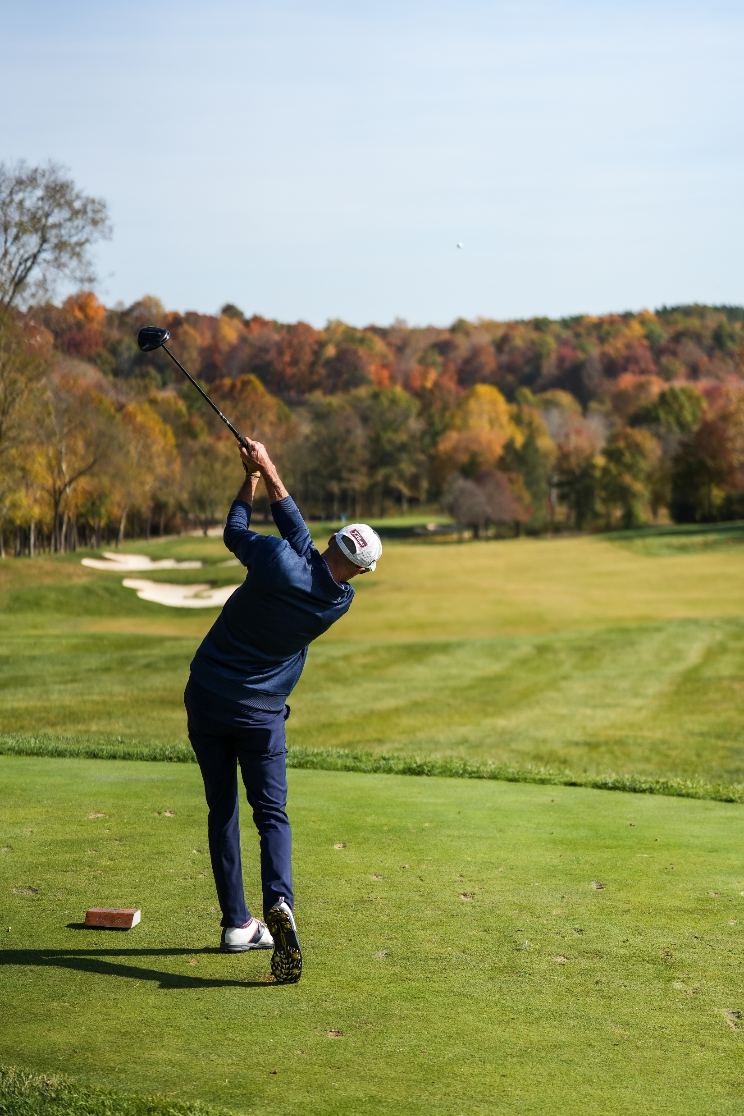
Golf For The Marines
Creighton Farms plans to prioritize the availability of the Club to their members, they are limiting dates and increasing their prices for outside groups.
As a result, 2025 will be our last year hosting a tournament at Creighton Farms. To accommodate the rising costs, our tournament will be held Monday, July 21st.
This is your last chance to play a round of golf at this exclusive Jack Nicklaus designed course while supporting MCA and Marines.
Tim Mundy

