Slide 1
Marine Corps Association Foundation
Board of Directors Meeting
Feb 2023
Notes:
Established by LtCol John A. Lejeune in 1913
It says a lot about the Business that we have been in service for 60 years in 2022

Slide 2
2022 Program Delivery
Over $1,190,000 spent on Marines
~7,000 Marines visited battlefields around the globe
121 Unit Libraries enhanced with books from the Commandant’s Professional Reading List
~4,000 awards for outstanding Marines
44 Marines won Writing Awards
~2,700 Marines received Wargaming support
Nearly 49,000 Marines impacted by MCA programs!
Notes:
Established by LtCol John A. Lejeune in 1913
It says a lot about the Business that we have been in service for 60 years in 2022

Slide 3
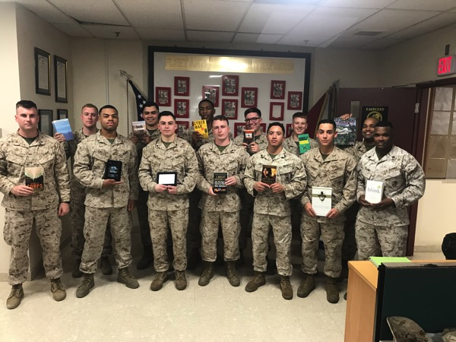
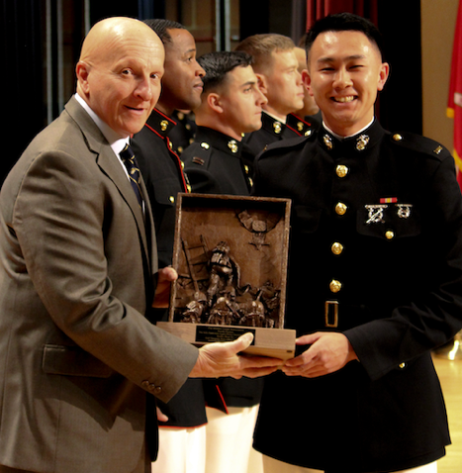
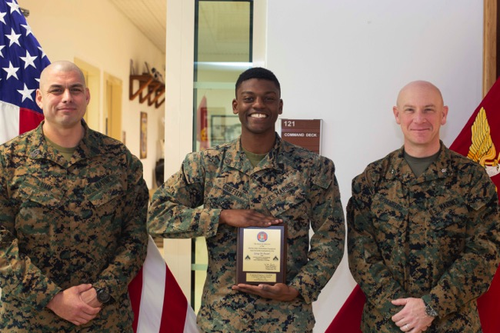
Program Delivery
Unit Library Program
Enhanced 121 unit libraries in 2022
Nearly 35,000 Marines
Kindles no longer available
Excellence Awards Program
Nearly 4,000 awards in 2022, mostly to enlisted Marines

Slide 4
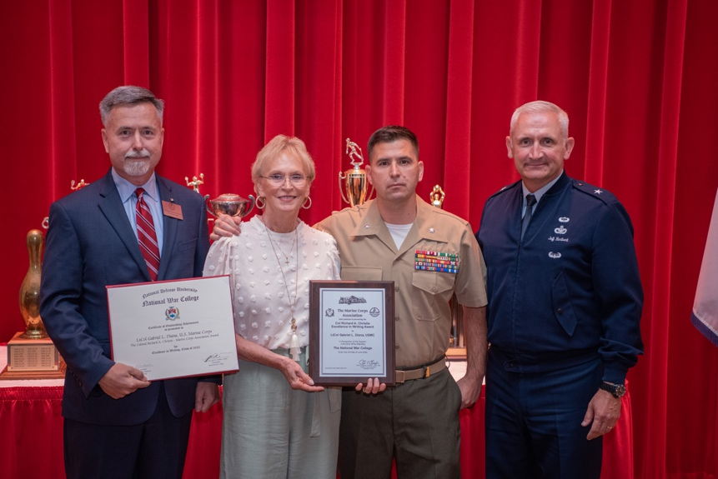
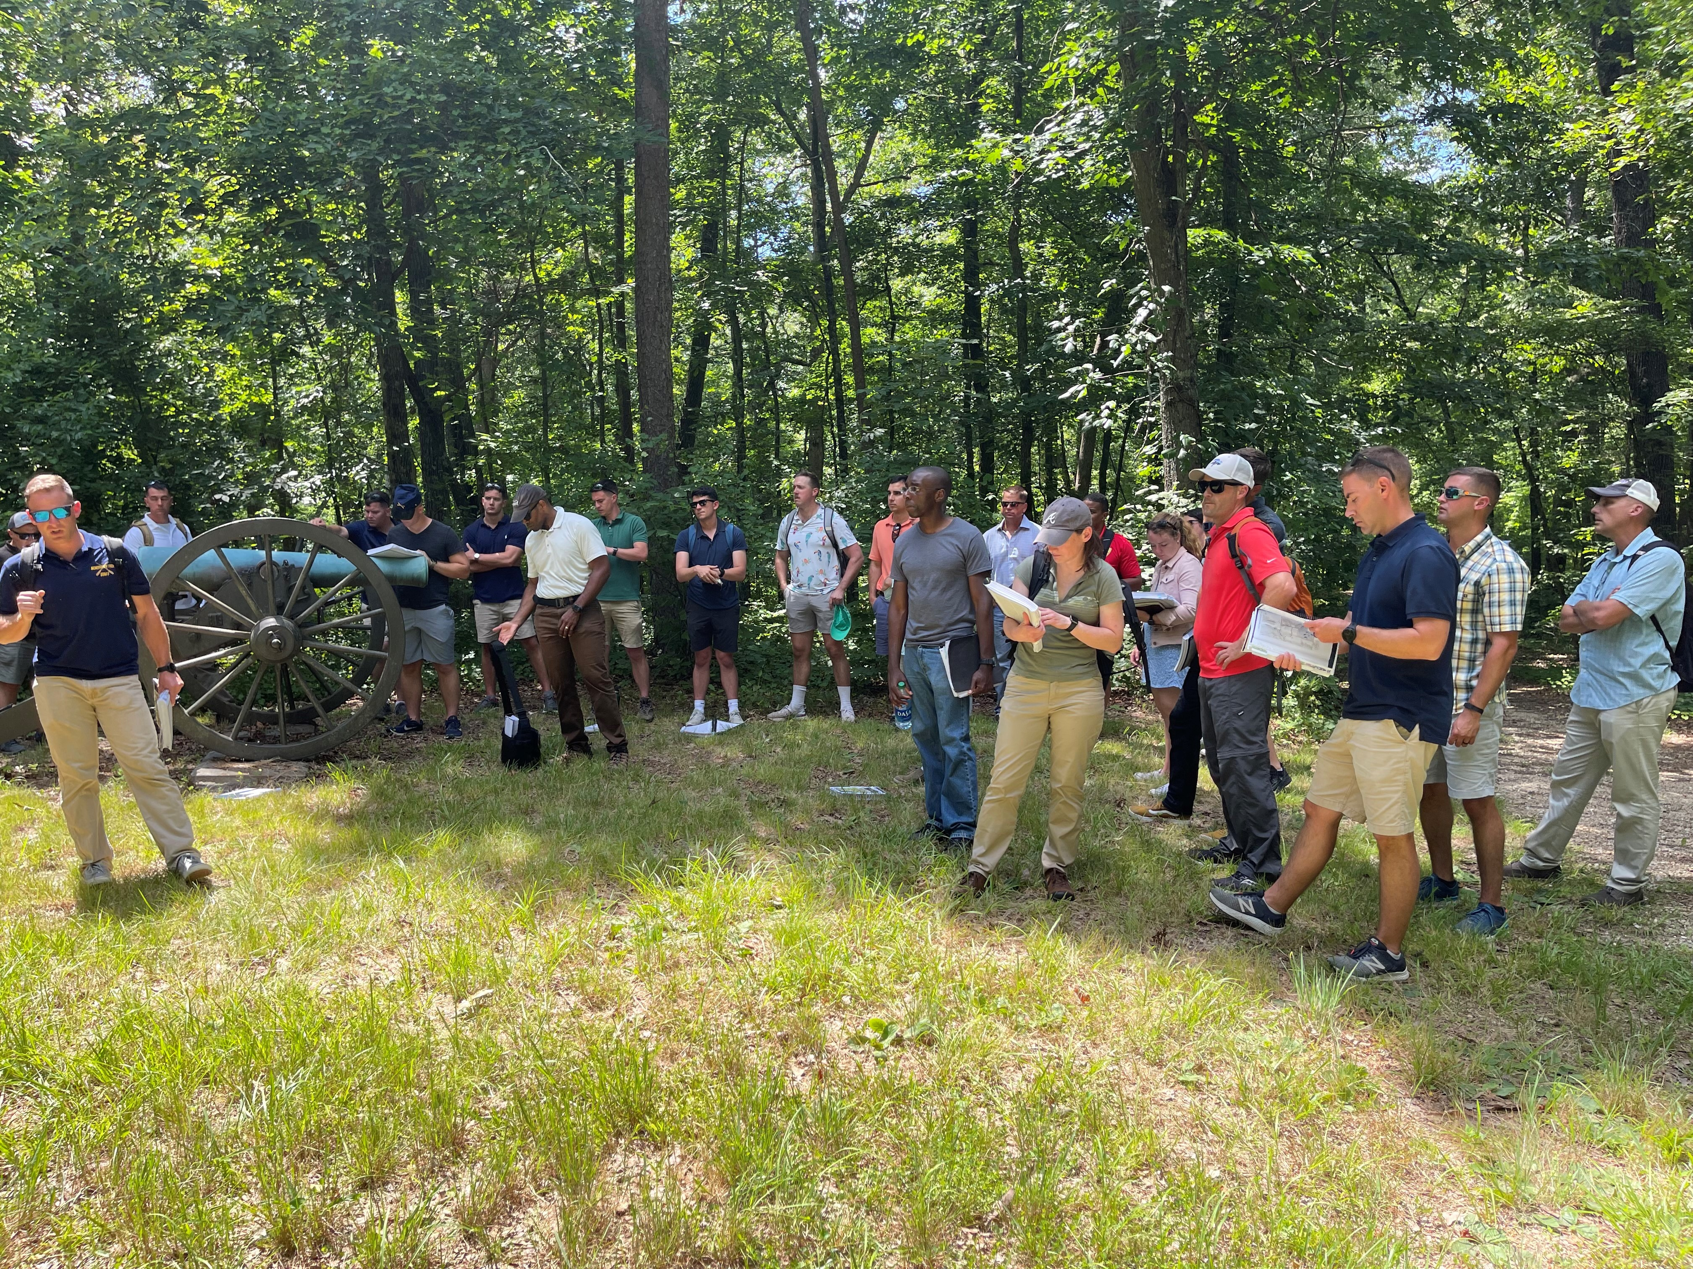
Program Delivery
Marine Writing Program
In 2022, 44 awards presented
Plaques, books, and cash awards
Commanders’ Forums Program
Staff Rides, PMEs, Guest Speakers
In 2022, 94 forums supported
Professional development of nearly 7,000 Marine leaders from NCOs to officers

Slide 5
2023 Fundraising Events
New interactive platform
Starting in February
Boot Camp
Guadalcanal
Tarawa
Peleliu
Okinawa
3rd Annual Giving Day will be held on 9 May
Will be looking for challenge and/or matching gift opportunities to inspire giving to MCAF
6th Golf For The Marines tournament will be held on 23 Oct at Creighton Farms
5 sponsors are on board to date including CACI as our platinum sponsor ($5K) for a second year in a row
Reevaluating the silent auction
$35K net goal
Donor identification, cultivation and solicitation opportunities
Board involvement
Dallas, Houston, etc
Individual visits
?? Net goal
Two additional virtual events
22 Jul – Sugar Bear Memorial Run
10 Nov – USMC Birthday 10K
$50K net goal
$30K net goal

Slide 6
Donor Pyramid (radio tower)
Notes:
Established by LtCol John A. Lejeune in 1913
It says a lot about the Business that we have been in service for 60 years in 2022

