Slide 1
Marine Corps Association Foundation
2021 Review and
2022 Way Ahead

Slide 2
Over $950,000 spent on Marines in 2021
Approximately $150,000 more than 2020
~9,000 (~4,000 in 2020) Marine leaders visit battlefields around the globe
Continuing Covid impacts; some events cancelled
2021 numbers were back to historical average
~128 (~186 in 2020) Unit Libraries enhanced with books from the Commandant’s Professional Reading Program
>4,500 (~same as 2020) awards for outstanding Marines
~42 (~half as many as 2020) Marines won Writing Awards
Unit and other writing programs fluctuate year to year
Notes:
LtGen Flynn: 1st LAR Bobby Christopher. Book in the pocket for Marines during lulls in training.

Slide 3
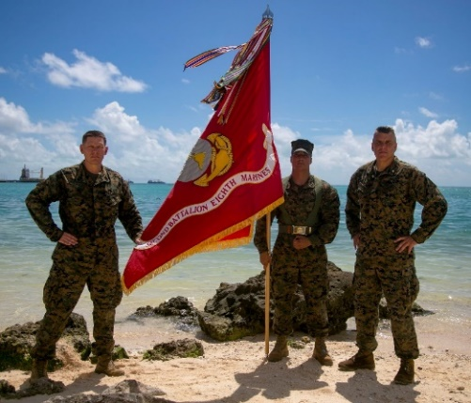
Marine Corps Association Foundation
Programs and Support
Unit Libraries
Commanders’ Forums
(battlefield studies)
Marine Excellence Awards
Writing Awards
Professional Development Membership Awards
Wargaming support
MCRD 4th Phase support
Planning resources
Unit Subscription Program in 2022
2021 — over $950,000 spent in Support of ~55,000 Marines!
45

Slide 4
2022 Fundraising Opportunities
Virtual Challenge Series throughout the year
2nd Annual MCAF “Giving Day” Tuesday, April 19th
Virtual auction for Nicole Horn Paintings in May
Unit Subscription Program fundraising day in September
Golf Tournament
Monday, October 24th
Silent auction opportunities
Matching gift campaign (end of year)

Slide 5
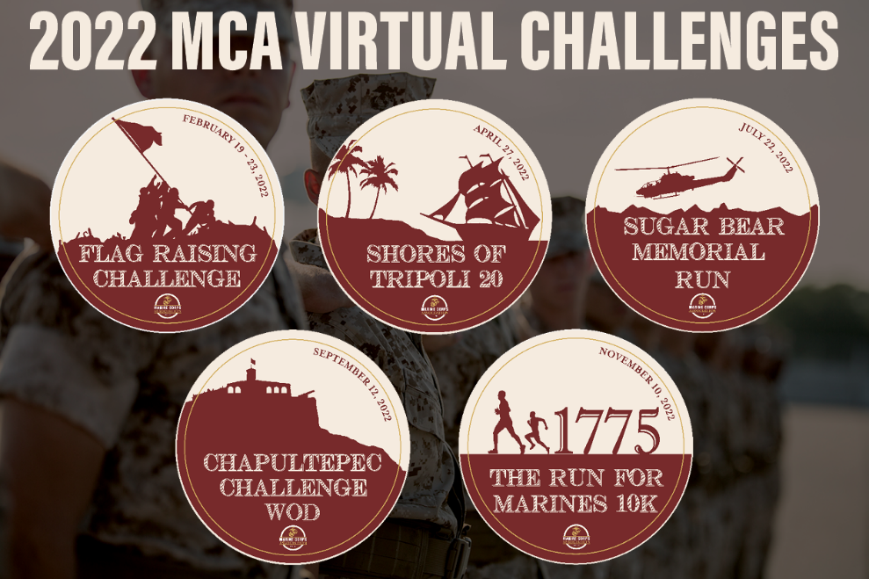
Virtual Challenge Series
Typically nets ~$20,000
Five events
Flag Raising Challenge
Shores of Tripoli 20
Sugar Bear Run
Chapultepec Challenge WOD
Nov 10th 10K
Opportunity to reach an audience beyond magazines, members, donors
Sugar Bear Foundation supports Gold Star families and Surviving Spouses and families
Marine Corps Marathon
Not a virtual event (though it could be by Oct 2022)

Slide 6
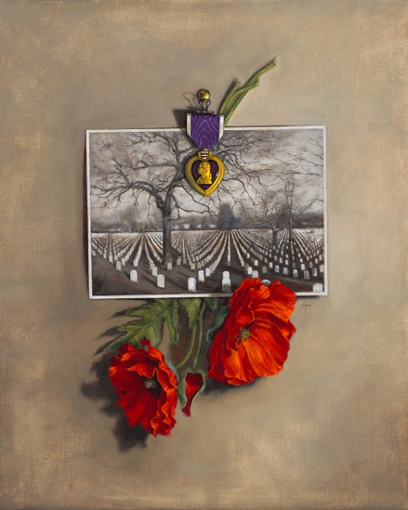
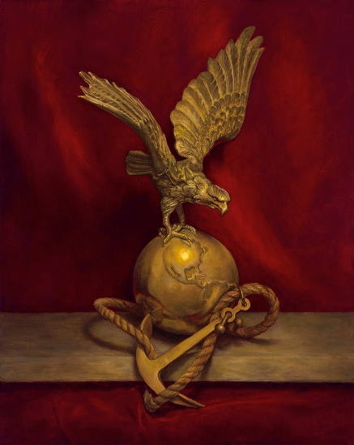
Giving Days and Virtual Auctions
2nd Annual Giving Day Tuesday, April 19th
$49,825 raised in 2021
Great opportunity to connect friends, etc.
Virtual auction for two paintings in May
Potentially displayed at MDM
Unit Subscription Program
5 copies of Gazette & Leatherneck delivered monthly to battalions/squadrons and up
Focused on TECOM and the MEFs
~$53,000 in annual program delivery
Giving day type fundraiser in September
5th Annual Golf for the Marines Tournament at Creighton Farms, October 24th

