Slide 1
Marine Corps Association Foundation
2022 Mid-year Update

Slide 2
Program Delivery
~$619,000 spent on Marines as of June 30, 2022
Typically, $1,000,000 spent on Marines annually
$950,000 in 2021
~29,000 Marines served through our programs
Typically, 60,000 – 70,000 Marines served annually
~55,000 in 2021
Notes:
LtGen Flynn: 1st LAR Bobby Christopher. Book in the pocket for Marines during lulls in training.

Slide 3
2022 Fundraising Opportunities
Unit Subscription Program
5 copies of Gazette & Leatherneck delivered monthly to battalions/squadrons and up
~$53,000 in annual program delivery
Fundraising day in September similar to Giving Day in April
5th Annual Golf for the Marines Tournament at Creighton Farms, October 24th
Silent auction opportunities
Matching gift campaign (end of year)
$50,000 match vs $25,000 in previous years

Slide 4
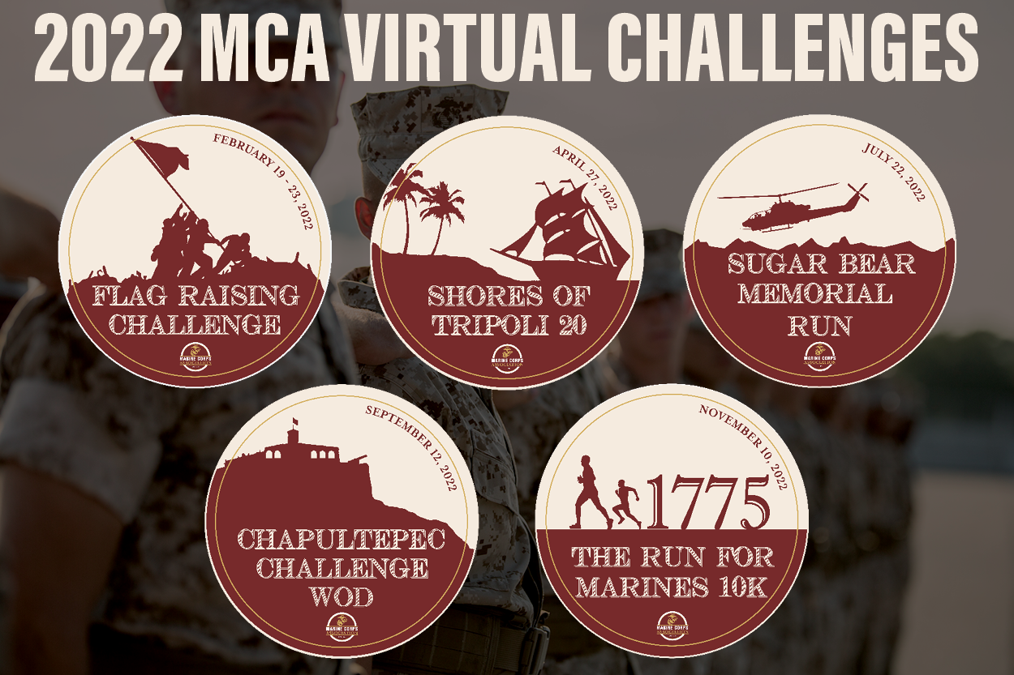
Virtual Challenge Series
Three completed
Flag Raising Challenge
Shores of Tripoli 20
Sugar Bear Run
327 participants @ $26
Cost (Pins, envelopes, postage): $1,827.00
Net revenue: $6,675.00
Two remaining
Chapultepec Challenge WOD
Nov 10th 10K

