Slide 1
MCA&F Finance Committee Summer Board Meeting Prep Aug 2022
8/7/2022
1

Slide 2
Finance Committee Agenda
Formal task review
Annual cadence review
Actions since last meeting
Meeting goals
Updates: FY22 Budget, Annual Audit
Discussion: Multi-year cash flow, IPS modification
Approval of information to present to board
Draft contained in this brief

Slide 3
Finance Committee Formal Tasks
Specified Tasks
Protect MCA&F assets by establishing appropriate financial policies
Ensure MCA&F compliance with legal and regulatory requirements
Provide an adequate system of financial controls
Implied Tasks
Support MCA&F strategic plan
Methodology
Review of financial status and approvals of financial plans
Performance to plan, financial statement audit and forecasts
Develop a standing annual cadence with a ‘forward looking’ approach

Slide 4
Finance Committee Annual Cadence and Policy Inventory
Winter Meeting
Prior FY Performance to Plan
Wealth management update (detailed)
Other business as needed
Spring
Financial Statement Audit kickoff
Wealth management update (informal)
Annual Policy and Charter review
Other business as needed
Summer Meeting
Current Year Budget to Actuals
Financial Statement audit review and approval
Wealth management update (detailed)
Other business as needed
Fall Meeting
Performance to Plan update
Wealth management update (informal)
Other business as needed
Policy Statement Inventory
Investment Policy Statement
Gift Acceptance and Stewardship Policy
Debt Policy
Finance Committee Charter

Slide 5
Finance Committee Actions Since Last Meeting
Audit results from CLA
28 Jun – Audit exit conference
02 Aug – Final audit report
Finance Committee pre-meeting
FY22 Budget performance review
2022 YTD investment performance update
Multi-year cash flow draft
IPS update discussion

Slide 6
Finance Committee Meeting Goals
Discuss multi-year cash flow analysis
Discuss Investment Policy Statement update goals
Discuss wealth manager performance
Approve information to present to board

Slide 7
MCA&F Finance Committee Brief to BOD/BOG Aug 2022
8/7/2022
7

Slide 8
Finance Committee Agenda
Investment Performance Update
Finance Committee discussion summary on
Multi-year cash flow
Investment Policy Statement update

Slide 9
Marine Corps Association & Marine Corps Association Foundation
Accounts Summary
As of 31 July 2022 | MCA | MCAF | Totals
Endowment | $10,071,325 | $559,140 | $10,630,465
Cash Reserve | $140 | $0 | $140
Totals | $10,071,465 | $559,140 | $10,630,605
Marine Corps Association Loan Management Account
Available Balance: $5,762,418.36
Outstanding Balance: $0
Effective Interest Rate 4.17%
For institutional use only. Distribution to any other audience is prohibited. | Global Institutional Consulting
Notes:
Read slide.

Slide 10
MCA Wealth Management Dashboard – 2022.07.31
Current Value
$10,071,465
Change YTD | -$1,244,101
Change since inception | $1,276,405
Performance YTD
-10.99%
MCA IPS Benchmark | -11.96%
Simple Benchmark | -11.59%
Net Deposits & Withdrawals YTD
$0
Total Deposits YTD | $0
Total Withdrawals YTD | $0
Asset Allocation
Returns YTD
-$1,244,101
Total Income | $85,781
Total Value Change | -$1,329,882
Wealth Management Fees YTD
$32,555.11
Basis of fee | .50% of value
Projected full year | $50,465.78
Notes:
Read slide.

Slide 11
MCAF Wealth Management Dashboard – 2022.07.31
Current Value
$559,140
Change YTD | -$70,105
Change since inception | $236,526
Performance YTD
-11.14%
MCAF IPS Benchmark | -11.96%
Simple Benchmark | -11.59%
Net Deposits & Withdrawals YTD
$0
Total Deposits YTD | $0
Total Withdrawals YTD | $0
Asset Allocation
Returns YTD
-$70,105
Total Income | $4,587
Total Value Change | -$74,691
Wealth Management Fees YTD
$1,684.41
Basis of fee | .50% of value
Projected full year | $2,789.40
Notes:
Read slide.

Slide 12
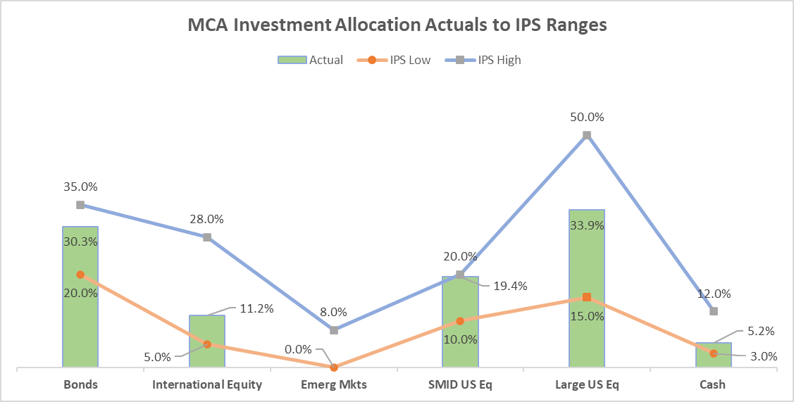
Finance Committee Allocation Ranges

Slide 13
Finance Committee Cash Flow
FC tasked MCA staff to develop an initial multi-year cash flow analysis to identify operating risks
Bottom Line: flat revenues combined with high inflation will result in sizeable negative cash flow by 2027
Current review included a high-level draft that needs further refinement
Goals for additional review
Generate more detailed assumptions for revenue and expenses
Create decision tool to allow for ‘gaming’ alternatives
Identify and manage risks (i.e. capital investment)

Slide 14
Finance Committee IPS Update
FC believes the current IPS needs to be reviewed and updated
Goals for review
Determine specific use for investment portfolio
Identify acceptable levels of portfolio complexity
Identify true costs of investment
Create an ‘actionable’ IPS that guides the wealth manager and offers specific support to MCA
Complete by Dec meeting

