Slide 1
MCA
Board Member Orientation
Feb 2025
1
1

Slide 2
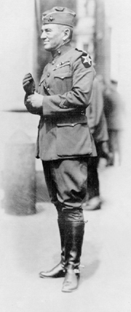
Marine Corps Association
Established in 1913 by (then) LtCol John A. Lejeune
Marine Corps Gazette published 1916
Leatherneck published 1917
1960s: Insurance (501c.19)
Until the 1970s, an office of HQMC
1975: NFE and merger with Leatherneck Association.
2004: Events + Awards
2007-9: The Marine Shop
2009: Serving Officers restricted from Governance
2009: Foundation (501c.3) “MCA&F”
2015-2017: MDM “intellectual component”
2020: “MCA” (again)
2
Notes:
More than 100 years old although there were efforts to get this going in 1911.
Professional Organization of the Marine Corps
Founded by Gen Lejeune – because there was an enduring need
Starts with a desire to make the Marine Corps more professional – “the aims, purposes and deeds of the Corps, and the interchange of ideas” - and keep an attachment to where we came from and what has gone on before.
Until the early 1970s, meetings were held in the Commandant’s office.
CMC was President of MCA
Membership strongly encouraged
Active Duty staff published Gazette
Merged with the Leatherneck Association
The significance of our connection to Gen Lejeune and “the inspiring words of our 13th Commandant … “

Slide 3
Marine Corps Association
History
The Marine Corps Association would “publish the history of the Marine Corps and disseminate information concerning the aims, purposes and deeds of the Corps, and the interchange of ideas for the betterment and improvement of its officers and men…”
John A. Lejeune
Guantanamo Bay, Cuba
25 April 1913
3
Notes:
More than 100 years old although there were efforts to get this going in 1911.
Professional Organization of the Marine Corps
Founded by Gen Lejeune – because there was an enduring need
Starts with a desire to make the Marine Corps more professional – “the aims, purposes and deeds of the Corps, and the interchange of ideas” - and keep an attachment to where we came from and what has gone on before.
Until the early 1970s, meetings were held in the Commandant’s office.
CMC was President of MCA
Membership strongly encouraged
Active Duty staff published Gazette
Merged with the Leatherneck Association
The significance of our connection to Gen Lejeune and “the inspiring words of our 13th Commandant … “

Slide 4
Vision
To be universally recognized as The Professional Organization for the United States Marine Corps.
4
Notes:
.The “acknowledged partner” phrase gets right to the point of the value of MCA&F. We work to support the vision of the Commandant in education, professional / leader development, rewarding superior performance and professionalism. For the vision to be realized we have to be partnering with the leadership to provide the assistance and programs desired.
We want to active leadership to take ownership … we need to be relevant IOT drive support … something of a circular argument
CMC / the Marine Corps WANTS / NEEDS a professional organization – and that organization must meet the needs of the Corps it serves. Have to respond to the “demand signal” For Marines to have a “demand signal” they need to be aware / familiar with what is possible. All requires communication

Slide 5
Mission Statement
To be the preeminent association for all Marines and Friends of the Corps dedicated to leader development, recognition of professional excellence and expanding awareness of the rich tradition, history and spirit of the United States Marines.
5
Notes:
This mission statement is valid and enduring. It reflects a recent minor edit to spotlight “leader development.”
There are several associations and foundation that support the Marine Corps today…MCUF, MCAA, MCSF, MCLEF, MCHF, SFF; scores of unit specific groups like 2d Mar Div Battalions, Squadrons, local groups like Semper Fi Society of Boston
No one has succeeded in tying those all together but our mission and focus could/should have a connection to nearly all. The connecting file is a work in progress and LtGen Faulkner has several efforts at being the adult in the room forging connections.
An initiative to connect with the Marine Corps League is a good example of working with an organization with a complementary mission set. And a potential revenue stream as we added the “intellectual component” of Modern Day Marine in 2017 and await confirmation on the next step in the partnership ..

Slide 6
Marine Corps Association
Two Non-Profit
Organizations
One Mission
Shared Vision
MCA - 501c19
Veterans Membership Association
Publications
Membership & Member Benefits - insurance, discounts
Retail Goods – uniforms, Marine themed clothing and items
MCAF - 501c3
Public Charity
Donated funds, sponsorships, grants to support MCA programs
6
Notes:
“Veterans” is an organizational tax status. Our members are also in large part active duty Marines. We serve those active Marines via programs while helping to keep veterans connected.
What is in each …
Talk to total MCA&F membership – back up to nearly XXXX K and also demographics – active, reserve, veteran, friend of the Corps.
The Association ( the “c 19”) is also a donor to the Foundation (the “c 3”) so you can say our members / sponsors / shoppers all support programs for Marines.

Slide 7
Marine Corps Association
Two Non-Profit
Organizations
One Mission
Shared Vision
 | Program | Member Benefit
Audience | Open to Marines, spouses, and the broader community | Exclusive to MCA members
Purpose | Supports education, professional development, and engagement | Adds value to MCA membership
Access | Often free or subsidized, some require registration | Requires paid membership
Examples | Spouse Summits, Professional Leadership Conferences, Writing Contests & Awards, Commanders’ Forums, Unit Libraries (CPRL), Battle Study Packages | Gazette & Leatherneck Magazine subscriptions, Event discounts, exclusive online content
7
Notes:
“Veterans” is an organizational tax status. Our members are also in large part active duty Marines. We serve those active Marines via programs while helping to keep veterans connected.
What is in each …
Talk to total MCA&F membership – back up to nearly XXXX K and also demographics – active, reserve, veteran, friend of the Corps.
The Association ( the “c 19”) is also a donor to the Foundation (the “c 3”) so you can say our members / sponsors / shoppers all support programs for Marines.

Slide 8
Organization
President & CEO
VP PRODEV
Publisher &
Editor-in-Chief
VP EVENTS CORPORATE SUPPORT & ADVERTISING
VP MEMBERSHIP MARKETING & SUPPORT
VP FOUNDATION
Director of Retail
Director of Finance & Business Ops
Director of Engagement & Outreach
Total Personnel: 82 (MCA 46 / Retail 36)

Slide 9
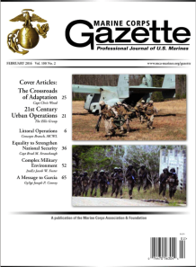
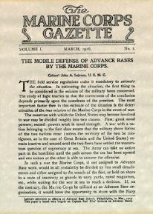
Marine Corps Gazette
Features and Initiatives:
Aid leadership in identifying challenges and opportunities.
Aligning monthly content with Deputy Commandants and MCA professional events.
Official content and constructive criticism
4 Annual Writing Contests + MCU awards
Sustaining the Distinguished Writers Certificate Program
Adding new recurring features/series and collections
Mission: “…the interchange of ideas for the betterment and improvement of its officers and men…”
- First Executive Committee, 1913
9
Notes:
No conformity of thought
Venue for independent thinking
Tool to enable professional growth

Slide 10
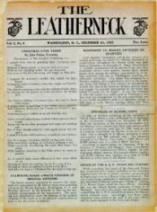
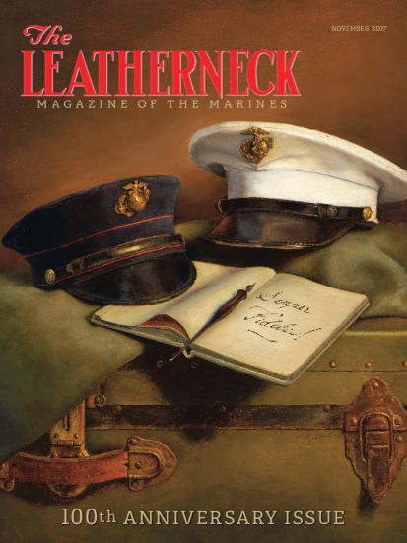
Published since 1917
Marine History, Firsthand Accounts, Lesser-known stories
Writers
Staff
Independent Authors
Marines
MCRC Contract for High Schools
No longer the “enlisted” or “veteran’s” magazine
Annual Writing Contest
Leatherneck needs Marines with recent experience to tell their stories. OEF/OIF, RESOLUTE SUPPORT, FREEDOM’S SENTINEL MEUs AND SPMAGTFs, Other Operations/Deployments
Notes:
Leatherneck: the human aspects of Marine Corps history and current ops

Slide 11
Publisher
Serves both magazines, responsible for coordination with our Printer/Distributor
currently Sheridan/CJK Group.
Continuing actions to avoid increased printing, paper and postage costs.
Average monthly print circulation and print invoicing (does not include labor and shared overhead)
Annual Readership:
Circulation/Readership are important to Advertisers, and as a reflection of Membership
2024 | Avg Monthly Copies | Avg Monthly Print Costs | Avg approx. cost per copy
GZ Print | 8,963 | $13,059.00 | $1.45
LN Print | 28,724 | $20,268.00 | $.70
2024 | Total Readership | Breakdown
GZ Print & Online | 16,488 | 51% AD; 43% Vet/Ret
LN Print & Online | 60,122 | 30% AD; 65% Vet/Ret
11

Slide 12
Advertising
2024 GAZ and LNK Net Advertising: $405,939 (Print and Web)
12

Slide 13
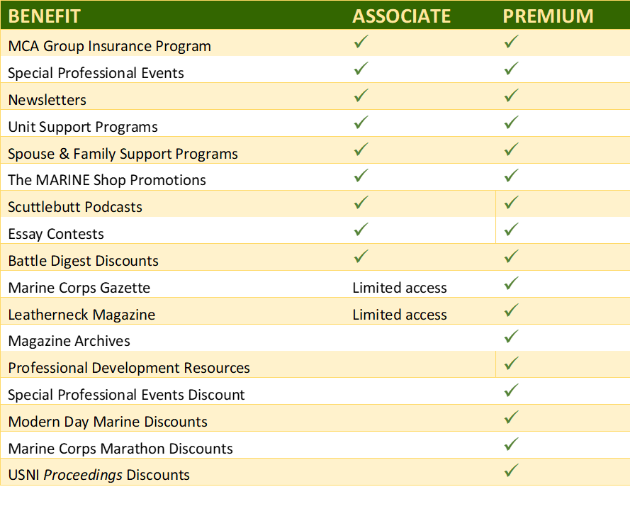
Membership
Premium (Paid) Full access to benefits, digital magazines (print-eligible), PME resources, discounts.
Associate (Free) Basic access, minimum benefits.
Total Force Program: No-cost Premium membership for Active-Duty, Reserve Marines and eligible spouses. Funded by MCAF*
MCA Memberships | as of Jan 2025
Total Memberships | 328,157
Associate Members | 275,407
Premium Members | 52,750
TF Program (Premium) | 16,504 *(5,649)
Notes:
We are a membership organization
-the membership total is a measure of our health, vitality, and place in the fabric of the active Marine Corps

Slide 14
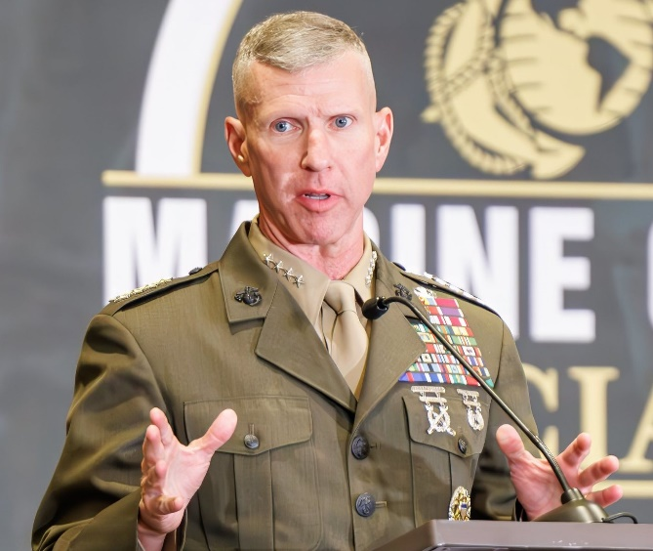
Events
Professional Events Program Began in 2004
Installations & Ground Logistics Awards Dinner
Two Ground Dinners Without Awards
Ground Awards Dinner
C4 Awards Dinner
16 Awards Presented
2024
Record breaking 32 events including supporting standing up the Marine Innovation Unit in New York and supporting the new Leadership Conferences
Added 3 new Awards Dinners for M&RA, TECOM and P&R (Luncheon)
94 Awards Presented (including 4 in Okinawa) Going up to 123 in 2025.
Hosted events from coast-to-coast, Okinawa and Germany
Gen Eric Smith
Commandant of the Marine Corps
14

Slide 15
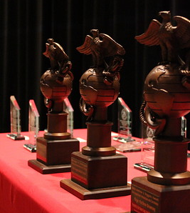
Sponsorships
Corporate Support funds MCA Professional Dinner events.
Some corporate support along with donations support Foundation Awards and Active-Duty Marine attendance
Primary sponsors are from industry with USMC interests
Sponsors attend the dinners to network, present awards, maintain their connection to the USMC and for recognition
Sponsorship levels - $500 - $75,000
USAA is the Semper Fidelis sponsor
Most individual average $2,000 each
Packages and Individual Dinners Offered ranging from $5,000-$75,000
USAA Affiliation expires at the end of 2026
Sponsorships Support both the Association and the Foundation
2024 Sponsorships Brought in by the Events Dept
MCAF | $ 377,160
MCA | $1,284,842
15

Slide 16
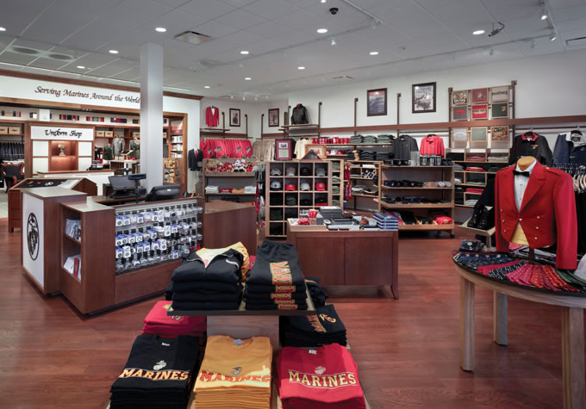
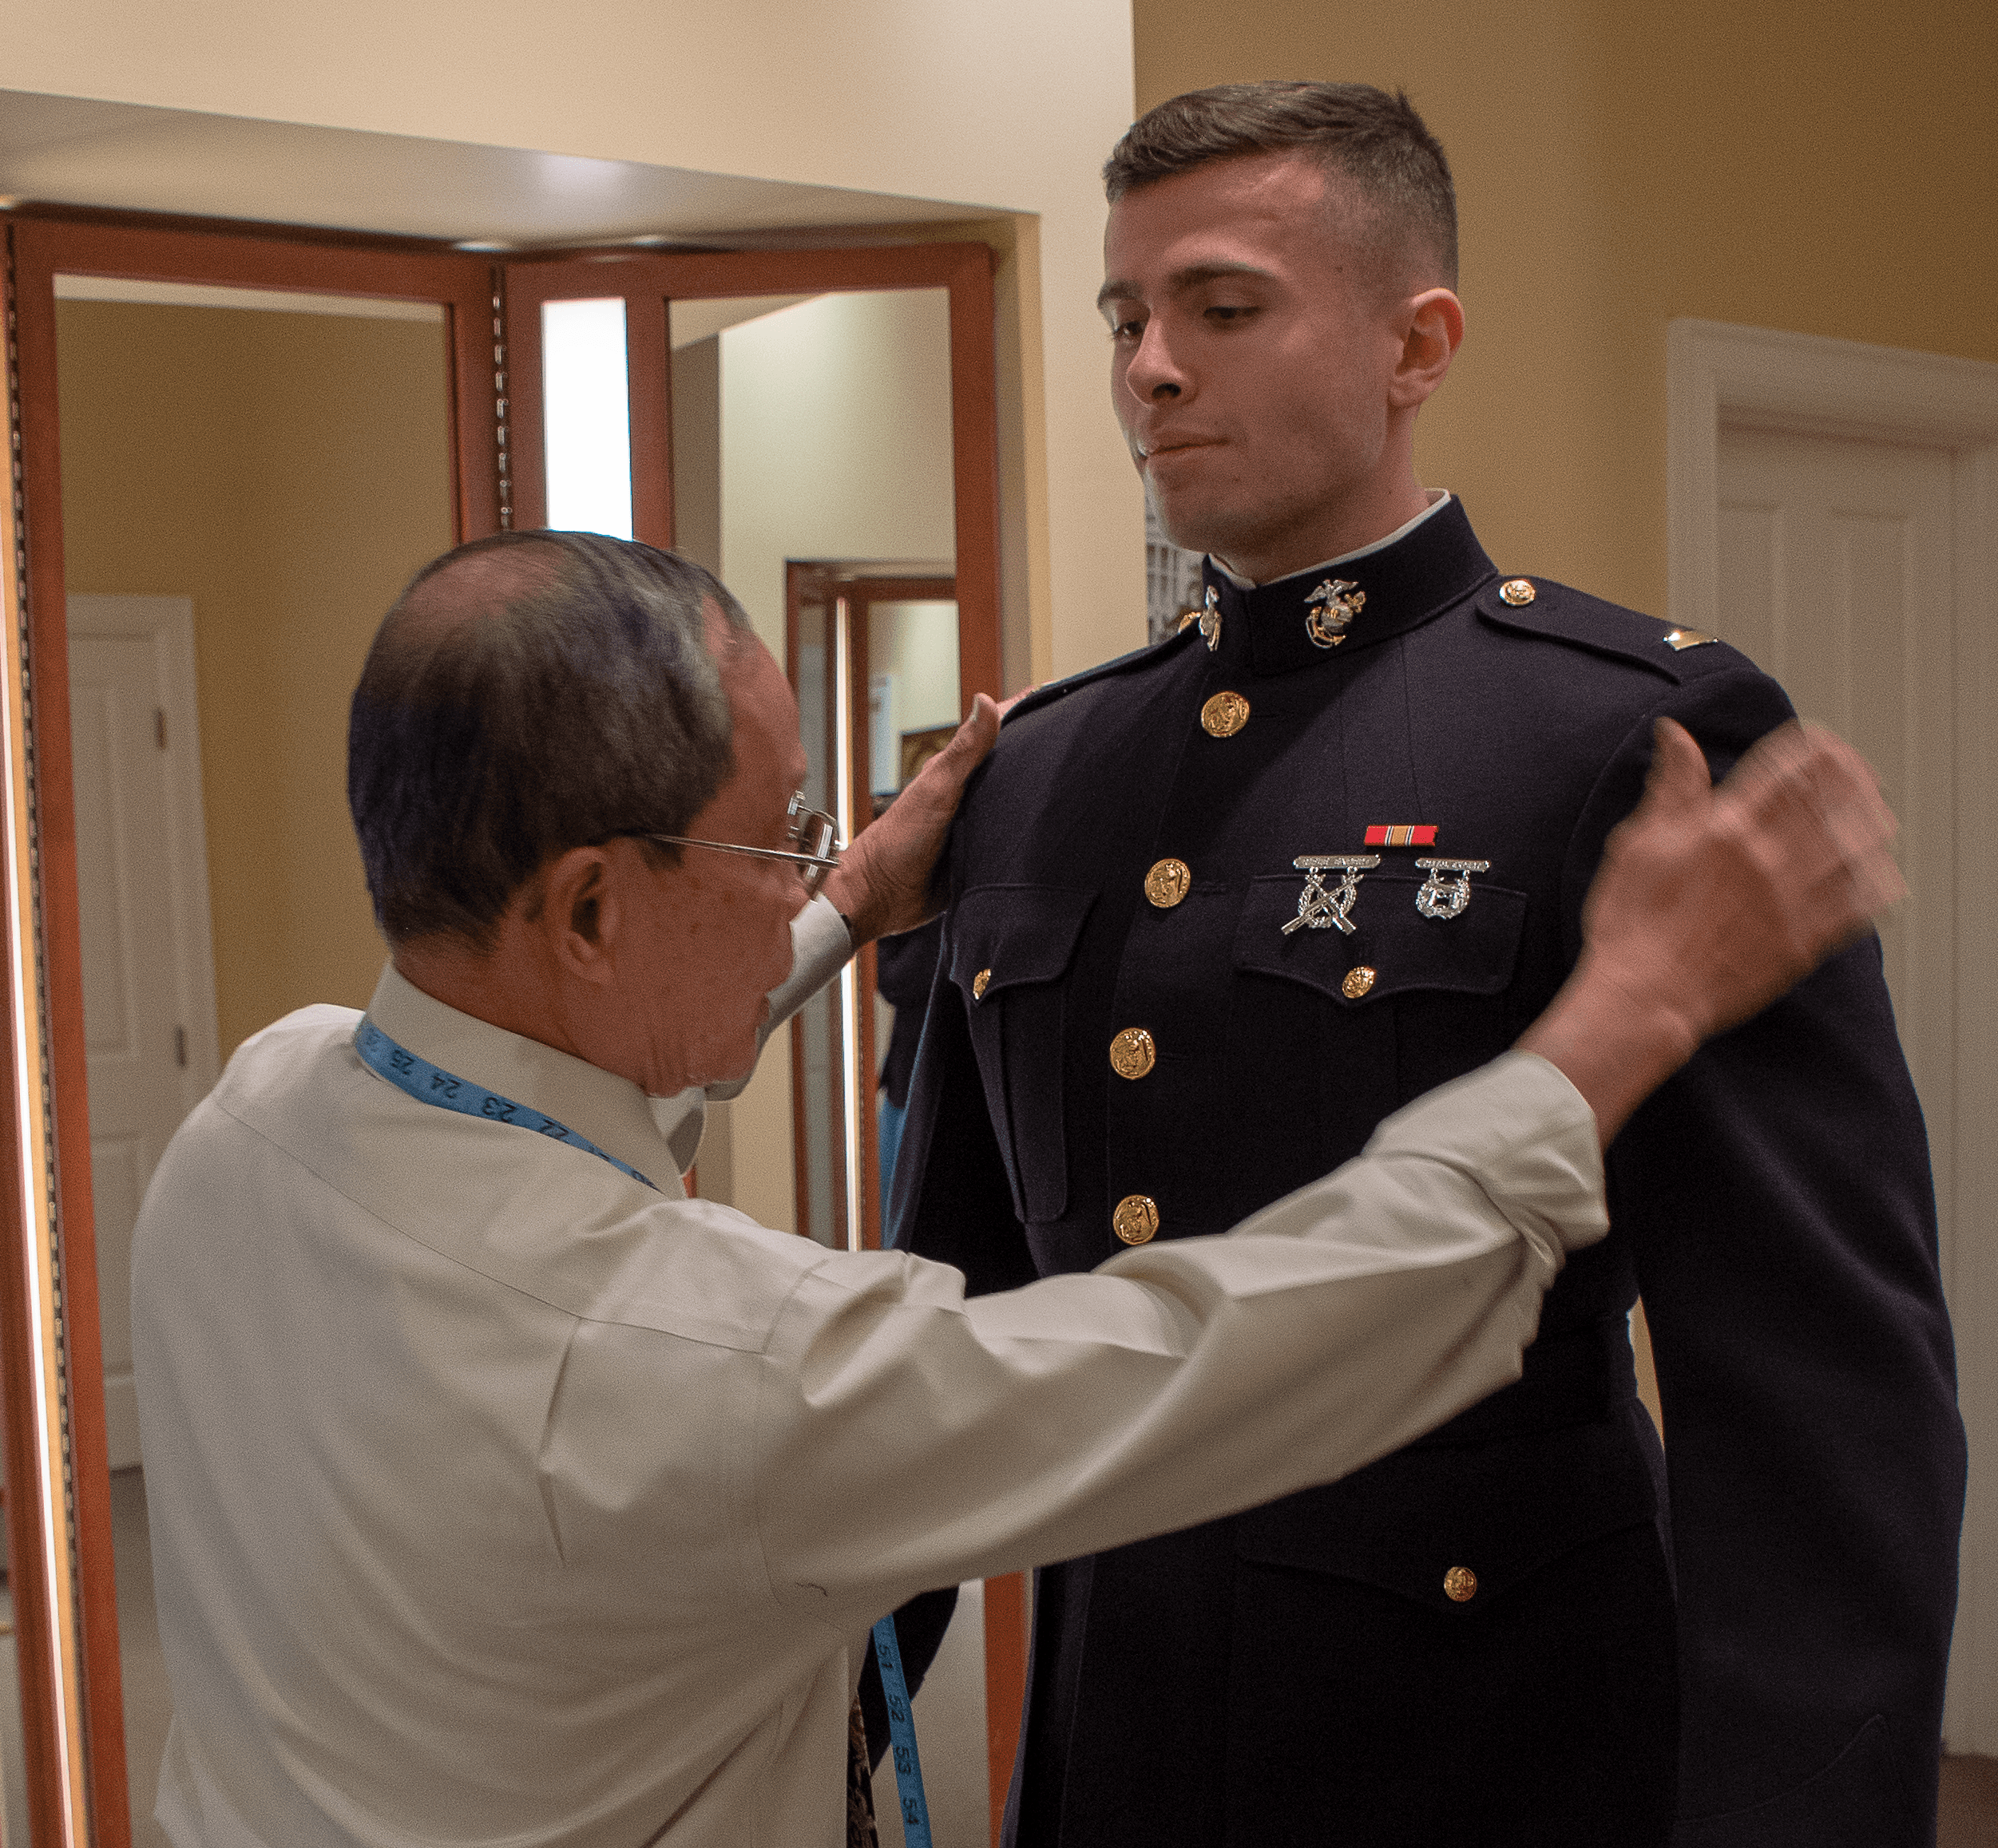
The MARINE Shop
Founded in 1962 and Acquired by MCA in 2007
Began Online Operations in 2009
Complies with all USMC Licensing and Certification Requirements
Uniform Financing since 2018
Consistently supplies at least 85% of commissioning 2ndLt Uniforms
Over 90% of general officers are Marine Shop customers.
16
Notes:
Trademark officer
Our position between manufacturer and redistributor guidance from Jessica O’Hover’s office

Slide 17
Marine Corps Association Foundation
Purpose: Obtain funds through donations, grants, etc,
to Support Marine Corps Association
Programs for Marines and families
Battlefield studies/staff rides around the world (study materials, logistics, etc.)
Books from CMC’s professional reading list provided to Unit Libraries
Monthly subscriptions of MCG & LNK provided to units across the Corps
Total Force Premium memberships for Marines
Professional Leadership Conferences, Commanders’ Forums, Guest speakers, Case Studies, Wargaming
Individual awards to recognize top performing Marines in formal schools, in their MOS, and writing contests
Honor grads and other awards at the MCRDs, OCS, TBS, and other schools across the Corps as well as unit level (e.g Cpls Courses)
Over 4,000 awards annually, 94% of them going to enlisted Marines
Spouse and family programs (Behind The Camouflage) to include spouse awards
Average Annual support: ~$1.7 million in support of 50,000+ Marines
45
17

Slide 18
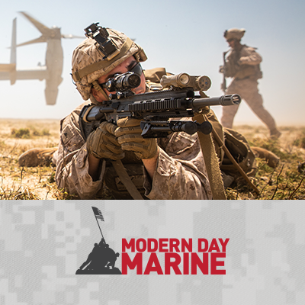
Modern Day Marine
Co-hosted by the Marine Corps Association and the Marine Corps League and produced by Emerald X, Modern Day Marine is a service level event to support CMC’s vision for key-leader engagement, strategic communications, professional military education and to showcase equipment and technology.
Director of Engagement and Outreach is the lead planner for MCA.
History:
1981: Inaugural Modern Day Marine hosted by MCL in conjunction with the MCL
National Convention in AZ
1982-92: Moved to Washington, DC, first Annual Enlisted Awards
1993: Moved to Quantico to “bring the expos to the Marines”
2015: MCA asked by CMC to add “intellectual component” to MDM /
beyond a “trade show,” strategic communication tool
2019: CMC directed CD to conduct an OPT to determine way ahead for MDM, CMC
directed move to DC
2020: COVID-19 Virtual Expo
2021: Planned for Quantico cancelled due to COVID plus ”Operation Allies Welcome”
2022: MDM 2022 was held at WEWCC for the first time
April 30-May 2 2025
Walter E. Washington Convention Center
Washington, DC
18
Notes:
Marine Corps News
Current Magazine Articles
Archives
Website Digital Content
Foundation and Membership Campaigns
Weekly Posts (TBT motivation Monday)
Today in History
Charlotte Birthday Ball
7th Marines
Iwo Jima
Art director-production assistant
Value: writing-active leadership
continued aim–Tim Day
entertainment-Ret Gen-Baseball OK

Slide 19
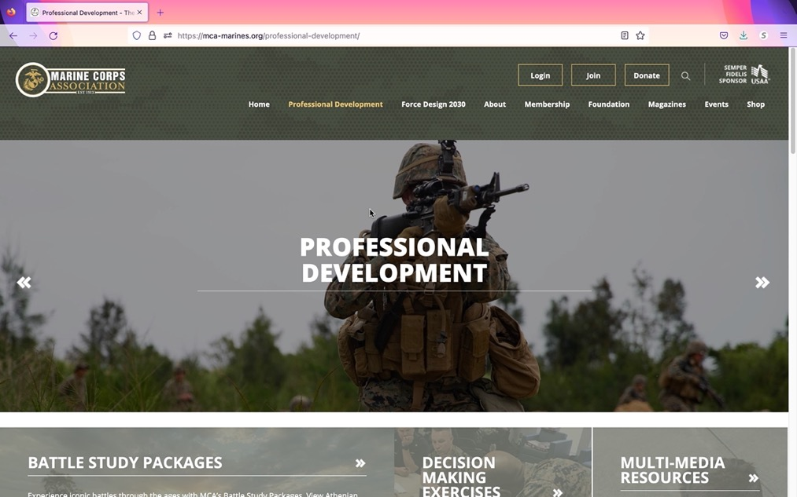
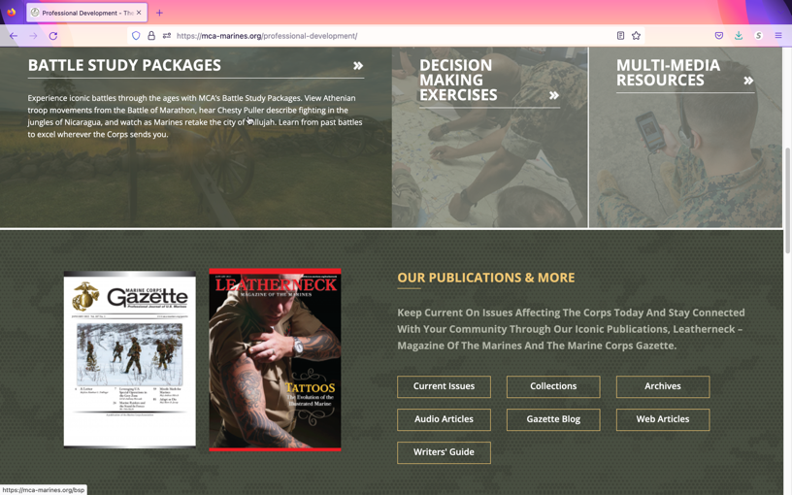
Professional Development
Battle Study Packages: organized by location, period/conflict, and Battles of the Corps
Decision Making Exercises: Searchable TDG collection, Case Studies, Wargames
Multi-media Resources: Short Films & Podcasts
Our Publications – Collections based on subject
References – authoritative DOD, DON, Joint and USMC sources
Professional Reading: CMC’s Professional Reading List, and other recommended reading lists
Delivering resources to today’s Marines:
19

Slide 20
Marine Corps Association
Board of Directors - Board of Governors
“Shared Governance”
Executive Committee
Governance
Committee
Development
Committee*
Investment &
Finance Committee
Futures
Committee
*MCAF Committee Only
20
Notes:
2 Boards: BOG for MCA, BOD for MCAF
Shared governance of MCA&F
Chairman and his executive committee lead
Development Committee is the one committee that is MCAF specific

Slide 21
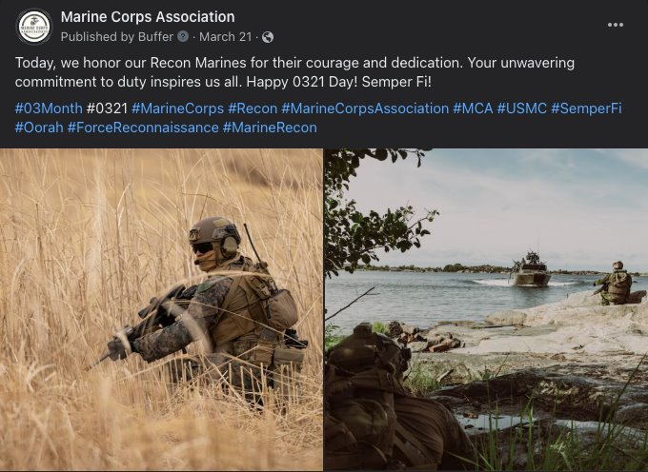
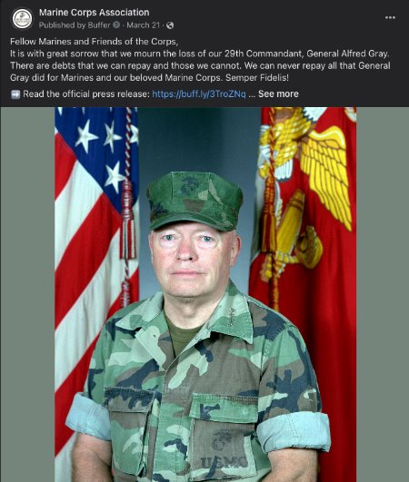
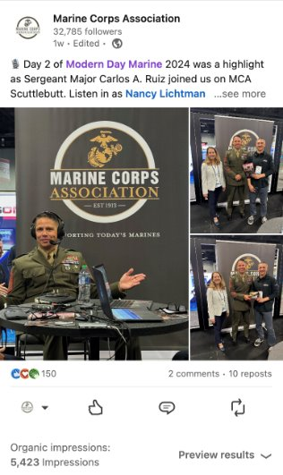
Marketing and Communications
Assist in increasing the value and growth of the organization measured by memberships, donations and sponsors, retail sales, event participation and use of professional development resources.
Highlight how MCA supports the Marine Corps through providing platforms for leadership to message key audiences, inform warfighting capabilities and develop Marines.
Owned:
-Social Media: FaceBook, Instagram, LinkedIn, X, YouTube
-Publications/Products: Leatherneck, Gazette, Podcasts (Scuttlebutt, Behind the Camouflage) Websites (MCA,The MARINE Shop)
-Production capability/support: Imagery acquisition, Graphics
Paid:
Marketing Platforms: Klaviyo, Buffer, Blubrry
Earned: Media engagements: Marine Corps Times, Military.com (Professional Dinners/Events)
21

Slide 22
USAA Contract
Contract agreement with USAA provides $755,000 in sponsorship, advertising and credit card fees
Expires at the end of 2026
22

