Slide 1
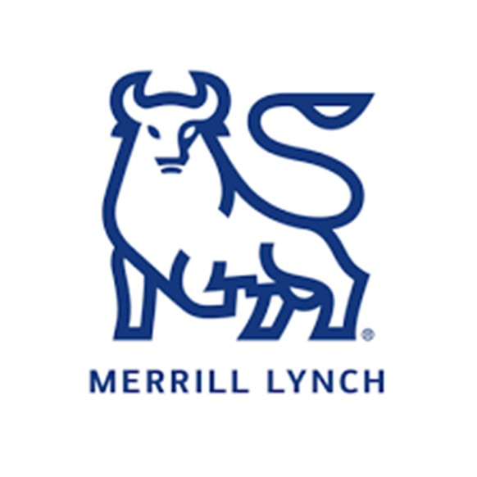
Marine Corps Association & Marine Corps Association Foundation
Accounts Summary
As of 31 Dec 2022 | MCA | MCAF | Totals
Endowment | $9,546,580 | $544,338 | $10,090,918
Cash Reserve | $2 | $0 | $2
Totals | $9,546,582 | $544,338 | $10,090,920
Marine Corps Association Loan Management Account
Available Balance: $5,626,272.58
Outstanding Balance: $0
Effective Interest Rate 6.325%
For institutional use only. Distribution to any other audience is prohibited. | Global Institutional Consulting
Notes:
Read slide.

Slide 2
MCA Wealth Management Dashboard – 2022.12.31
Current Value
$9,546,582
Change YTD | -$1,768,984
Change since inception | $751,522
Performance YTD
-14.31%
MCA IPS Benchmark | -15.32%
Simple Benchmark | -12.78%
Net Deposits & Withdrawals YTD
-$150,000
Total Deposits YTD | $0
Total Withdrawals YTD | -$150,000
Asset Allocation
Returns YTD
-$1,618,984
Total Income | $441,712
Appreciation/Depreciation | -$2,060,696
Wealth Management Fees YTD
$54,160.42
Basis of fee | .50% of value
Projected full year | $54,160.42
Notes:
Read slide.

Slide 3
MCAF Wealth Management Dashboard – 2022.12.31
Current Value
$544,338
Change YTD | -$84,906
Change since inception | $221,724
Performance YTD
-13.49%
MCAF IPS Benchmark | -15.32%
Simple Benchmark | -12.78%
Net Deposits & Withdrawals YTD
$0
Total Deposits YTD | $0
Total Withdrawals YTD | $0
Asset Allocation
Returns YTD
-$84,906
Total Income | $25,469
Appreciation/Depreciation | -$110,375
Wealth Management Fees YTD
$2,854.21
Basis of fee | .50% of value
Projected full year | $2,854.21
Notes:
Read slide.

Slide 4
Portfolio Commentary
Key Updates
Higher Capital Gains Distributions than anticipated in down year
International Equity Rally Late 2022
MFS Intl Intrinsic Value Fund Underperformance → Schwab International Dividend ETF
Dollar-Cost Averaging w/ cash
Pacer US Cash Cows ETF
Tweedy Browne Intl Value / Schwab International Dividend ETF
Top Performers
Abbey Capital Multi Asset
PIMCO Low Duration Income
Tweedy Browne Intl Value Fund
Bahl & Gaynor IncGr SMA
Bottom Performers
MFS Intrinsic Value
Akre Focus Fund
T. Rowe Price All Cap Opps.
Considerations
Continue to Dollar-Cost Average into portfolio through Q1
For institutional use only. Distribution to any other audience is prohibited. | Global Institutional Consulting
Notes:
Read slide.

Slide 5
Market Outlook
2022: Worst year for 60/40 portfolio since 1937
Less Hawkish (not dovish) Fed
Recession to bring inflation down
Consumer Spending, Housing & Manufacturing tipping towards recession
One Factor to Rule Them All: Quality (Free Cash Flow)
Equity-like Returns in Fixed Income w/ Fed pivot
Merrill S&P target 4000 by year end w/ turbulence (See RIC Report)
Recession could push to 3000
Bearish consensus puts 4600 in bullish surprise
Overall Comments
Strategic Asset Allocation well-positioned for MCA&F long-term mission
Dollar-cost average into high quality equities & intermediate term fixed income
Remember, markets are leading indicator of economy. Will turn up prior to economy
Opportunity to rebalance
For institutional use only. Distribution to any other audience is prohibited. | Global Institutional Consulting
Notes:
Read slide.

Slide 6
Benchmark Detail
IPS Benchmark
EQUITY
25% Russell 1000 TR
15% Russell 2000 TR
15% MSCI EAFE TR
5% MSCI Emerging Markets TR
5% S&P 500 TR
FIXED INCOME
29% BBG Barclays Universal TR
6% US Treasury Bills 30 Days
Simple Benchmark
EQUITY
20% S&P 500 TR
20% Dow Jones Industrial Avg TR
20% MSCI World ex US TR
FIXED INCOME
40% BBG Barclays US Aggregate Bond
For institutional use only. Distribution to any other audience is prohibited. | Global Institutional Consulting
Notes:
Read slide.

Slide 7
Disclosures: Merrill Lynch, Pierce, Fenner & Smith Incorporated (also referred to as “MLPF&S” or “Merrill”) makes available certain investment products sponsored, managed, distributed, or provided by companies that are affiliates of Bank of America Corporation (“BofA Corp.”). MLPF&S is a registered broker-dealer, registered investment adviser, Member SIPC and a wholly owned subsidiary of BofA Corp.
Representatives of MLPF&S may assist you with:
• Investment products and services provided through MLPF&S and other nonbank investment affiliates
• Insurance products offered through Merrill Lynch Life Agency Inc. (“MLLA”)
• Banking products are provided by Bank of America, N.A., Member FDIC and a wholly owned subsidiary of BofA Corp.
Investment, insurance and annuity products:
- Are Not FDIC Insured Are Not Bank Guaranteed May Lose Value
- Are Not Deposits Are Not Insured by Any
- Federal Government Agency
- Are Not a Condition to Any Banking Service or Activity
MLLA is a licensed insurance agency; Bank of America, N.A., is a national bank. All are wholly owned subsidiaries of BofA Corp.
Bank deposits are FDIC insured up to applicable limits.©
This material is being provided to you upon your request and is for informational purposes only. The information contained herein has been obtained from sources or data that we believe to be reliable, but we do not offer any guarantees as to its accuracy or completeness. Market information is subject to change without notice and past performance is no guarantee of future results. Neither the information nor any opinion expressed constitutes a solicitation for the purchase or sale of any security or other instrument. Merrill considers your trade confirmations and account statements to be the official documentation of all of your transactions.
For institutional use only. Distribution to any other audience is prohibited. | Global Institutional Consulting
Notes:
Read slide.

