Slide 1
MCA&F Board Member Orientation Brief
February 2021
Notes:
Start with thanks and introductions.
We’ll spend about two hours on this brief – it can go more quickly or use whatever time you have to discuss specific aspects of MCA&F
The purpose is to have a thoughtful conversation about MCA and MCAF which collectively we know as MCA&F, where you fit as a new board member and some view of where we’re going together.

Slide 2
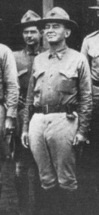
Marine Corps Association
History
The Marine Corps Association would “publish the history of the Marine Corps and disseminate information concerning the aims, purposes and deeds of the Corps, and the interchange of ideas for the betterment and improvement of its officers and men…”
John A. Lejeune
Guantanamo Bay, Cuba
25 April 1913
Notes:
More than 100 years old although there were efforts to get this going in 1911.
Professional Organization of the Marine Corps
Founded by Gen Lejeune – because there was an enduring need
Starts with a desire to make the Marine Corps more professional – “the aims, purposes and deeds of the Corps, and the interchange of ideas” - and keep an attachment to where we came from and what has gone on before.
Until the early 1970s, meetings were held in the Commandant’s office.
CMC was President of MCA
Membership strongly encouraged
Active Duty staff published Gazette
Merged with the Leatherneck Association
The significance of our connection to Gen Lejeune and “the inspiring words of our 13th Commandant … “

Slide 3
Vision
To be universally recognized as The Professional Organization for the United States Marine Corps.
Notes:
.The “acknowledged partner” phrase gets right to the point of the value of MCA&F. We work to support the vision of the Commandant in education, professional / leader development, rewarding superior performance and professionalism. For the vision to be realized we have to be partnering with the leadership to provide the assistance and programs desired.
We want to active leadership to take ownership … we need to be relevant IOT drive support … something of a circular argument
CMC / the Marine Corps WANTS / NEEDS a professional organization – and that organization must meet the needs of the Corps it serves. Have to respond to the “demand signal” For Marines to have a “demand signal” they need to be aware / familiar with what is possible. All requires communication

Slide 4
Mission Statement
To be the preeminent association for all Marines and Friends of the Corps dedicated to leader development, recognition of professional excellence and expanding awareness of the rich tradition, history and spirit of the United States Marines.
Notes:
This mission statement is valid and enduring. It reflects a recent minor edit to spotlight “leader development.”
There are several associations and foundation that support the Marine Corps today…MCUF, MCAA, MCSF, MCLEF, MCHF, SFF; scores of unit specific groups like 2d Mar Div Battalions, Squadrons, local groups like Semper Fi Society of Boston
No one has succeeded in tying those all together but our mission and focus could/should have a connection to nearly all. The connecting file is a work in progress and LtGen Faulkner has several efforts at being the adult in the room forging connections.
An initiative to connect with the Marine Corps League is a good example of working with an organization with a complementary mission set. And a potential revenue stream as we added the “intellectual component” of Modern Day Marine in 2017 and await confirmation on the next step in the partnership ..

Slide 5
Why the Marine Corps Association & Foundation Does What it Does:
Our Values
We believe in advancing the values of the Marine Corps and are dedicated to building an adaptive, engaged, and informed community that is focused on the development of Marine leaders for our Corps and Nation.
Notes:
The “Why” (why we do our mission)—not specifically the “Purpose” or “In Order To” statement. The “Why” is what binds the entire organization together across all our actions, duties and responsibilities. In our developing strategy this “why” becomes a statement on our “values.”
Everyone on our staff has other employment options. In most cases, they play above their title, compensation and position. We’re able to be lean and successful because even though we’re focused on the Marine Corps with a staff that is >10% Marine Veterans this is a shared belief in the mission and value of the Marine Corp. It permeates our staff.
We are “here” because we recognize the needs and take great satisfaction in helping Marines grow to reach their potential.

Slide 6
Marine Corps Association & Foundation
Two Not-for-Profit
Organizations
One Mission
Shared Vision
MCA - 501c19
Veterans Membership Association
Publications
Member Benefits - insurance, discounts
Retail Goods
  USMC Uniforms
  Marine Birthday Ball Supplies
  Marine Clothing, Glassware,
  Jewelry, etc.
Professional Dinners
Book Signings
MCAF - 501c3
Public Charity
Program delivery to advance leadership and recognize excellence
  Libraries
  Forums
  Writing Awards
  Excellence Awards
  Professional Development Memberships
Notes:
“Veterans” is an organizational tax status. Our members are also in large part active duty Marines. We serve those active Marines via programs while helping to keep veterans connected.
What is in each …
Talk to total MCA&F membership – back up to nearly XXXX K and also demographics – active, reserve, veteran, friend of the Corps.
The Association ( the “c 19”) is also a donor to the Foundation (the “c 3”) so you can say our members / sponsors / shoppers all support programs for Marines.

Slide 7


MCA&F Becoming MCA
Our organization was historically known as the “Marine Corps Association”
Name changed to “MCA&F” in 2011 in order to give more visibility to our new Foundation
“Foundation” in the title created confusion in the Marine community (MCHF, MCUF, MCSF, etc.)
Many Marines still know us as “the Association” and we leverage that better as MCA
Our supporting Foundation remains as it has been – an important part of the MCA family
Change effective 1 April 2021

Slide 8
Marine Corps Association & Foundation
Board of Directors - Board of Governors
“Shared Governance”
Executive Committee
LtGen George Flynn, USMC (Ret) Chairman
Mr Jay Holmes, Vice Chairman
Col Todd Ford, USMC (Ret) Finance Committee Chairman
Mr Kurt Chapman Development Committee Chairman
LtGen Mark Faulkner, USMC (Ret) MCA&F President & CEO
Mr. Bryan Wood, SES (Ret) General Counsel
Col Steve Zotti, USMC (Ret) Futures Committee Chairman
LtGen John Toolan, USMC (Ret) Governance Committee Chairman
Governance
Committee
Development
Committee*
Investment &
Finance Committee
Futures
Committee
*MCAF Committee Only
Notes:
2 Boards: BOG for MCA, BOD for MCAF
Shared governance of MCA&F
Chairman and his executive committee lead
Development Committee is the one committee that is MCAF specific

Slide 9
Marine Corps Association & Foundation
President & Chief Executive Officer
LtGen Mark Faulkner, USMC (Ret)
Chief Operating Officer
Col Dan O’Brien, USMC (Ret)
Publisher/Gazette Editor
Col Chris Woodbridge, USMC (Ret)
Foundation
Col Tim Mundy, USMC (Ret)
Member Services
Jaclyn Baird
The MARINE Shop
Janice Gwazdauskas
Chief Financial Officer
Johnna Ebel
StratComm/Leatherneck Editor/
E-Commerce
Col Mary Reinwald, USMC (Ret)
Events/Advertising Sales
LeeAnn Mitchell
IT
Mike Munson
Retail Support
Sabrina Deaver
Notes:
These are the key leaders in the organization
5 of the 11 names on the slide are retired Marines and one more who served. Among the 100 employees of MCA&F there are only a five more (Bennett, Terry, Pulley, Randy Stegner, Kerry Knowles) more who have served for a total of 11 veterans.
We have some really good people who have never served but are very dedicated!

Slide 10
Marine Corps Association
CEO
Executive
Assistant
COO
CFO
Strat.
Comm
Retail
Support
The MARINE Shop
Events
Publisher
Member
Services
IT
Foundation
Gazette
E-Commerce
Marketing
Leatherneck
Notes:
This chart shows the whole MCA&F family including the Foundation Operation staff that looks a lot like another department when you are inside the building. There are also three area reps not listed.
We will look at each one of these blocks in the course of the brief except for Executive Assistant (board secretary and facilities).
This is also a good place to mention that WE ARE A HEAVILY MATRIXED organization where many folks support both MCA and MCAF – we track those expenses so that they are properly binned.

Slide 11
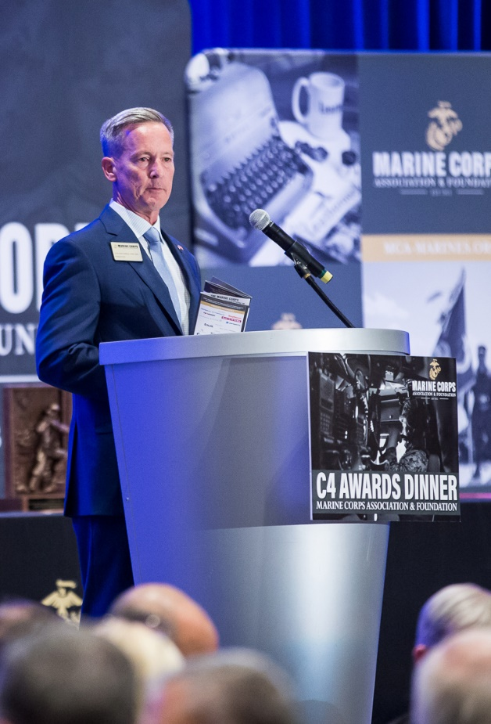
Marine Corps Association & Foundation
President and Chief Executive Officer
Leader of the organization
Sets the strategic direction
Reports to the Board
Interacts with the active leadership of the Marine Corps
Active outreach to donors, sponsors, the retired General Officer Community and other Marine Corps related and joint service organizations.

Slide 12
Marine Corps Association & Foundation
Chief Operating Officer
Functions as Deputy and Chief of Staff
Responsible for day-to-day business operations via the Department Heads
Assists CEO with the strategic direction of the organization
Coordinates and integrates
Particular focus on Retail and Membership

Slide 13
Marine Corps Association & Foundation
Chief Financial Officer
CFO
Accounting Specialist
Accounts Payable Specialist & Cashier
Payroll & Benefits Specialist
Senior Accountant

Slide 14
Marine Corps Association & Foundation
Accounting Process
Two separate legal entities, both incorporated in D.C.
  1972 and 2009
  Unique tax id numbers, unique filing requirements
Both are Not-for-Profits required to file separate IRS and State annual returns
  MCA 501(c)(19) - Veterans Service Organization
  MCAF 501(c)(3) - Charitable Organization (Public Charity)
Separate accounting and tax reporting, but consolidated financials
  Two general ledgers Different accounting principles
  Two sets of financial statements Different benchmarks

Slide 15
Accounting Process Cont.
MCA
  Investments $10million
  Total Assets $17million
  Revenue Sources:
  Member Dues
  Retail Sales
  Corporate Support
  Advertising
  Subscriptions
  Affinity & Insurance
  Modern Day Marine
Shared
Mission
Vision
Staff
Facilities
Board
Committees
MCAF
Investments $450K
Total Assets $800K
Revenue Sources:
Donations
MCA Support
Special Events

Slide 16
Marine Corps Association & Foundation
Audit
Frequency:
Annually, as required by Governance, MCB, Charitable Solicitation, Lenders
Conducted by:
Independent Certified Public Accountants
CliftonLarsonAllen
Reports:
To the Board Audit Committee (fiduciary duty oversight)
Auditors Report financial statements
Internal Control Communication
Governance Communication

Slide 17
Employee Breakdown/Benefits
86 Employees
  74% FT
  26% PT
  Five Remote: NC, CA, AZ
Annual Compensation Review
Annual Bonus Plan tied to Employee Evaluation/Goals
Employee Handbook updated Jan 2019

Slide 18
Employee Benefits
PT Benefits
  401k with 5% match
  Paid Holiday (8-11 days)
  Birthday leave
  Vision
  Supplemental Insurance
FT Benefits
  Same as above PLUS Flexible Spending Plans
  Employer-shared health & dental
  Employer-paid life, disability, AD&D, EAP, sick, vacation, bereavement, jury duty, military leave
  Tuition Reimbursement

Slide 19
Marine Corps Association
Marine Corps Gazette
Editor
Col Chris “Woody” Woodbridge (Ret)
Senior
Editor
Copy Editor
(On site)
Administration
Support
Production
Coordinator
Copy Editor
(Off site)

Slide 20
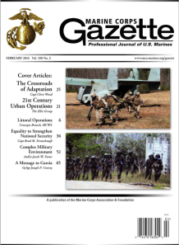
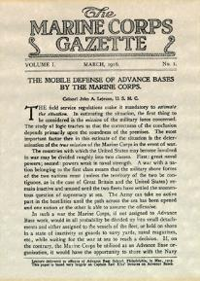
Marine Corps Gazette
Mission: “…the interchange of ideas for the betterment and improvement of its officers and men…”
- Unchanged since the First Executive Committee (1913)
Goal: The Gazette recognized as the preeminent source for professional debate on the most important issues for the Corps and relevant as an integral resource for the Corps’ leader development and professional growth.
Notes:
No conformity of thought
Venue for independent thinking
Tool to enable professional growth

Slide 21
Marine Corps Gazette
Current Initiatives:
Future-focused to aid leadership in identifying challenges and opportunities.
Expanding professional resources for members and Marines
Aligning monthly content with Deputy Commandants and professional events.
Providing a platform for CMC and SMMC
Examples:
Expanding the Gazette web presence and on-line offerings using the MCA&F Website
Increasing reader interaction and providing Professional Development Resources: Gazette Blog, TDG Collection, Maneuver Warfare Collection; Marine Corps Battle History Collection; Historical & Decision-Forcing Case Studies; Cold War/Great Power Competition Collection
Notes:
Focused primarily on currently serving Marines

Slide 22
Publisher
Serving as Publisher for both magazines, the Gazette Editor is responsible for coordination with our Printer/Distributor, LSC Communications.
Comparative circulation for 2019 and 2020:
Circulation is important to Advertisers, our Printer and as a reflection of membership
 | Jan-June 2019 | July-Dec 2019 | Jan-June 2020 | July-Dec 2020
GZ Print | 34,226 | 32,902 | 34,154 | 36,970
LN Print | 83,654 | 74,175 | 78,610 | 73,221
Digitial GZ & LN | 22,367 | 20,912 | 22,088 | 28,013
Notes:
Based on 6 month averages Jan to June.

Slide 23
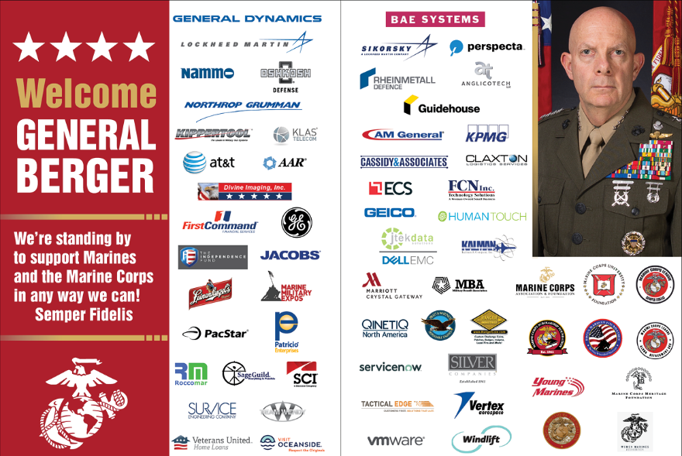
Publisher
Advertising
James G Elliot Co is only representing us for ”non-endemic” national retail ads as part of the Military Advertising Network
All other advertising is responsibility of Events/Corporate Sponsorship to coordinate
Recent initiatives including improved website ads, thank you ads in publications and combined ads for sponsors
2019
GAZ and LNK $458,900
Online Web Ads:
2020: $24,380
2019: $24,230
2020
GAZ and LNK $460,715

Slide 24
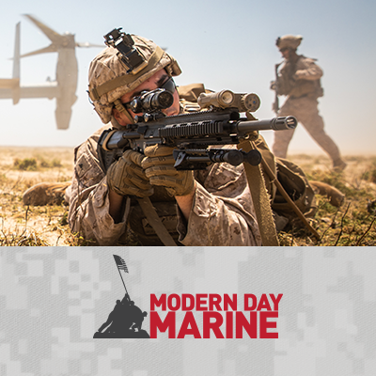
Modern Day Marine
Service level event showcasing all manner of equipment and technology
Presentations of emerging doctrine and strategic level issues of interest to Marines and industry
An opportunity for HQMC to deliver CMC message to Marines, the legislative branch, and industry
MCA and Marine Corps League are co-sponsors
Sept 21-23, 2021, MBC-Quantico
May 10-12, 2022, Washington DC Convention Center
Notes:
Marine Corps News
Current Magazine Articles
Archives
Website Digital Content
Foundation and Membership Campaigns
Weekly Posts (TBT motivation Monday)
Today in History
Charlotte Birthday Ball
7th Marines
Iwo Jima
Art director-production assistant
Value: writing-active leadership
continued aim–Tim Day
entertainment-Ret Gen-Baseball OK

Slide 25
Marine Corps Association
Leatherneck
Editor
Col Mary Reinwald (Ret)
Deputy
Editor
Staff
Writer
Graphic
Designer
Production
Coordinator
Copy
Editor
Notes:
Writers-contrast content creation happens here

Slide 26
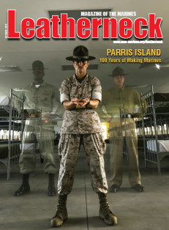
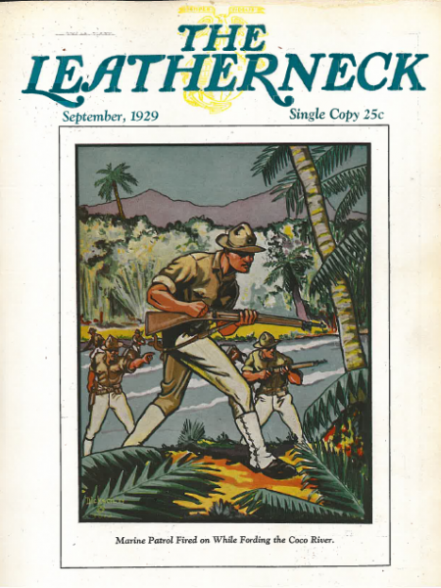
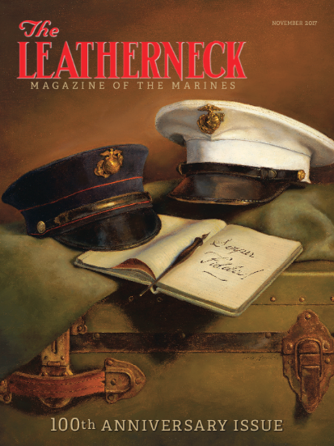
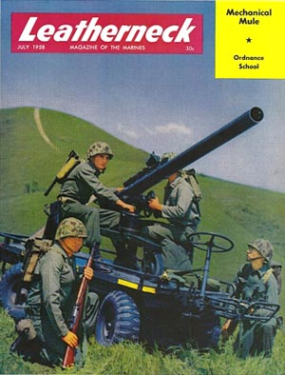
Introduction
Magazine of the Marines
Yesterday, Today, and Tomorrow
Published since 1917
Writers
  Staff
  Independent Authors
  Active Duty Marines

Slide 27
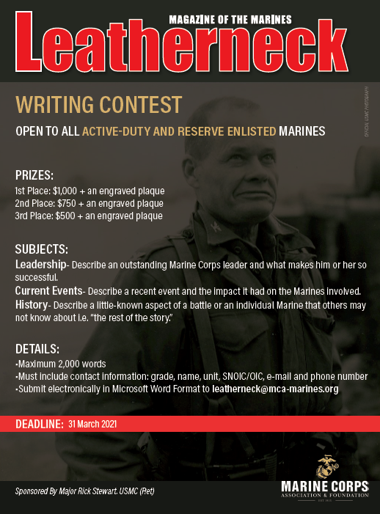
Leatherneck Writing Contest
  Sponsored by MCAF
  +50 entries annually
  +10 published
  LCpls and Cpls usually win

Slide 28
Marine Corps Association & Foundation
Strategic Communications/E-Commerce
Director
Col Mary Reinwald (Ret)
Marketing
Analyst
Communications
Manager
Communications
Coordinator
Content Coordinator
Photographer
Website Manager

Slide 29

Strategic Communications Mission
Collaborate with all departments to ensure communications efforts are:
  Consistent
  Cohesive
  Collaborated
Increase awareness of MCA&F and its mission among nonmembers
Provide support to all departments
Notes:
Have products for board members
From CEO for Mary
New Organization
-started as a result of our detailed look at process and messaging-connecting to mission and themes that are consistent
Has improved the quality, balance and better connected our audience to our mission and purpose

Slide 30
Communication
Minimize Quantity - Maximize Effectiveness
Email
Membership Acquisition
Event Awareness
Foundation Campaigns
Monthly Publications
Outside Partners/Affiliates
Website
Ecomm
Marketing
Approvals
Integration
Web Development (MCA and TMS websites)
Briefs
Internal
Area Reps
TMS Presentations
TBS Presentation
Outside Partners
Schools and Courses
Miscellaneous
Internal Magazine Ads
Area Rep Supplies
Materials for Events
Internal Reports
Direct Mail
Semi-Annual Newsletters
Membership Materials

Slide 31
Social Media
Facebook
+370,000 likes
Weekly Reach 65,000
Weekly 3,000 engaged users
Twitter
+9,000 Followers
Monthly Reach +50,000
LinkedIn
23,000 Followers
Monthly Reach +150,000
Instagram
+23,000 Follows
Weekly Reach +10,000
Social Media Posts
  Marine Corps News
  Current Magazine Articles
  Archives
  Website Digital Content
  Foundation and Membership Campaigns
  Today in History
  Promoting MCA&F
  TMS – Cross Branding
  Crazy Captions
Notes:
Marine Corps News
Current Magazine Articles
Archives
Website Digital Content
Foundation and Membership Campaigns
Weekly Posts (TBT motivation Monday)
Today in History

Slide 32

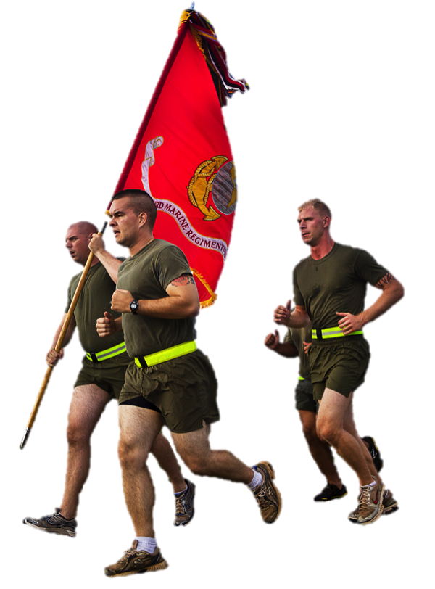
Initiatives
Professional Development Resources web page
Marine Corps Marathon
Virtual Races
Oral Histories
MCPP inserts
Facebook Donations
Catalogs
Retail initiatives
Gazette Forum Blog
Podcasts
Notes:
Marine Corps News
Current Magazine Articles
Archives
Website Digital Content
Foundation and Membership Campaigns
Weekly Posts (TBT motivation Monday)
Today in History
Charlotte Birthday Ball
7th Marines
Iwo Jima
Art director-production assistant
Value: writing-active leadership
continued aim–Tim Day
entertainment-Ret Gen-Baseball OK

Slide 33
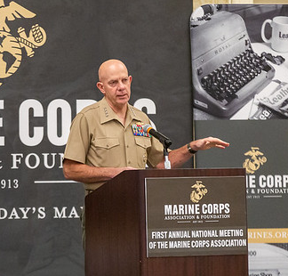
MCA as a National Military Association
MCA “meeting the basic eligibility requirement” to be the second USMC related NMA
Authorizes ”limited DoD support” to our annual national conference
Adds prestige to MCA and assists in recognition by CMC and other Marines
Our second annual meeting will allow official designation by SecDef with CMC and SecNav support
Notes:
Marine Corps News
Current Magazine Articles
Archives
Website Digital Content
Foundation and Membership Campaigns
Weekly Posts (TBT motivation Monday)
Today in History
Charlotte Birthday Ball
7th Marines
Iwo Jima
Art director-production assistant
Value: writing-active leadership
continued aim–Tim Day
entertainment-Ret Gen-Baseball OK

Slide 34
Marine Corps Association & Foundation
Membership
COO
Col Dan O’Brien (Ret)
3 Area Representatives
Director Member Services
Member Service
Representative
Member Service
Representative
Notes:
As we reorganized staff and sought to achieve greater synergy at manageable costs, the COO takes on a more direct role in membership…
The Area Reps are on the front lines at the places where we gain new members
Adam-SOI East Frank-MCRD SD Kevin-Quantico – Heavy retention challenges and access challenges.
Jaclyn and a small staff in member services interact with members, process, keep track and help us all focus.
Summer intern assisted with analytics.

Slide 35
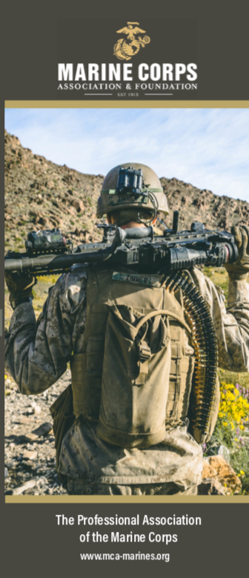
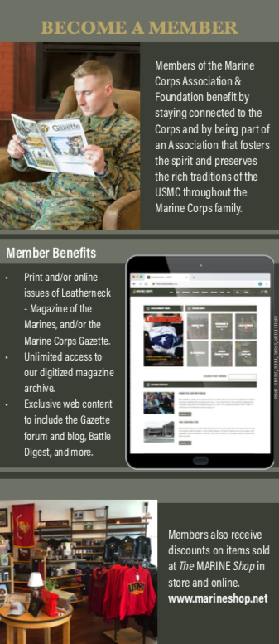
Membership
Acquisition Sources
  Area Reps
  Retail
  Digital
  Direct Mail
  Promotions
Year | Total
2014 | 64,657
2017 | 69,458
2018 | 67,814
2019 | 56,477
2020 | *56,481
*Includes 8,873 Covid 19 Extensions
Notes:
We are a membership organization
-the membership total is a measure of our health, vitality, and place in the fabric of the active Marine Corps

Slide 36
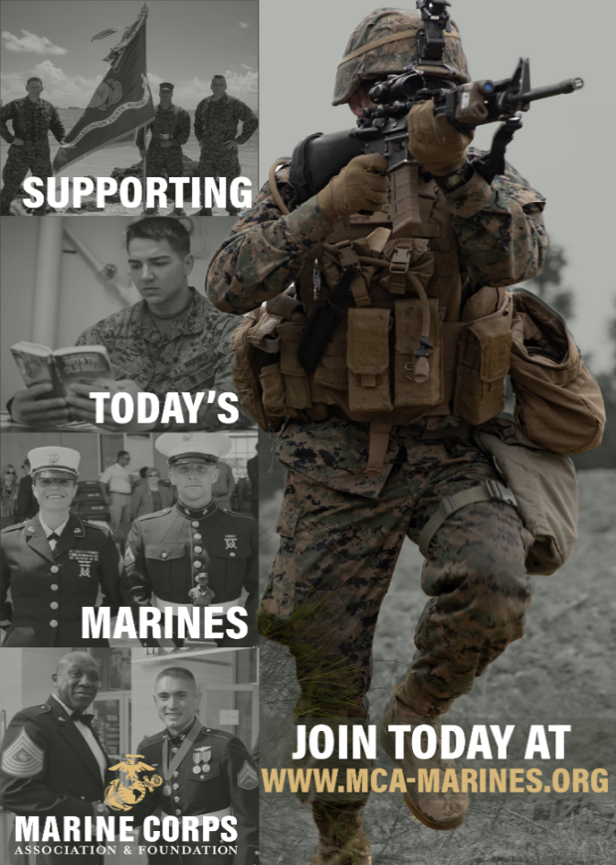
Membership
Illustrates relevance of our organization
Supports sponsorship and advertising revenue
Many efforts over the past several years to spark membership
Work within ethics regulations on USMC leadership endorsements
Professional Development Membership Awards Program - a consistent challenge!

Slide 37
Marine Corps Association
Retail Operations
COO
E-Commerce
Col Reinwald
Retail Support
Sabrina Deaver
The MARINE Shop
Janice Gwazdauskas
Call Center
Fulfillment
Warehouse
Purchasing

Slide 38
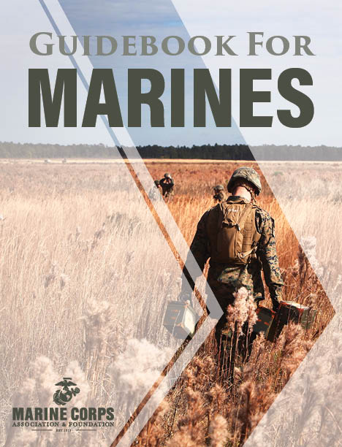
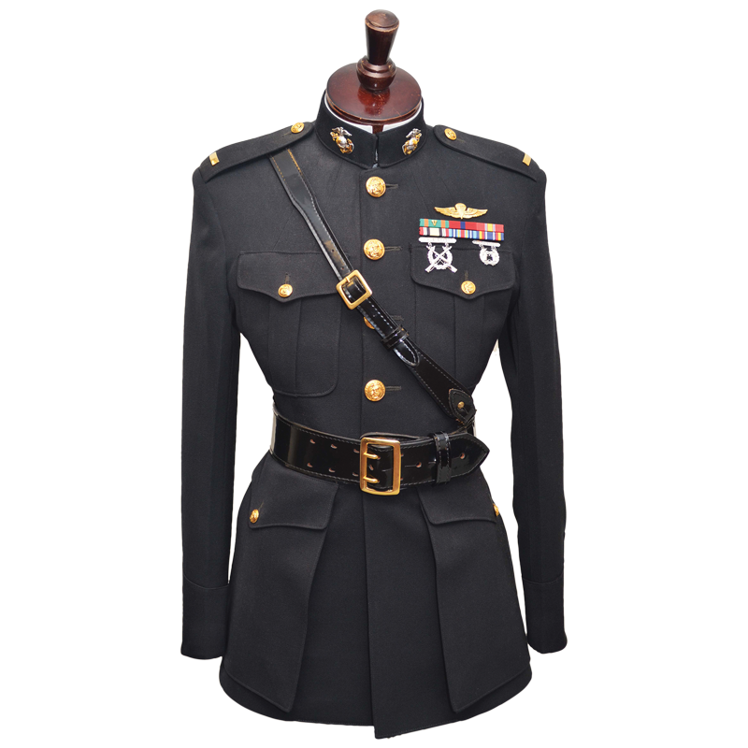
Retail Facts
2020 Retail Revenue - $5.7 million
Retail Net $253,300
E-Commerce – 19,303 orders
Uniform Sales
  ≈ 70% of newly commissioned Lieutenants - The MARINE Shop
Business-to-Business
  Biggest customer – MCCS: 40,199 Guidebooks
Available worldwide with the best service and quality
Notes:
Getting net totals from Lynn

Slide 39
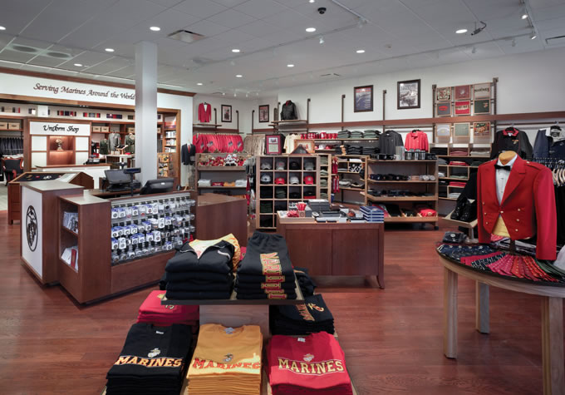
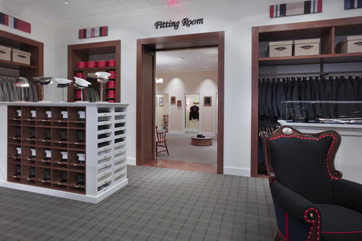
The MARINE Shop
Founded in 1972
Acquired by MCA&F in 2007
Began Online Operations in 2009
Works with USMC Licensing Trademark Office
Marine Corps Systems Command certifies every uniform item
Uniform financing since 2018
New officer uniforms remain the major line of effort
Notes:
Trademark officer
Our position between manufacturer and redistributor guidance from Jessica O’Hover’s office

Slide 40
Purchase Card Industry Data Security Standard (PCI DSS)
MCA&F and PCI
Compliant since 2014
Self assessments questionnaires and scanning current
PCI Policy annual review scheduled
Annual PCI training scheduled for 2021 PCI users
Cyber Security
Firewalls updated and patched
Desktops updated and patched weekly
Annual training and probing of user community

Slide 41
Events and Corporate Sponsorship
Director
LeeAnn Mitchell
Events
Coordinator
Events
Assistant

Slide 42
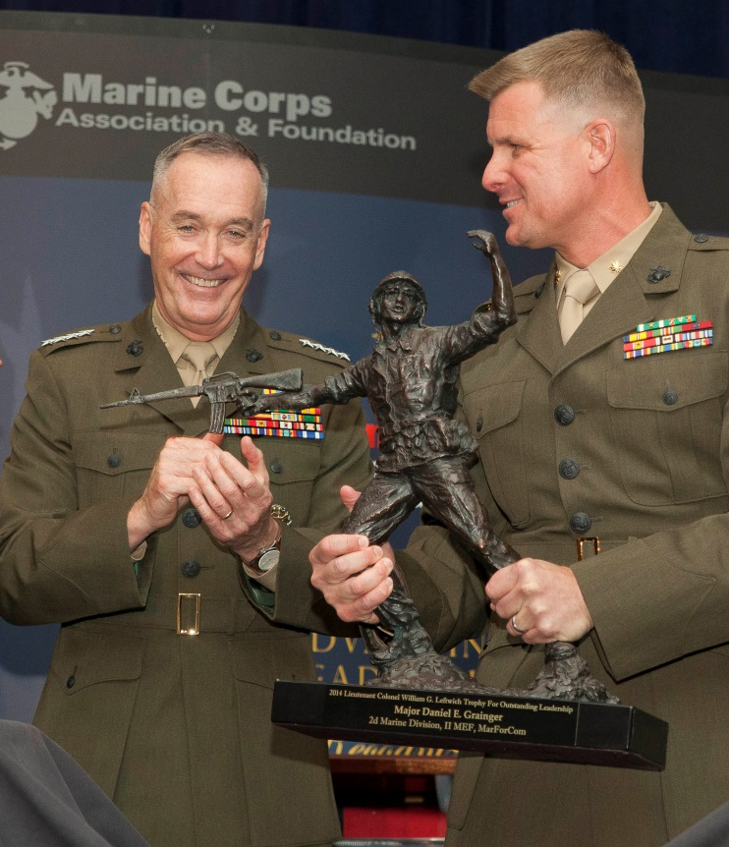
History
Professional Events Program Began in 2004
  Ground Awards Dinner
  Two Ground Dinners Without Awards
  Ground Logistics Awards Dinner
  C4 Awards Dinner
  16 Awards Presented
2020 Was Challenging
  Over a dozen events during a typical year
    9 in-person in 2020 due despite the
    coronavirus & reduced gatherings
  5 Awards Dinners
  2 Awards Ceremonies
  49 Awards Presented (including 4 in
  Okinawa)
  Hosted events from the NCR to Okinawa

Slide 43
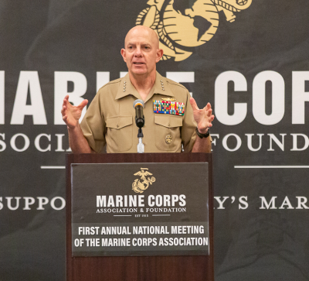
A Growing MCA&F Presence
Hosted 9 Events in 2020 including the following speakers:
  VADM Scott Conn, USN
  VADM William Merz, USN
  VADM Andrew Lewis, USN
  LtGen Charles Chiarotti, USMC
  Gen David Berger, USMC
  LtGen Eric Smith, USMC
Notable Speakers
  Former SecDef James Mattis
  Former SecDef Robert Gates
  Gen Joseph Dunford
  Gen Robert Neller
  US Congressman Rob Wittman
Gen David Berger,
Commandant of the Marine Corps
2020 First Annual National Meeting of the Marine Cops Association

Slide 44
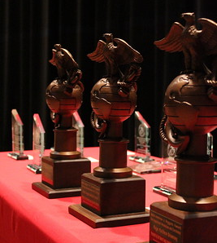
Sponsorships
Corporate Support funds MCA Professional Dinner events.
Some corporate support along with donations support Foundation Awards and Active Duty Marine attendance
Primary sponsors are from industry with USMC interests
Sponsors attend the dinners to network, present awards, maintain their connection to the USMC and for recognition
Sponsorship levels - $500 - $75,000
  (USAA is the Semper Fidelis sponsor)
  Most average $1900 each
  Packages and Individual Dinners Offered
Sponsorships 2019/2020*
MCAF | $200.078 / $171,537*
MCA | $992,000 / $760,000*
*Results impacted by limited gatherings

Slide 45
Marine Corps Association Foundation
CEO
COO
CFO
Member
Services
Strategic
Communications
Foundation
Publications
Business
Notes:
MCAF is the fastest growing part of our organization in terms of cash flow and impact on Marines
MCA does great things and is in no way diminished by the increased activity in MCAF – you’ll see the numbers over the next two days.
As a 501 c 3 MCAF helps deliver programs using its tax status that are needed and helping to solidify us as trusted partner with Marine Corps Leadership. We are able to take in individual and corporate donations and then turn that $$ around in the form of one of our five programs.
The growth of MCAF and the support it provides Marines reflects the dynamic nature and potential of our organization!! From a relatively humble beginning in 2009, MCAF is growing.
Speak to the organization …
The chart above illustrates how much of the MCA supports MCAF activity …. And there is more ….

Slide 46
Marine Corps Association Foundation
Director
Col Tim Mundy, USMC (Ret)
Foundation
Programs Coordinator
(& Area Rep, NCR)
Foundation
Programs
Administrator
Donor
Development
Officer
Administrative
Assistant

Slide 47
Purpose
The Marine Corps Association Foundation was founded in 2009 as the non-profit arm of the Marine Corps Association and helps develop leaders by providing forums for professional education, exchanging ideas, and preserving the traditions of the Corps. We stand by Marines with valuable resources through every step of their Marine Corps journey.

Slide 48
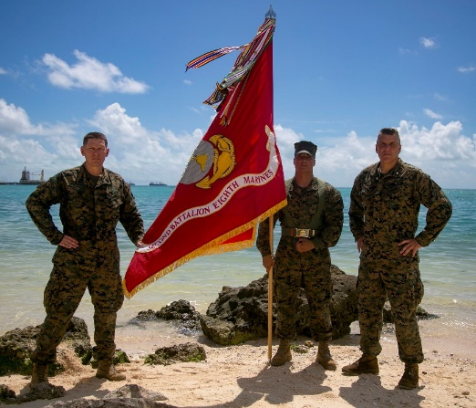
Marine Corps Association Foundation
Programs and Support
Unit Libraries
Commanders’ Forums
Marine Excellence Awards
Writing Awards
Professional Development Membership Awards
Wargaming support
MCRD 4th Phase introduction to PME & self study
2020 — $800,000 spent in
Support of ~65,000 Marines!
45

Slide 49

USAA Contract Renewal
Contract agreement with USAA provides $755K in sponsorship, advertising and credit card fees
Expires at the end of 2021
Begin renegotiation in February 2021
We are unsure of USAA’s intentions and may need to explore options

Slide 50
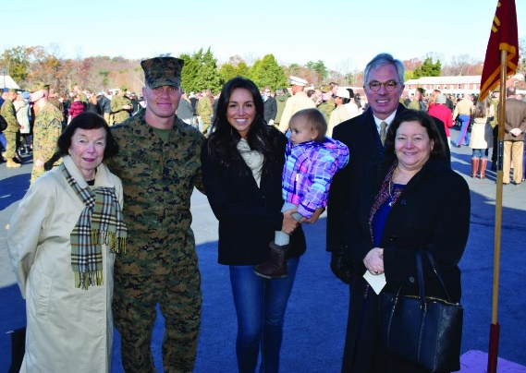
Moving Forward – Adapting to Meet Demand
Great examples of partnership between MCA&F and a dedicated leader for fundraising and donations.
Victor E. Johnson Uniform Award
$3,500 gift for uniform costs (generously funded by Chris Bird and his family) awarded to the top prior enlisted OCS Candidate with dependents (spouse and child/children)
Goal is for the award to become self-funded (endowed)
1stLt. Shaun Blue TBS Leadership Award
Statue of Lt Blue awarded to one TBS lieutenant annually who inspired their peers (peer nominated)
Created to remember Lt Blue, a KIA in OIF
Funding for initial awards and endowment provided by a Marine veteran and successful businessman
A proposed model for the Future:
Endowed Program = well-defined and compelling need + dedicated lead + MCAF support + individual and corporate donations + financial management

Slide 51
Summary
Broad Engagement – Marines, veterans, friends of the Corps, sponsors, donors, shoppers, etc..
Period of dynamic change
Enhanced Partnerships
Constantly looking to expand the reach and value of our programs, content and services for the active Marine Corps and veterans
Guided by our Strategic Plan
Remaining true to our mission

