Slide 1
MCA Board Member Orientation Brief
February 2022

Slide 2
Marine Corps Association
History
The Marine Corps Association would “publish the history of the Marine Corps and disseminate information concerning the aims, purposes and deeds of the Corps, and the interchange of ideas for the betterment and improvement of its officers and men…”
John A. Lejeune
Guantanamo Bay, Cuba
25 April 1913
Notes:
More than 100 years old although there were efforts to get this going in 1911.
Professional Organization of the Marine Corps
Founded by Gen Lejeune – because there was an enduring need
Starts with a desire to make the Marine Corps more professional – “the aims, purposes and deeds of the Corps, and the interchange of ideas” - and keep an attachment to where we came from and what has gone on before.
Until the early 1970s, meetings were held in the Commandant’s office.
CMC was President of MCA
Membership strongly encouraged
Active Duty staff published Gazette
Merged with the Leatherneck Association
The significance of our connection to Gen Lejeune and “the inspiring words of our 13th Commandant … “

Slide 3
Vision
To be universally recognized as The Professional Organization for the United States Marine Corps.
Notes:
.The “acknowledged partner” phrase gets right to the point of the value of MCA&F. We work to support the vision of the Commandant in education, professional / leader development, rewarding superior performance and professionalism. For the vision to be realized we have to be partnering with the leadership to provide the assistance and programs desired.
We want to active leadership to take ownership … we need to be relevant IOT drive support … something of a circular argument
CMC / the Marine Corps WANTS / NEEDS a professional organization – and that organization must meet the needs of the Corps it serves. Have to respond to the “demand signal” For Marines to have a “demand signal” they need to be aware / familiar with what is possible. All requires communication

Slide 4
Mission Statement
To be the preeminent association for all Marines and Friends of the Corps dedicated to leader development, recognition of professional excellence and expanding awareness of the rich tradition, history and spirit of the United States Marines.
Notes:
This mission statement is valid and enduring. It reflects a recent minor edit to spotlight “leader development.”
There are several associations and foundation that support the Marine Corps today…MCUF, MCAA, MCSF, MCLEF, MCHF, SFF; scores of unit specific groups like 2d Mar Div Battalions, Squadrons, local groups like Semper Fi Society of Boston
No one has succeeded in tying those all together but our mission and focus could/should have a connection to nearly all. The connecting file is a work in progress and LtGen Faulkner has several efforts at being the adult in the room forging connections.
An initiative to connect with the Marine Corps League is a good example of working with an organization with a complementary mission set. And a potential revenue stream as we added the “intellectual component” of Modern Day Marine in 2017 and await confirmation on the next step in the partnership ..

Slide 5
Why the Marine Corps Association Does What it Does:
Our Values
We believe in advancing the values of the Marine Corps and are dedicated to building an adaptive, engaged, and informed community that is focused on the development of Marine leaders for our Corps and Nation.
Notes:
The “Why” (why we do our mission)—not specifically the “Purpose” or “In Order To” statement. The “Why” is what binds the entire organization together across all our actions, duties and responsibilities. In our developing strategy this “why” becomes a statement on our “values.”
Everyone on our staff has other employment options. In most cases, they play above their title, compensation and position. We’re able to be lean and successful because even though we’re focused on the Marine Corps with a staff that is >10% Marine Veterans this is a shared belief in the mission and value of the Marine Corp. It permeates our staff.
We are “here” because we recognize the needs and take great satisfaction in helping Marines grow to reach their potential.

Slide 6
MCA&F Becoming MCA
Historically known as the “Marine Corps Association”
Name changed to “MCA&F” in 2011 in order to give more visibility to our new Foundation
“Foundation” created confusion in the Marine community (MCHF, MCUF, MCSF, etc.)
Many Marines still know us as “the Association”
No impact to the Foundation status
Change effective 1 April 2021

Slide 7
Marine Corps Association
Two Not-for-Profit
Organizations
One Mission
Shared Vision
MCA - 501c19
Veterans Membership Association
Publications
Member Benefits - insurance, discounts
Retail Goods
Uniforms
Marine Birthday Ball Supplies
Marine Clothing, Glassware,
Professional items
Professional and Awards Dinners
MCAF - 501c3
Public Charity
Program delivery to advance leadership and recognize excellence
Libraries
Forums
Writing Awards
Excellence Awards
Professional Development Memberships
Notes:
“Veterans” is an organizational tax status. Our members are also in large part active duty Marines. We serve those active Marines via programs while helping to keep veterans connected.
What is in each …
Talk to total MCA&F membership – back up to nearly XXXX K and also demographics – active, reserve, veteran, friend of the Corps.
The Association ( the “c 19”) is also a donor to the Foundation (the “c 3”) so you can say our members / sponsors / shoppers all support programs for Marines.

Slide 8
Marine Corps Association
Board of Directors - Board of Governors
“Shared Governance”
Executive Committee
Governance
Committee
Development
Committee*
Investment &
Finance Committee
Futures
Committee
*MCAF Committee Only
Notes:
2 Boards: BOG for MCA, BOD for MCAF
Shared governance of MCA&F
Chairman and his executive committee lead
Development Committee is the one committee that is MCAF specific

Slide 9
MCA Organization
President & CEO
VP PROFESSIONAL DEVELOPMENT & Editor of the Gazette
Annual Mtg/Expo Dir
Publisher Expos & NMA
VP COMMUNICATIONS & RETAIL OPERATIONS
Editor of Leatherneck
E-Commerce
TMS
Retail Support
Marketing
Website Management
VP CORPORATE SPONSORSHIP & EVENTS
Advertising Sales
Veteran Member Acquisition/Sales
VP FOUNDATION OPERATIONS
Program Delivery
Active-Duty Member Acquisition
VP BUSINESS Finance
HR
Compliance
IT
Facilities
Contract Management
Executive Assistant

Slide 10
Marine Corps Association
Accounting Process
Two separate legal entities, both incorporated in D.C.
1972 and 2009
Unique tax id numbers, unique filing requirements
Required to file separate IRS and State annual returns
MCA 501(c)(19) - Veterans Service Organization
MCAF 501(c)(3) - Charitable Organization (Public Charity)
Separate accounting and tax reporting, but consolidated financials
Two general ledgers Different accounting principles
Two sets of financial statements Different benchmarks

Slide 11
Accounting Process Cont.
MCA
Investments $10million
Total Assets $17million
Revenue Sources:
Member Dues
Retail Sales
Corporate Support
Advertising
Subscriptions
Affinity & Insurance
Modern Day Marine
Shared
Mission
Vision
Staff
Facilities
Board
Committees
MCAF
Investments $450K
Total Assets $800K
Revenue Sources:
Donations
MCA Support
Special Events

Slide 12
Employee Breakdown/Benefits
86 Employees
74% FT
26% PT
Three Remote: NC and CA
Compensation Review Conducted in Fall 2021
Annual Bonus Plan tied to Employee Evaluation/Goals
Employee Handbook updated June 2021

Slide 13
Employee Benefits
PT Benefits
401k with 5% match
Paid Holiday (8-11 days)
Birthday leave
Vision
Supplemental Insurance
FT Benefits
Same as above PLUS Flexible Spending Plans
Employer-shared health & dental
Employer-paid life, disability, AD&D, EAP, sick, vacation, bereavement, jury duty, military leave
Tuition Reimbursement

Slide 14
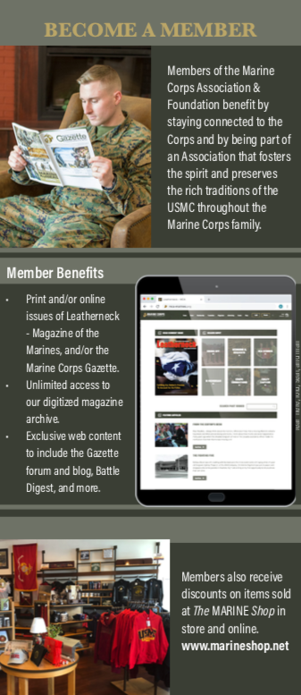
Membership
Area Reps
Direct Mail
Retail
Promotions
Digital
Year | Total
2017 | 69,458
2018 | 67,814
2019 | 56,477
2020 | 56,481*
2021 | 46,466**
*Includes 8,873 Covid 19 Extensions
**Includes 7,962 PDMAP
Notes:
We are a membership organization
-the membership total is a measure of our health, vitality, and place in the fabric of the active Marine Corps

Slide 15
Membership Initiatives
Unit Subscription Program
Approximately 1,500 Gazettes and Leathernecks distributed monthly
All three MEFs and TECOM
MEF HQs, Div/Wing/MLG level
Regiments, Groups, Battalions, Squadrons
~$53,000 in annual program delivery
Partnerships for Certification Opportunities
Member benefits that assist Marines both in and out of the Corps
Naval Community College certifications & credentials
International Society of Logistics (SOLE)
Certified Professional Logistician Program
Certified Master Logistician Program
Sig Sauer Academy Courses

Slide 16
Marine Corps Association
Marine Corps Gazette
Editor
Col Chris “Woody” Woodbridge (Ret)
Deputy Editor
Professional Development Content Coordinator
Associate Editor
(On site)
Publishing
Assistant
Layout & Production
Coordinator
Copy Editor
(Off site)

Slide 17
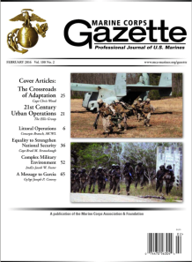
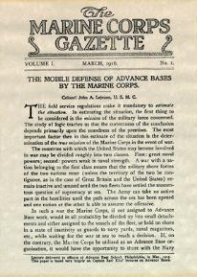
Marine Corps Gazette
Mission: “…the interchange of ideas for the betterment and improvement of its officers and men…”
- Unchanged since the First Executive Committee (1913)
Goal: The Gazette recognized as the preeminent source for professional debate on the most important issues for the Corps and relevant as an integral resource for the Corps’ leader development and professional growth.
Notes:
No conformity of thought
Venue for independent thinking
Tool to enable professional growth

Slide 18
Marine Corps Gazette
Current Initiatives:
Future-focused to aid leadership in identifying challenges and opportunities.
Expanding professional resources for members and Marines
Aligning monthly content with Deputy Commandants and professional events.
Providing a platform for CMC and SMMC
Examples:
Expanding the Gazette web presence and on-line offerings using the MCA Website and mobile application
Increasing reader interaction and providing Professional Development Resources: Gazette Blog, TDG Collection, Maneuver Warfare Collection; Marine Corps Battle History Collection; Historical & Decision-Forcing Case Studies; Cold War/Great Power Competition Collection
Notes:
Focused primarily on currently serving Marines

Slide 19
As Publisher for both magazines, the Gazette Editor is responsible for coordination with our Printer/Distributor, LSC Communications.
Shortage in paper supply has been mitigated by “pre-ordering” the necessary stock used in our print magazines
Supply chain disruptions, labor shortages and ongoing challenges in the USPS continue to delay delivery of print magazines for some of our members.
Circulation:
Publisher
 | Jan-June 2020 | July-Dec 2020 | Jan-June 2021 | July-Dec 2021
GZ Print | 34,154 | 36,970 | 31,343 | 30,321
LN Print | 78,610 | 73,221 | 67,221 | 53,655
Digitial GZ & LN | 22,088 | 28,013 | 21,186 | 20,986
Notes:
Based on 6 month averages Jan to June.

Slide 20
Publisher
Advertising
James G Elliot Co is no longer representing us as of Feb 2022. “Non-event.” No impact on advertising sales.
All other advertising is responsibility of VP Corporate Sponsorship, Advertising and Events and this revenue source continues to increase.
Recent initiatives including improved website ads, thank you ads in publications and combined ads for sponsors.
Total Print Ad Revenue 2021: $456,083.84
Online Ads 2021: $8,380

Slide 21
Modern Day Marine
Service level event to support CMC’s vision for key-leader engagement, strategic communications and to showcase equipment and technology
Presentations of emerging concepts and strategic level issues of interest to Marines and industry
An opportunity for HQMC to deliver CMC message to Marines, Congress, DoD/DON, the joint force, allies and industry partners
MCA and Marine Corps League are co-hosts
May 10-12, 2022, Washington DC Convention Center
Notes:
Marine Corps News
Current Magazine Articles
Archives
Website Digital Content
Foundation and Membership Campaigns
Weekly Posts (TBT motivation Monday)
Today in History
Charlotte Birthday Ball
7th Marines
Iwo Jima
Art director-production assistant
Value: writing-active leadership
continued aim–Tim Day
entertainment-Ret Gen-Baseball OK

Slide 22
Marine Corps Association
Leatherneck
Editor
Col Mary Reinwald (Ret)
Deputy
Editor
Staff
Writer
Graphic
Designer
Production
Coordinator
Notes:
Writers-contrast content creation happens here

Slide 23
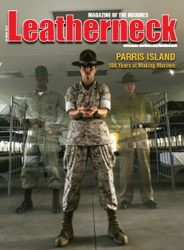
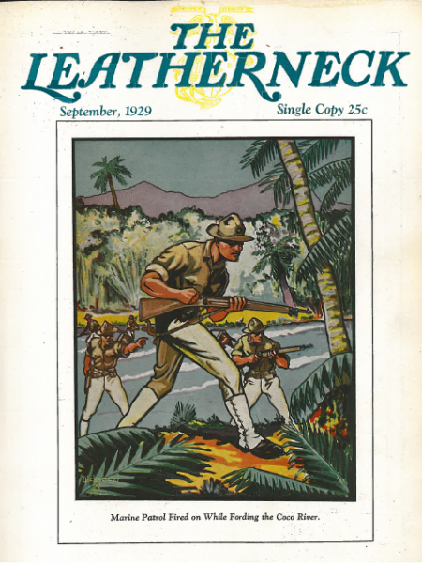
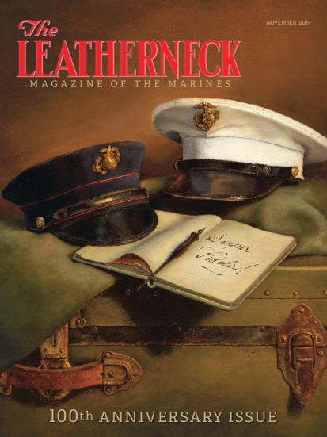
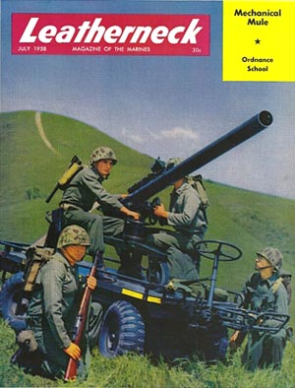
Introduction
Magazine of the Marines
Yesterday, Today, and Tomorrow
Published since 1917
Writers
Staff
Independent Authors
Active Duty Marines

Slide 24
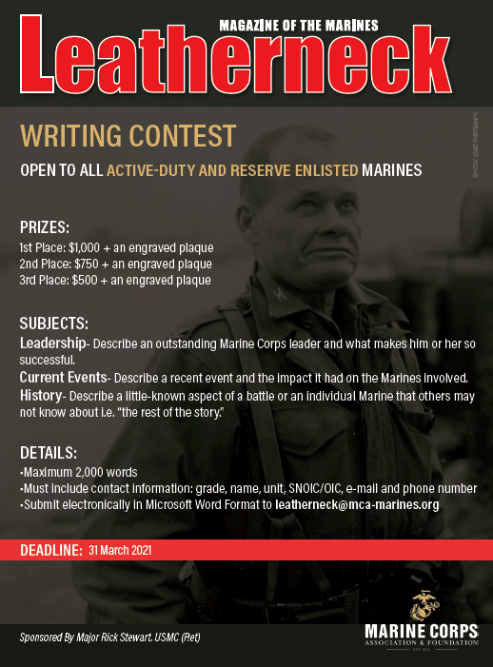
Leatherneck Writing Contest
Sponsored by MCAF
+50 entries annually
+10 published
LCpls and Cpls usually win

Slide 25
Marine Corps Association
Retail Operations
Retail Director
The MARINE Shop
Purchasing
Operations
Systems

Slide 26
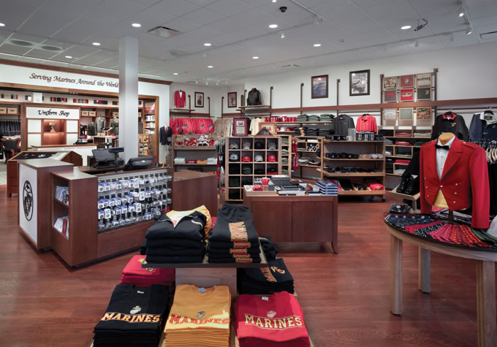
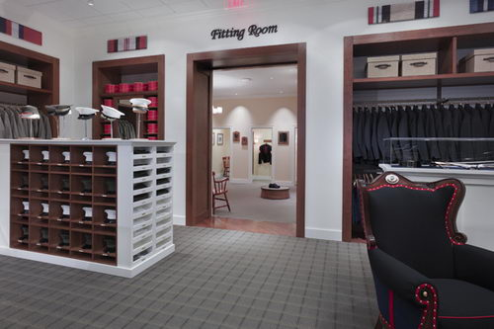
The MARINE Shop
Founded in 1962
Acquired by MCA in 2007
Began Online Operations in 2009
Works with USMC Licensing Trademark Office
Marine Corps Systems Command certifies every uniform item
Uniform financing since 2018
Notes:
Trademark officer
Our position between manufacturer and redistributor guidance from Jessica O’Hover’s office

Slide 27
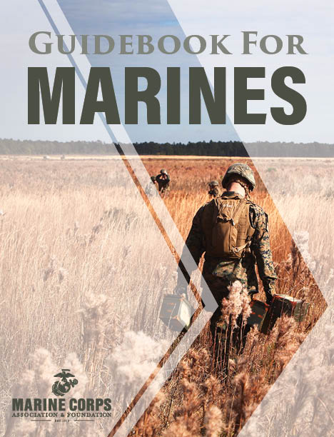
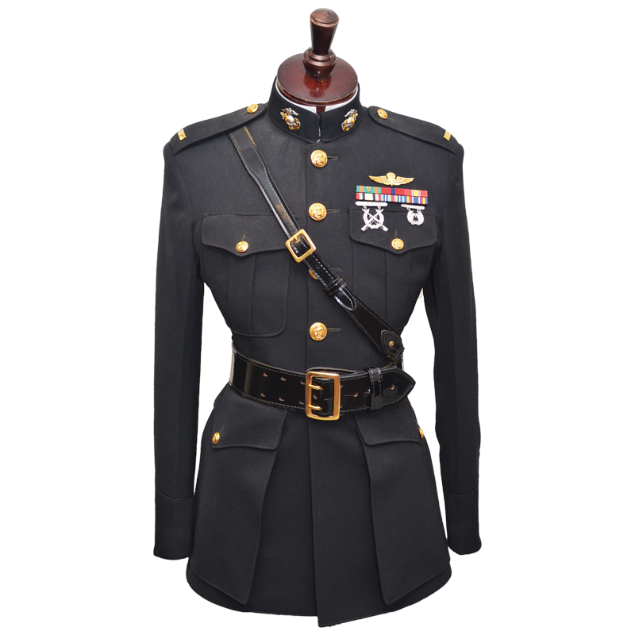
Retail Facts
2021 Retail Revenue - $6.08 million
Uniform Sales primary focus
Commissioning packages
≈ 75% of newly commissioned Lieutenants
Evening dress
Boat Cloaks
Other recurring uniform purchases
Business-to-Business
MCCS: 40,199 Guidebooks
Available worldwide with the best service and quality
Notes:
Getting net totals from Lynn

Slide 28
Events and Corporate Sponsorship
Vice President
LeeAnn Mitchell
Events
Coordinator
Events Assistant/
Advertising Coordinator

Slide 29
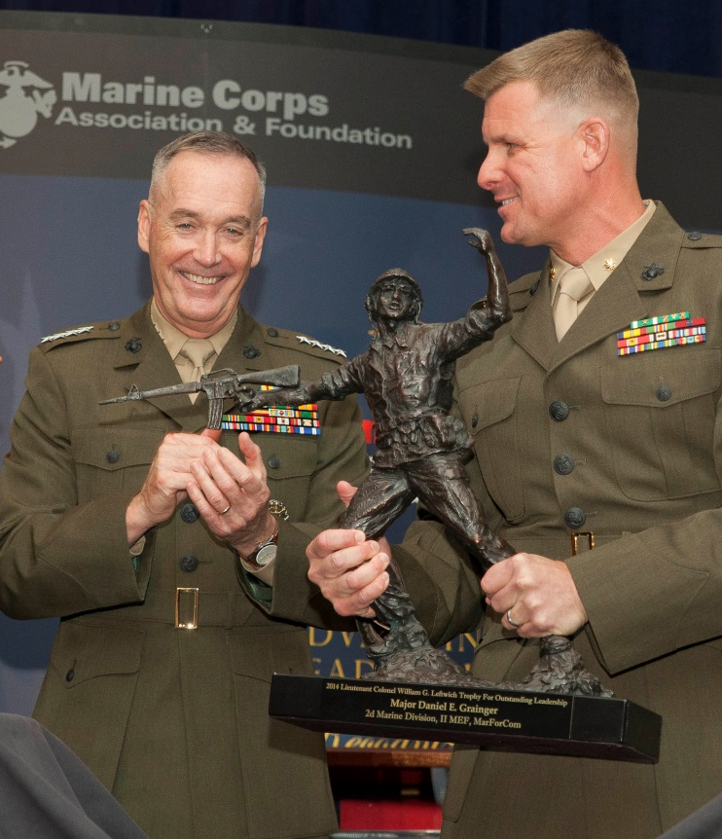
Events
Professional Events Program Began in 2004
Ground Awards Dinner
Two Ground Dinners Without Awards
Ground Logistics Awards Dinner
C4 Awards Dinner
16 Awards Presented
2021 Continued to Challenge Us
Over a dozen events during a typical year
9 in-person in 2021 due despite the
coronavirus & reduced gatherings at the
beginning of the events cycle
6 Awards Dinners
1 Awards Ceremonies
51 Premier Awards Presented
Hosted events only in the NCR due to Covid

Slide 30
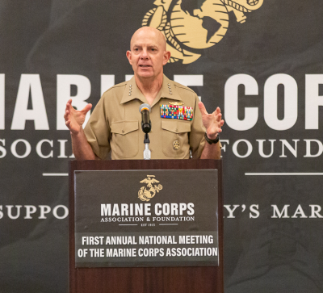
Speaker
Hosted 9 Events in 2021 including the following speakers:
Gen David Berger, USMC
Gen Eric Smith, USMC
Gen Gary Thomas, USMC
Gen Paul Nakasone, USA
VADM Scott Conn, USN
LtGen David Furness, USMC
Other Notable Speakers Over The Years
Former SecDef James Mattis
Former SecDef Robert Gates
Gen Joseph Dunford
US Congressman Rob Wittman
Gen David Berger,
Commandant of the Marine Corps
2021 Second Annual National Meeting of the Marine Corps Association

Slide 31
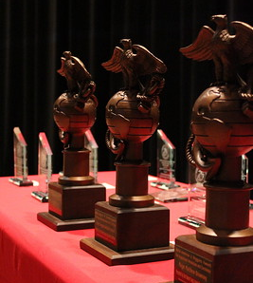
Sponsorships
Corporate Support funds MCA Professional Dinner events.
Some corporate support along with donations support Foundation Awards and Active-Duty Marine attendance
Primary sponsors are from industry with USMC interests
Sponsors attend the dinners to network, present awards, maintain their connection to the USMC and for recognition
Sponsorship levels - $500 - $75,000
(USAA is the Semper Fidelis sponsor)
Most average $2,000 each
Packages and Individual Dinner Sponsorships Offered
Sponsorships 2020/2021*
MCAF | $171,537*/$232,014
MCA | $$760,000*/$824,646
*Results impacted by limited gatherings

Slide 32
Marine Corps Association Foundation
Vice President
Col Tim Mundy, USMC (Ret)
Foundation
Programs Coordinator
(Area Rep, NCR)
Foundation
Programs
Administrator
MCA Area Rep
East
MCA Area Rep
West
Donor
Development
Officer
Administrative
Assistant (PT)
Program Delivery
USMC Member Acquisition
Fundraising

Slide 33
Purpose
Help develop leaders by providing forums for professional education, exchanging ideas, and preserving the traditions of the Corps.
Provide Marines with valuable resources to assist in their professional development.
Recognize their excellent achievements.
Encourage participation of active-duty Marines as members of their professional association.
*The 501(c)(3) nonprofit arm of MCA founded in 2009

Slide 34
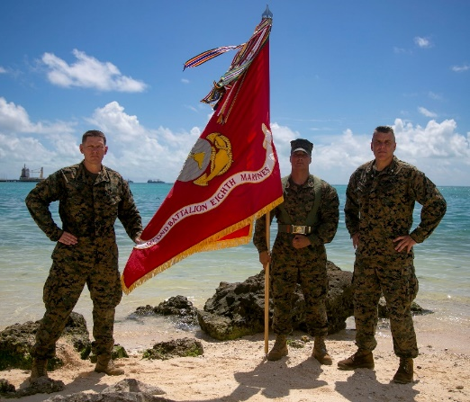
Marine Corps Association Foundation
Programs and Support
Unit Libraries
Commanders’ Forums
(battlefield studies)
Marine Excellence Awards
Writing Awards
Professional Development Membership Awards
Unit Subscription Program
Wargaming support
MCRD 4th Phase introduction to PME & self study
2021 — $900,000 spent in Support of ~55,000 Marines!
45

Slide 35
USAA Contract Renewal
Contract agreement with USAA provides $755K in sponsorship, advertising and credit card fees
Recent contract renegotiation has opened up other opportunities

Slide 36
Summary
Broad Engagement – Marines, veterans, friends of the Corps, sponsors, donors, shoppers, etc..
Period of dynamic change
Enhanced Partnerships
Constantly looking to expand the reach and value of our programs, content and services for the active Marine Corps and veterans
Guided by our Strategic Plan
Remaining true to our mission

