Slide 1
MCA Membership Problem Framing
“Wicked Problem:”
incomplete, contradictory, and changing requirements that are often difficult to recognize
there is no single solution to the problem, and no determinable stopping point
Because of complex interdependencies the effort to solve one aspect of a wicked problem may reveal or create other problems.

Slide 2
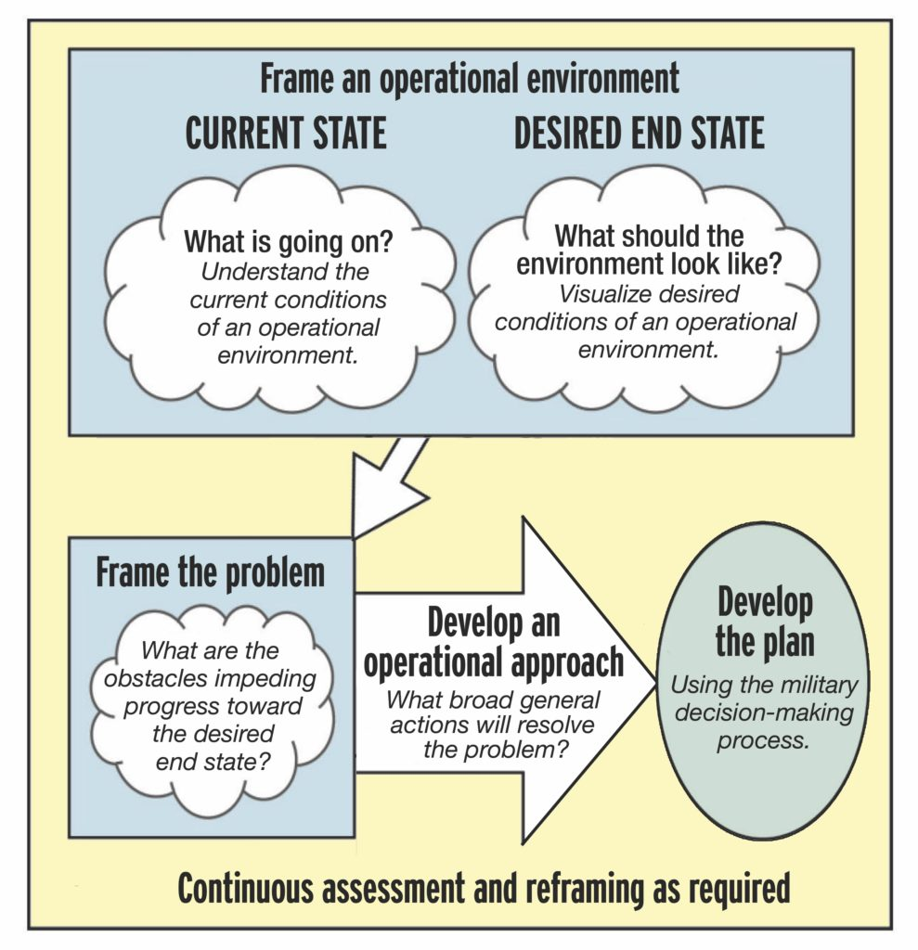
Problem Framing & Design
Data analysis & partial solutions:
Rate change
Subsidized membership ”awards” (PDMAP)
USMC leader’s “Endorsement” (Prohibited)
Define the “to-be or “should be” model of membership in the MCA:
Populations
Numbers
$ ?
Value/Benefits
Other?
The Obstacles to achieving the future state are the basis for coordinated actions— Lines of Effort

Slide 3
Understanding the Current State
Membership Trends 2018-2021

Slide 4
Understanding the Current State
Membership Revenue Trends 2018-2021
2nd Half 2021
Decrease of 6,413 members after addition of 2,607 PDMAP
Revenue of $640,152 including $52,140 from PDMAP
2022 budgeted $1,297,439 in revenue with 49,400 members

Slide 5
Desired Future State?
Separate membership from revenue and subscriptions.
Completely change the view of membership in the Professional Association as a revenue source and instead fund memberships as a “program” using fundraising and/or reserve resources.
Membership should be earned and awarded like a Marines’ Eagle Globe and Anchor or Primary MOS qualification, or at specific service milestones i.e. re-enlistment (2d term?) and/or promotion/career designation.
Membership itself is free, individual Marines choose to activate their membership which is defined (currently) as access to digital publications and resources.
Other products and resources are “pay to play” and their costs are pro-rated by rank. This is analogous to COSTCO or Amazon vs Amazon Prime.”

Slide 6
Past Problem Statements
How to increase membership in the Professional Association of the Marine Corps through emphasizing value to the profession of arms, developing unique and exclusive resources, and focusing on the most influential leadership of the Corps?
How to maintain value to our veteran subscribers while increasing appeal to new veterans?
How to continue to “recruit” members, most of whom are “non-committed” among the first term enlisted/junior officer populations?

