Slide 1
Modern Day Marine 2022
&
National Military Association Update

Slide 2
Modern Day Marine
Service level event to support CMC’s vision for key-leader engagement, strategic communications and to showcase equipment and technology
Presentations of emerging concepts and strategic level issues of interest to Marines and industry
An opportunity for HQMC to deliver CMC message to Marines, Congress, DoD/DON, the joint force, allies and industry partners
MCA and Marine Corps League are co-hosts
May 10-12, 2022, Walter E. Washington Convention Center
Notes:
Marine Corps News
Current Magazine Articles
Archives
Website Digital Content
Foundation and Membership Campaigns
Weekly Posts (TBT motivation Monday)
Today in History
Charlotte Birthday Ball
7th Marines
Iwo Jima
Art director-production assistant
Value: writing-active leadership
continued aim–Tim Day
entertainment-Ret Gen-Baseball OK

Slide 3
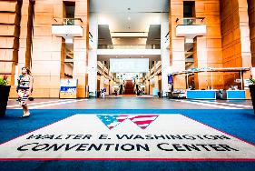
Modern Day Marine 2022
POA&M
BACKGROUND
MDM will be the right event, at the right place, that incorporates a technology and concepts demo, professional development of the force, and showcases the Marine key stakeholders that will support future force design efforts.
APPROVED THEME
Today’s Innovation…Tomorrow’s Battles Won
12 May: Day 3 of Expo
11 May: Day 2 of Expo
10 May: Day 1 of Expo
9 May: MCSC APBI
7 APR: FPC - All Presentation Materials Submitted. Media Plan,
Grand Banquet & Enlisted Awards Parade plans confirmed
MPC (MCA)
10 MAR: MPC - Presenters Confirmed, Marine Zone Layout Confirmed,
Marine Stage Presentations Confirmed
1 MAR: MDM Attendee & Exhibitor Registration “go live date”
6 JAN: IPC
Marine Stage Slots Allocated, Show Theme Approved, DC & IM Award Recipients Approved
6 DEC: CMC Information Brief
2 DEC: Number, Type & Timing of MDM inclusive events, session tracks, presentation slots per track, and
anticipated audience sizes to facilitate registration process build
4 NOV: MDM 2022 Kick Off Mtg w/ USMC Experimentation, Requirements & Acquisitions Organizations. Enlisted
Awards MARADMIN prepared for release by 12/2/2021. Enlisted Awards Parade Plan Confirmed
13 OCT: Site visit to DC Convention Center/AUSA Annual Meeting
30 SEP: Draft MDM 2022 Concept Review w/ CD

Slide 4
Modern Day Marine 2022
(Post IPC Draft SOE)
Monday, 9 May, MCSC APBI – Walter E. Washington Convention Center, Washington, DC
0800 – 1730 Marine Corps Systems Command Schedule (Independent event planned and executed by MCSC ICW MDM to facilitate invited Industry attendance
Tuesday, 10 May, Day One – Walter E. Washington Convention Center, Washington, DC
0800 – 0930 Congressional Breakfast CMC Host + Remark; Congressional GOH Remarks
0945 – 1000 Opening Ceremony – Main Entrance to Exhibit Hall ACMC
1000 Expo Hall Open & Presentation Schedule Initiated CMC/ACMC introduce Keynote Speaker
1530 End of Presentation Schedule
1630 Expo Hall Close
1830 – 1930 Grand Banquet Reception – Marriott Marquis, Washington, DC (901 Massachusetts Ave, NW)
1930 – 2130 Grand Banquet (CMC GOH Remarks (MCL Iron Mike & Dicky Chappelle Awards)
Wednesday, 11 May, Day Two – Walter E. Washington Convention Center, Washington, DC
0830 – 1000 Marine Corps League Awards Ceremony & Leadership Breakfast CMC & SMMC GOHs
1000 Expo Hall Open & Presentation Schedule Initiated
1200 - 1330 MDM Personal Financial Planning Lunch Hosted by MCA
1530 End of Presentation Schedule
1630 Expo Hall Close
1600-1830 MDM International Reception & Presentation hosted by the British Embassy and MCA
Thursday, 12 May, Day Three – Walter E. Washington Convention Center, Washington, DC
1000 Expo Hall Open & Presentation Schedule Initiated
1200 - 1400 Operation Semper Fi & MDM Career Transition Lunch Hosted by MCA (CG MCRC GOH)
1400 - 1500 Marine Zone Semper Fi Mixer
1530 Expo Hall Close, End of Presentation Schedule & End of show

Slide 5
MDM 2022 Content Framework
Proposed/Tentative & Pre-Decisional
Time Slot / Date | Organization(s) | Topic / Audience | Presentation Type
1000 – 1100/ Tue, 5/10 | CMC/ACMC | State of the Corps/FD2030 SITREP | Remarks followed by Q&A
1100 – 1200 / Tue, 5/10 | DEPSECDEF | Keynote –OR-- | Remarks followed by Q&A
 | SECNAV | Keynote / Alternate –OR-- | “”
 | ADM Gilday | Keynote Alternate | “”
1200 – 1300 / Tue, 5/10 | ASN RD&A | FY ’23 Acquisitions Look Ahead | Remarks followed by Q&A
1330 – 1500 / Tue, 5/10 | DC CD&I CDD MCWL MCSC PEO LS N95 | Force Design 2030: Experimentation, Requirements, Acquisitions & Naval Integration | Panel followed by Q&A
1500 – 1600 / Tues, 5/10 | MARSOC | MARSOC Operational Approach for Modernization | Remarks/Panel followed by Q&A
All conducted in the Main Briefing Center
Media Roundtables to follow as available

Slide 6
MDM 2022 Content Framework
Proposed/Tentative & Pre-Decisional
Time Slot / Date | Organization(s) | Topic / Audience | Presentation Type
1000 – 1130 / Wed, 5/11 | DC PP&O w/ Allied Attachés | The Pacific: Partnership in the Littorals | Panel followed by Q&A
1230 – 1400/ Wed 5/11 | DC M&RA CG MCSC DC/ADC CD&I Add TECOM? | Talent Management 2030 SITREP and Way Ahead | Co-remarks followed by Q&A
1400– 1530 / Wed, 5/11 | DC-AVN DC-I PEO AVN | Aviation Adaptation and Operations in the Information Environment for FD 2030 | Co-remarks followed by Q&A
Time Slot / Date | Organization(s) | Topic / Audience | Presentation Type
1000 – 1100 / Thu, 5/12 | FMF INDOPACOM III MEF | Implementing Force Design 2030 and the Marine Littoral Regiment | Presentation followed by Q&A
1100 – 1200 / Thu, 5/12 | CG TECOM CG TRNGCMD CG EDCOM | Training and Education for the Future Force FD2030 & TM2030 | Presentation followed by Q&A
All conducted in the Main Briefing Center
Media Roundtables to follow as available

Slide 7
Modern Day Marine
MDM gross sales as of 28 Jan 22: 63,380 SqFt = $3,660,910. The Budgeted SqFt Sales Goal is 71,000 NSF = $4,031,000. 91% to the NSF revenue goal at 14 weeks out. First week of sponsorship sales = $15,000. The Budgeted Sponsorship Sales Goal is $600,000.
2023 Dates: June 27-29, WEWCC (Execute updated Partnership w/ Emerald)
The changes in location and timing present new opportunities and requirements:
Increased ability to support CMC’s engagement and communications priorities (Congress)
Increased International Military and Industry participation
MCA comprehensive communications & marketing plan, to include:
messaging and promotion including retail sales
daily show updates
membership initiatives
professional development content and events.
Staffing/presence requirements ”senior, skilled guides/escort representatives” –potential emergent opportunity for MCA Board Members
Notes:
Marine Corps News
Current Magazine Articles
Archives
Website Digital Content
Foundation and Membership Campaigns
Weekly Posts (TBT motivation Monday)
Today in History
Charlotte Birthday Ball
7th Marines
Iwo Jima
Art director-production assistant
Value: writing-active leadership
continued aim–Tim Day
entertainment-Ret Gen-Baseball OK

Slide 8
National Military Association Update

Slide 9
NMA Update (1)
The MCA request package was updated and resubmitted through the chain of command (HQMC → SECNAV →ASD-PA) in Oct 21
The governing policy DoDI 5410.19, was last updated on Nov. 13, 2001. The policy had been modified as DoDI 5410.19 Vol.2: Community Outreach Activities: OSD Outreach Programs, Speaking Engagements, and Support to Non-DoD Organizations on Sept. 29, 2021
Conference with the Senior Policy Advisor to ASD-PA on Wed 19 Jan.
Approval letter (with stipulations) signed by ASD-PA on 25 Jan 2022.

Slide 10
NMA Update (2)
What does this mean to us? – NO CHANGE
DoDI 5410.19 paragraph 5.1-5.2 states “Components may respond to requests for Component-unique information or speakers by national organizations.” This same policy states “non-federal entities may request static displays color guard or patriotic openers…” using Form 2536 “Request for Armed Force Participation in Public Events”
DoDI 5410.19 and Ethics Regulations prohibit NFEs from communicating in any way (advertising, marketing, fundraising activities) that designation as an NMA implies endorsement by the service component or department.
Who are the other NFEs designated as NMAs at present?
The Adjutant General Association of the United States.
The Air Force Association.
The Association of the United States Army.
The Enlisted Association of the National Guard.
The Marine Corps League.
The National Guard Association of the United States.
The Navy League.
The Non-Commissioned Officers Association of the United States of America.
The Reserve Officers Association of the United States.

Slide 11
MDM back-up slides

Slide 12
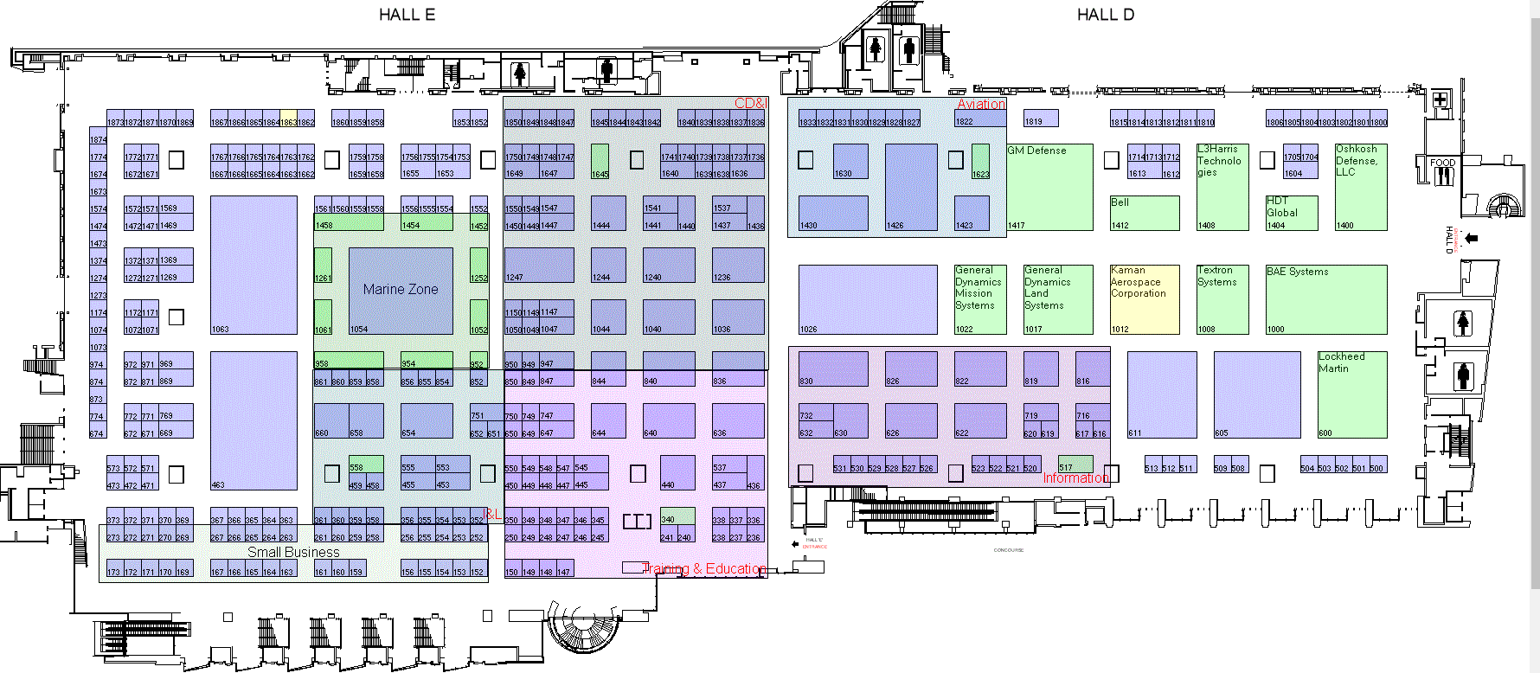
MDM 2022 Exhibit Hall
Floorplan
From Briefing Spaces

Slide 13
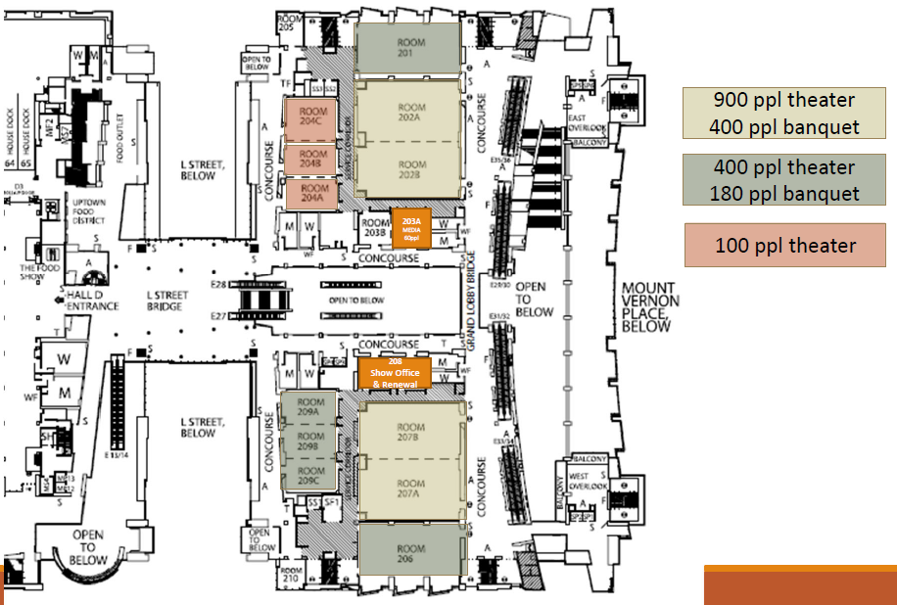
Briefing / Meeting Spaces
Configuration Options
400 pax Briefing / Meeting Space
900 pax Briefing
or
400 pax Dining
“Main Briefing Center”
MDM ”Chow Hall”
100 pax Briefing /
Meeting Space
To Hall D
400 pax Briefing / Meeting Space

