Slide 1
Marine Corps
Association Foundation
Charity Rating Services
Overview

Slide 2
Three Main Charity Rating Services
GuideStar, BBB Wise Giving Alliance, and Charity Navigator
The Marine Corps Association Foundation is rated with all three
GuideStar and Charity Navigator are the most popular with donors

Slide 3
GuideStar
The world's largest source of nonprofit information
Nonprofit organizations who reach platinum level status are considered the most trusted in the United States
MCAF has achieved the platinum level status each year since 2018

Slide 4
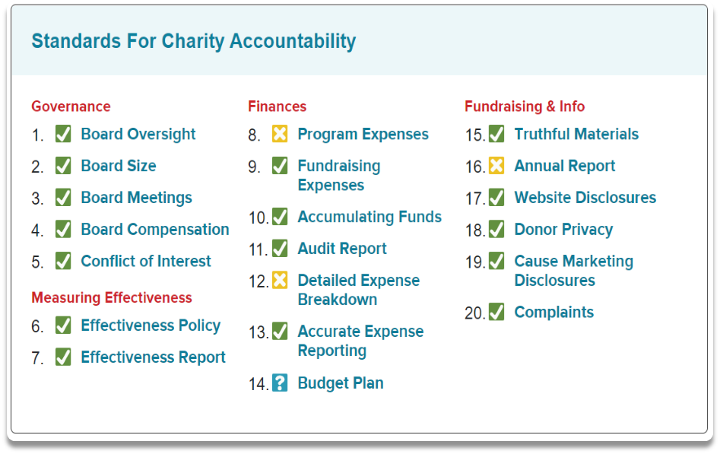
BBB Wise Giving Alliance
BBB Standards address four areas of accountability: governance, results reporting, finances, and truthful transparent communications
MCAF’s last report (July 2020) did not meet two finance standards and one fundraising & info standard; one finance standard was not verified
We can resolve standards 12, 14, and 16 this year

Slide 5
Charity Navigator
Star rating shows how a charity is using donor support, sustaining programs and services, and being accountable and transparent
Evaluation of the Financial Health and the Accountability and Transparency of the organization determine the star rating
Star rating determined by a mathematical equation of both categories averaged over three years

