Slide 1
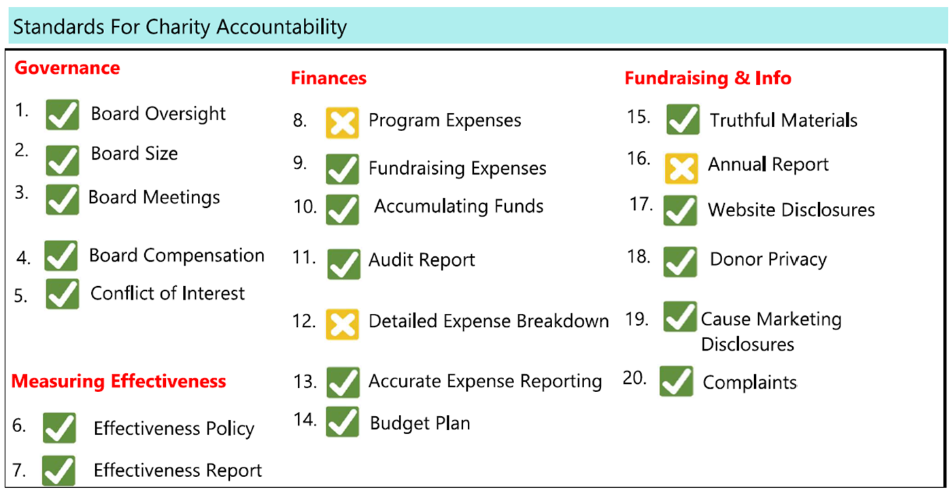
BBB Standards for Charity Accountability address four areas of charity accountability: governance, measuring effectiveness, finances and fundraising & info.
Every two years, the BBB/Wise Giving Alliance reviews charities and issues a report on their findings. MCAF was reviewed in July and did not meet three of their 20 Standards.
The Foundation and Business office staff are working to meet the criteria for approval on Standards 12 & 16.

