Slide 1
MCA&F Finance Committee Brief to BOD/BOG Aug 2022
8/7/2022
1

Slide 2
Finance Committee Agenda
IPS investment ranges
Investment Policy Statement update
Multi-year cash flow

Slide 3
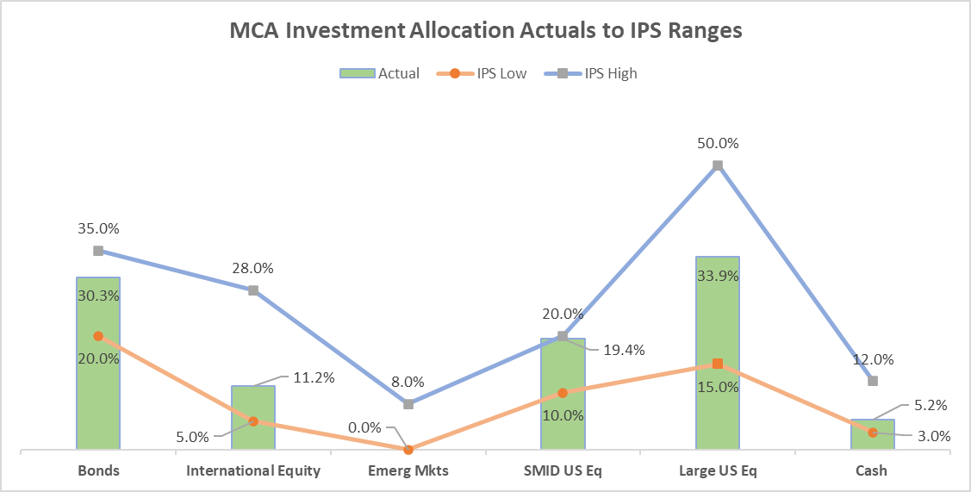
Finance Committee Allocation Ranges

Slide 4
Finance Committee IPS Update
FC believes the current IPS needs to be reviewed and updated
Goals for review
Determine specific use for investment portfolio (endowment potential)
Identify acceptable levels of portfolio complexity
Identify true costs of investment
Create an ‘actionable’ IPS that guides the wealth manager and offers specific support to MCA
Complete by Dec meeting

Slide 5
Finance Committee Cash Flow
FC tasked MCA staff to develop an initial multi-year cash flow analysis to identify operating risks
Bottom Line: flat revenues combined with high inflation will result in sizeable negative cash flow by 2027
Current review included a high-level draft that needs further refinement
Goals for additional review
Identify and manage financial risks over long term (i.e. capital investment)
Generate more detailed assumptions for revenue and expenses
Create decision tool to allow for ‘gaming’ alternatives

