Slide 1
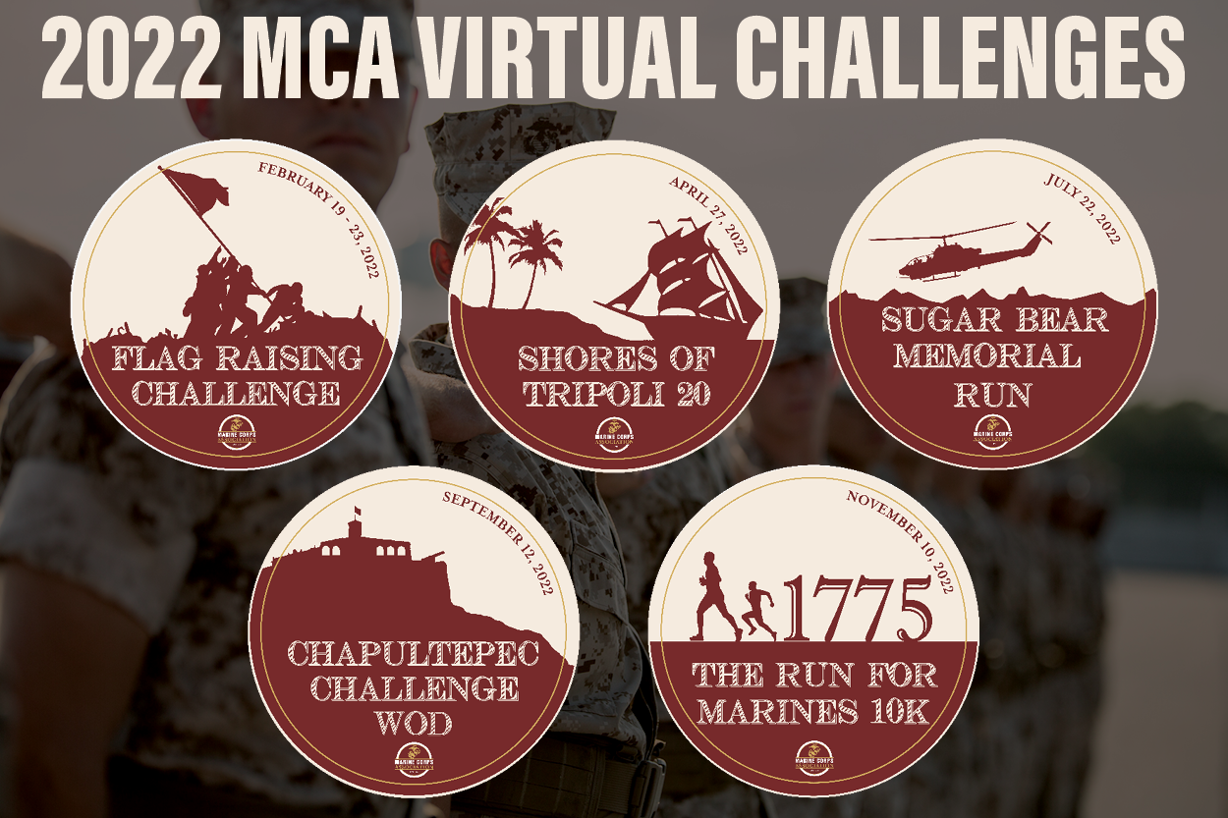
Virtual Challenge Series
Three completed
Flag Raising Challenge
Shores of Tripoli 20
Sugar Bear Run
327 participants @ $26
Cost (Pins, envelopes, postage): $1,827.00
Net revenue: $6,675.00
Two remaining
Chapultepec Challenge WOD
Nov 10th 10K

