Slide 1
Proposed Membership Initiative
7 February 2023

Slide 2
Current Membership
~41,000 Members
Primary benefit are digital and print versions of magazines
Additional benefits in professional development resources, event discounts, and insurance discounts
PDMAP subsidizes Marine memberships
Area Reps obtain majority of new members at Recruit Depots/School of Infantry
Majority of new officer memberships are from uniform purchases.
Notes:
Current Approach:
Association-focused
Digital and print paid memberships
Members must register and create a profile
PDMAP subsidizes Marine memberships
Majority of new paid members are acquired through Area Reps contact at Recruit Training/School of Infantry (Marine Combat Training)
Purchases of commissioning uniforms and officer's uniform packages accounts for the majority of new officer memberships.

Slide 3
Proposed Membership Model
Purpose: Redefine membership model to increase total membership numbers and revenue
Two types
Marine Corps Association
Marine Corps Association Foundation
Categories
Associate - Inactive, No membership payment
Premium – Active/Paid by MCAF or individual
Notes:
Make distinction between members and revenue as unpaid memberships are important in other ways (advertising, partnerships etc)
MCAF is only 423

Slide 4
Associate Members
Initial Level of Membership
No payment received
Goal is to move Associate members to Premium membership
Benefits are no cost to MCA
Insurance and other discounts
Announcements
Newsletters
Access to limited content
Basic contact information required to add to database – name, email address or phone number
Contact information obtained from
Area Reps Events
Donors Other lists
Notes:
Counted in membership total, receive no benefits, and in one of two “databases” (Nimble and CP)
Nimble – current and past members, donors etc. Some shoppers approximately 500,000
Counterpoint – all shoppers. Working on cleaning it up approximately 400,000
Dedicated marketing plan required to move to Premium status
Welcome email/follow up emails/modified version of Extra Rations
Benefits Will expand as we research more external discounts
Contact info Every list, attendee, shopper etc will fall into this category
Database entry is critical to marketing opportunities

Slide 5
Premium Members
Paid members who have activated their membership and receive all benefits
Total Force
All Active Duty including assigned USN and other allied/joint assigned
Paid by MCAF
Digital Access only to magazines and resources but can upgrade to hard copy magazine
Receives full benefits and access to all resources
Others
Veterans, retirees, Friends of the Corps, and family
Paid for by individuals, companies, or sponsors
Received Digital or Hard Copy (subscription) of magazines
Receives full benefits and access to all resources
Notes:
Counted in membership totals, receive all benefits, and activated in Nimble
*PAID Memberships
Digital or hard copy dependent on pricing structure
Types
Individual
Sponsors - % of membership based on total paid
Corporate
High School Contract – point of contact at each school
Marine Corps PME students (joint/allied/interdepartmental)

Slide 6
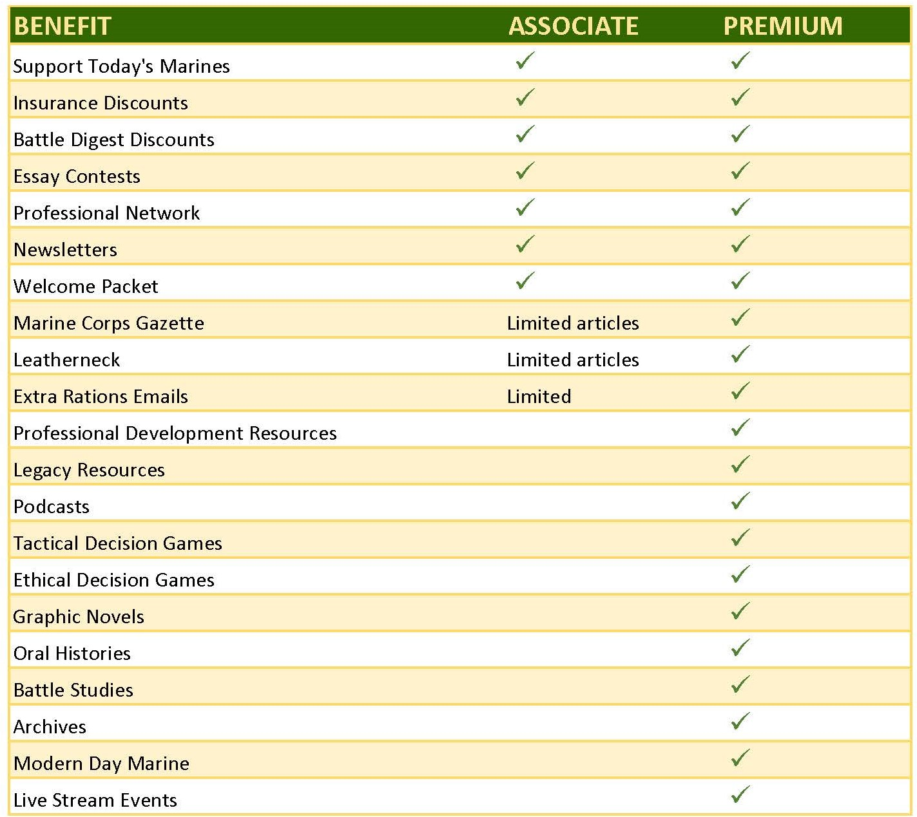
Proposed Membership Benefits
Notes:
Potential
MDM
Special invite
Restricted digital access to certain speakers
Member only on line speakers
Coffee Series with senior leaders (see AUSA)
Explore additional discounts
Car Trip Dental Computer Veteran owned/supportive business Florists/Candy
Expand Existing Content
Feature an article from the archives every day on the Legacy site. We could continue the Extra Rations articles too but maybe add a list with links to the previous weeks articles included with each
Post a photo every day on social media to include one mystery photo to promote engagement. We’d ask followers to guess the who, when, and where of a picture
Feature/promote a podcast or interview once a week on the website
Feature one of our pro dev items weekly (TDG/EDG/battle studies/Corps Voices etc)
Post a photo and short write up on an award recipient each week. One week a dinner award recipient, one week a Chesty Puller award, one week an essay winner etc.
Create stories/reels from our dinners from interviews with speakers, VIPs, award recipients, and guests. We could come up with a variety of questions and just get short sound bites.
Use short highlights of speeches from dinners on social media but lock up the video afterwards behind the paywall and feature it the day after on the website.
Not sure about this one – should we lock up the live streams to members only?

