Slide 1
Five Year Direct Mail
Net Revenue
FY21 results are estimated

Slide 2
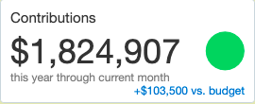
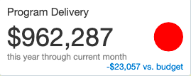
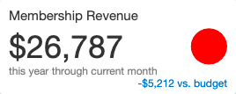
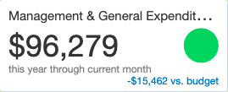
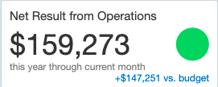
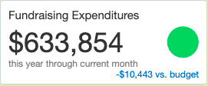
MCAF YEAR-END DASHBOARD 2021
(Elements that provide the net result)
Revenue
Expense

Slide 3
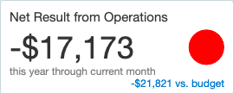
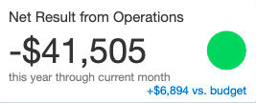
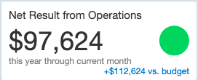
Net Result Year-End Comparisons
*
* Planned Budget deficit of $48K
2018** 2019** 2020*** 2021****
** $125K MCA to MCAF
*** $10K MCA to MCAF
**** $25K MCA to MCAF
2022 Budget: $0 MCA to MCAF

