Slide 1
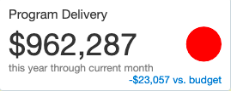
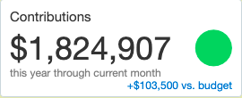
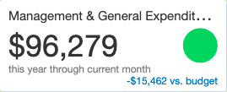
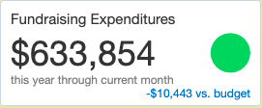
MCAF YEAR-END DASHBOARD 2021

Slide 2
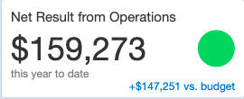
MCAF YEAR-END DASHBOARD 2021

Slide 3
MCAF YEAR-END DASHBOARD 2021

Slide 4
MCAF YEAR-END DASHBOARD 2021
 |  | Budget 2022 |  | Budget 2021
Revenue |  | $ 1,874,881 |  | $ 1,753,407
Program Expenses |  | $ 979,646 |  | $ 985,345
Management & General Expenses |  | $ 116,162 |  | $ 111,742
Fundraising Expenses |  | $ 779,074 |  | $ 644,298
Net Results |  | $ - |  | $ 12,022

