Slide 1
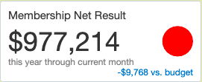
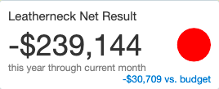
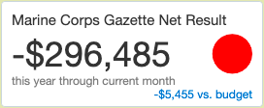
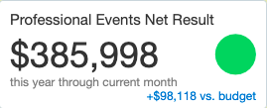
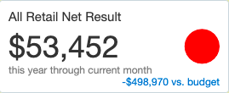
MCA YEAR-END DASHBOARD 2021
End of Year Performance Indicators with Budget Comparison

Slide 2
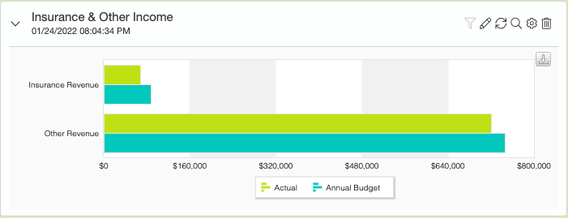
MCA YEAR-END DASHBOARD 2021

Slide 3
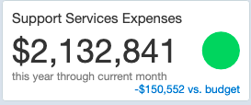
MCA YEAR-END DASHBOARD 2021
Administrative
Business Office
Information Technology
Strategic Communications

Slide 4
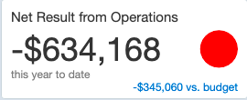
MCA YEAR-END DASHBOARD 2021

Slide 5
MCA YEAR-END DASHBOARD 2021

Slide 6
MCA YEAR-END DASHBOARD 2021

Slide 7
MCA YEAR-END DASHBOARD 2021
MARINE CORPS ASSOCIATION
Budget Comparison
MCA SUMMARY RESULTS
 |  | Budget 2022 |  | Budget 2021
 | Membership and Publishing net result | 103,815 |  | 319,762
 | Retail net result | 332,293 |  | 552,423
 | Events net result | 259,578 |  | 287,880
 | Affinity, Insurance, Other revenue | 1,215,710 |  | 834,221
 | Administrative expenses | -2,183,866 |  | -2,283,394
 |  | --------------- |  | ---------------
 | MCA net result | -272,471 |  | -289,108
 | Compensation Adjustment (Wage) | -123,338
 | Compensation Adjustment (Tax/401K Match) | -15,602
 |  | --------------- |  | ---------------
 | Adjusted MCA net result | -411,411

Slide 8
Retail Results 2021
 | 2021 Actual | Budget 2021 | 2020 Actual
Cost of Goods as % of Sales | 64.27% | 63.14% | 63.40%
Retail Expense as % of Sales | 34.91% | 29.16% | 33.37%

Slide 9
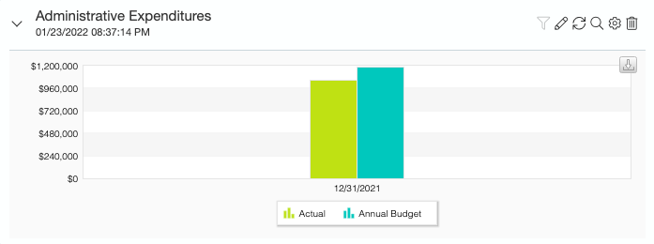
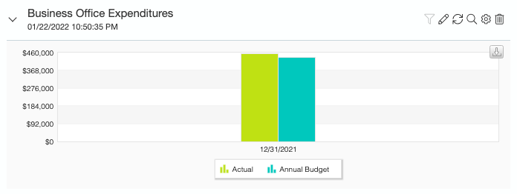
MCA YEAR-END DASHBOARD 2021

Slide 10
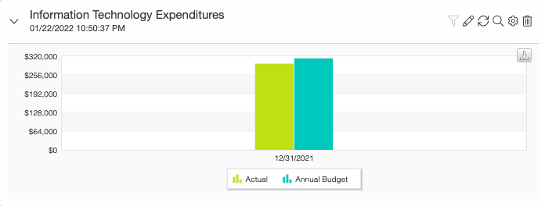
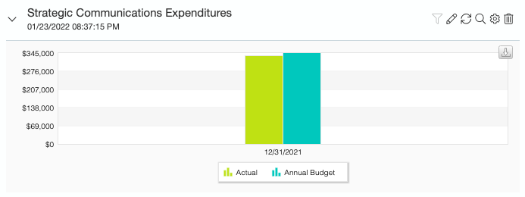
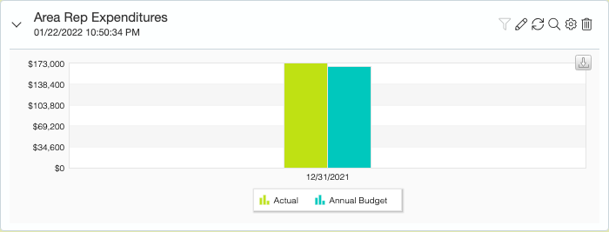
MCA YEAR-END DASHBOARD 2021

