Slide 1
Marine Corps Association Foundation
2020 Highlights and
2021 Way Ahead

Slide 2
Over $800,000 spent on Marines in 2020
~4,000 (~9,000 in 2019) Marines visit battlefields around the globe
Expense down; nearly as many events cancelled as executed
~186 (~173 in 2019) Unit Libraries enhanced with books from the Commandant’s Professional Reading List
New Commandant’s Professional Reading Program
Intro to PME at the MCRD’s
>5,000 (~same as 2019) awards for outstanding Marines
~77 (~same as 2019) Marines won Writing Awards
Nearly 65,000 Marines impacted by MCAF programs!
Notes:
LtGen Flynn: 1st LAR Bobby Christopher. Book in the pocket for Marines during lulls in training.

Slide 3
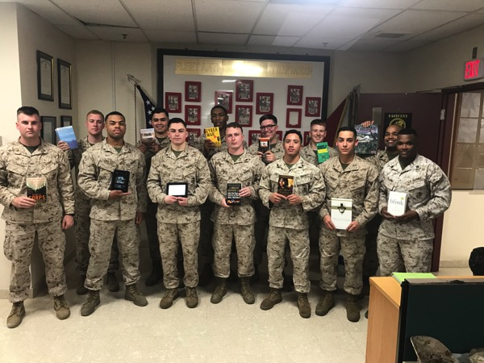
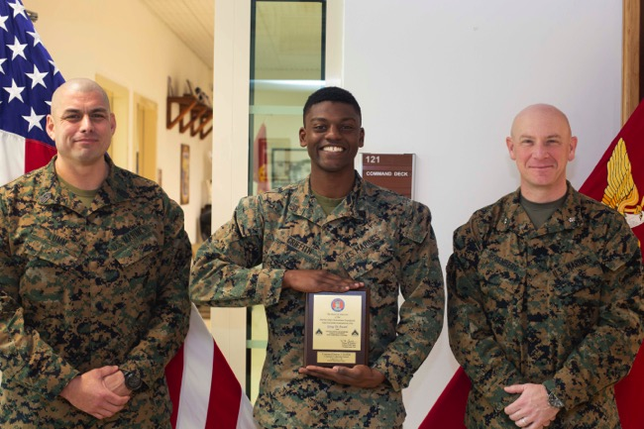
Program Delivery
Unit Library Program
Enhanced 186 unit libraries in 2020
~45 Kindles for deploying units
Nearly 54,000 Marines
Intro to PME @ MCRD’s
Excellence Awards Program
Nearly 6,000 awards in 2020, mostly to enlisted Marines
Notes:
LtGen Flynn: do we post award pictures in magazines or on social media? Can we?
Ron: do we send things like this out to hometown newspapers? The Marines’ in the photo’s hometown?
Alex H: how do we use premier award winners to reinforce membership? Use award (alumni) to push our message.
Wendy: social media is the platform young Marines use. Find someone they want to connect to (twitter, etc) and bring them into MCA&F. Reach them where they are.

Slide 4
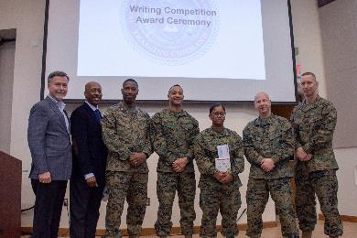
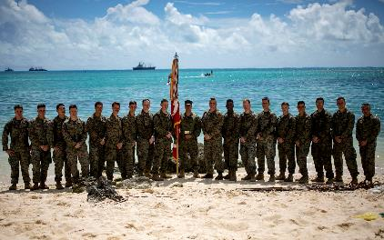
Program Delivery
Marine Writing Program
In 2020, 77 awards presented
Plaques and cash awards
Commanders’ Forums Program
Staff Rides, PMEs, Guest Speakers
In 2020, 40 forums supported
Professional development of nearly 4,000 Marine leaders, from NCOs to officers

Slide 5
2021 Fundraising Opportunities
MCAF “Giving Day” targeted for 8 June
Golf Tournament
18 October 2021
Silent auction opportunities
Sign up early!
Matching gift campaign (end of year)
Virtual Challenge Series
Direct Mail Acquisition

Slide 6
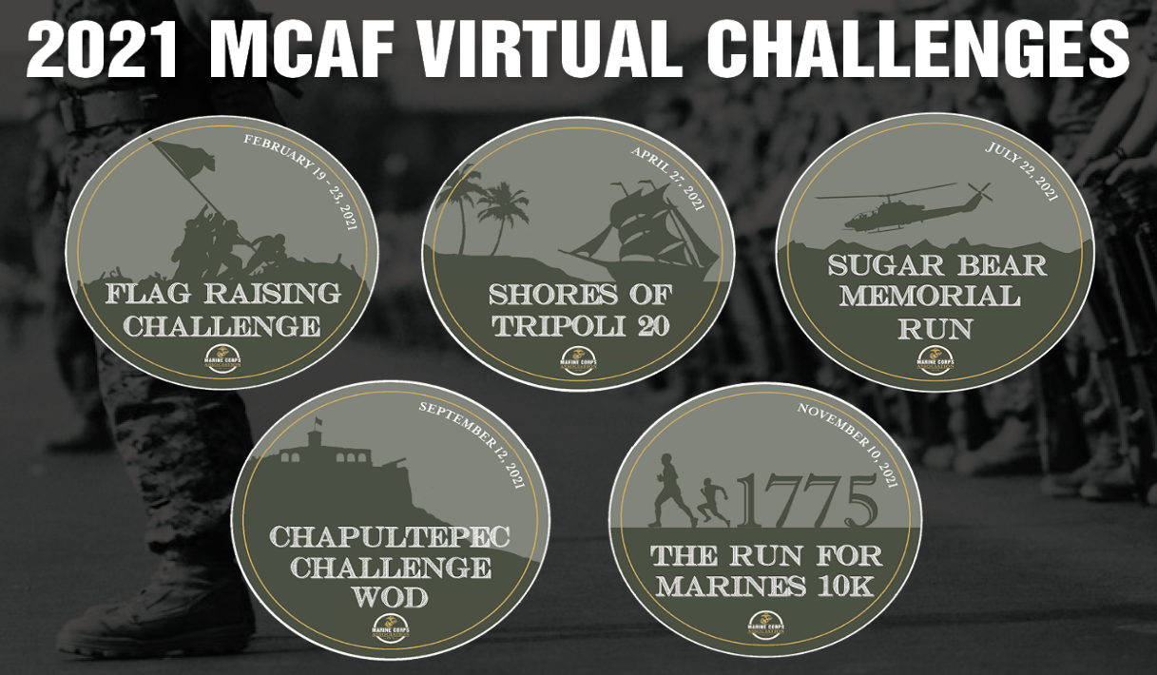
Virtual Challenge Series
2020 net: $20,200
Four main events
Flag Raising Challenge
Shores of Tripoli 20
Sugar Bear Run
Nov 10th 10K
New: Workout of the Day
Chapultepec Challenge
2021 plan will set the challenges for future years
Opportunity to reach an audience beyond magazines, members, donors
Sugar Bear Foundation supports Gold Star families and Surviving Spouses and families

Slide 7
Expanded Direct Mail Acquisition
Wiland Co-op Model offers unlimited list potential compared to internal prospects which have remained relatively static in size
Growing the file requires a larger target set
New Wiland agreement now provides new models that can target higher response, higher average gift, or both
Segment | Available Universe
Member | 15,000-20,000
Retail | 5,000-10,000
Wiland | 16-22 million

Slide 8
Expanded Direct Mail Acquisition
Wiland models lists around an organization’s donor behavior
With MCAF participation in the model, they can provide better lists, increase response & target high dollar donors
In Acquisition, response rate is much more critical than average gift
Work towards upgrading once they are active donors
Next step: exchanging with other organizations through a list management company to find quality lists
Example: MCHF November response rate over 7%
(MCAF 2020: member 1.09%, retail 0.93%, Wiland 1.92%)

