Slide 1

Marine Corps Association and Foundation
February 9, 2021
Audit, Tax and Consulting Services
CLAconnect.com
WEALTH ADVISORY
OUTSOURCING
AUDIT, TAX, AND
CONSULTING

Slide 2
Audit and Tax Requirements
Why have an audit? Compliance - required by:
Va. Code Ann. § 58.1-609.11(D)(4) and MCA Bylaws
  Article VIII, Section 2(e) – “Arranging an audit of the accounts of the Association, at least annually, by an independent auditing firm approved by the Board. The results of the audit will be provided to the Board of Governors.”
  Article IX, Section 1 – “The Board of Governors … shall appoint as standing committees from among the Governors … an Audit & Investment Committee (A&IC).”
Why prepare tax returns
  The federal government and state governments require filings, and in some cases, payment of taxes, in order to operate a business, whether it is for-profit or non-profit
Notes:
VA Code - If the entity's gross annual revenue was at least $750,000 in the previous year, then the entity must provide a financial review performed by an independent certified public accountant. However, for any entity with gross annual revenue of at least $1 million in the previous year, the Department may require that the entity provide a financial audit performed by an independent certified public accountant. If the Department specifically requires an entity with gross annual revenue of at least $1 million in the previous year to provide a financial audit performed by an independent certified public accountant, then the entity shall provide such audit in order to qualify for the exemption under this section, which audit shall be in lieu of the financial review

Slide 3
Audit and Tax Requirements (Continued)
Why prepare annual tax returns for a nonprofit?
Compliance
  Federal returns are required for 501(c)(3) and 501(c)(19)
  State returns are required if any “unrelated business income is present”

Slide 4
Tax Preparation
Federal Forms 990 and 990-T and Related Schedules
State Forms: Virginia Form 500, California Form 109 and 199, North Carolina Form CD-405 and CD-479
Both the Association and the Foundation
Service / Communication Throughout the Year Ensures Compliance

Slide 5
What is an Audit?
An investigation of MCA&F’s consolidated financial statements to determine whether they are fairly stated and free of material misstatement.
Why are the financial statements consolidated and what does that mean? Nonprofits that are “controlled” by another organization where there’s an “economic interest” are to be consolidated (i.e., combined).

Slide 6
Auditor’s Responsibility Under
U.S. Generally Accepted Auditing Standards
The primary objective of our audit is to express an opinion on the fair presentation of the consolidated financial statements.
We plan and perform the audit to obtain reasonable assurance about whether the consolidated financial statements are free of material misstatements, whether caused by error or fraud. Because of the nature of audit evidence and the characteristics of fraud, we are to obtain reasonable, not absolute, assurance that material misstatements are detected. We have no responsibility to obtain reasonable assurance that misstatements, whether caused by error or fraud, that are not material to the financial statements are detected.

Slide 7
What Do We Do During An Audit
Risk Assessment
Internal Control Tests
Substantive Tests
Analytical Tests
Confirmation Procedures
Inquiries
Unexpected Tests
Service / Communication Throughout the Year and Not Just at Audit Time
=
NO SURPRISES!

Slide 8
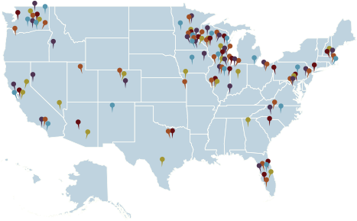
Who We Are - CLA
CLA is among the nation’s leading accounting and professional services firms.
Dedicated - Structured to provide clients with highly specialized industry insight, the firm delivers its outsourcing, audit, accounting, tax, consulting, and advisory capabilities from industry-specific perspectives.
Experienced - With over 120 locations in the United States operating in conjunction with our global network of contacts and Nexia affiliate firms, we have the resources and experience to help you achieve your goals in the U.S. and beyond. Our low staff-to-partner ratio assures clients receive significant partner attention.
Committed - Our teams are service-driven and work with many fast growing businesses. We exceed expectations and deliver in advance of deadlines. We are here to support your journey and are excited to be a part of the team.
150,000+ clients served
6,500+ people
Focused on small business, their owners, foreign and domestic
$1.1 billion in revenue
More than 120 locations
CLA’s average turnover is 4% lower than the industry for the prior three years
800+ principals
One of the top 10 accounting firms in the U.S.

Slide 9
Overview of CLA’s Nonprofit Practice
Leading provider in nonprofit assurance, tax and employee benefit plans
  More than 7,000 nonprofit clients nationally and more than 500 locally
  More than 2,000 associations served
  CLA prepares more 990s than any other professional services firm in the US based on data obtained from CauseIQ.
CLA exists to create opportunities for our clients, our people, and communities through industry-focused wealth advisory, outsourcing, audit, tax and consulting services.

Slide 10

Association Experience = Added Value
Our association practice is one of the largest in the country, serving approximately 2,000 associations and membership organizations with operating budgets from $100,000 to $300 million.
A unique approach:
  Event Partner of the American Society of Association Executives (ASAE)
  Team members lead numerous volunteer committees
  Frequently speak and write as thought leaders in the industry

Slide 11
Not Just Associations … Military Associations
Air Force Association
Association of the United States Army
Marine Corps Association
Military Officers Association of America
Marine Corps Scholarship Foundation
Women in Military Service for America Memorial Foundation

Slide 12
Nat’s Clients Include
American Petroleum Institute
Auto Care Association
Edison Electric Institute
Mortgage Bankers Association
National Association of Broadcasters
National Rural Electric Cooperative Association and a host of other trade and professional associations.

Slide 13
MCA&F Audit History and Comparison to Others
People, systems and protocols
Audit findings
Financial results
Reserves

Slide 14
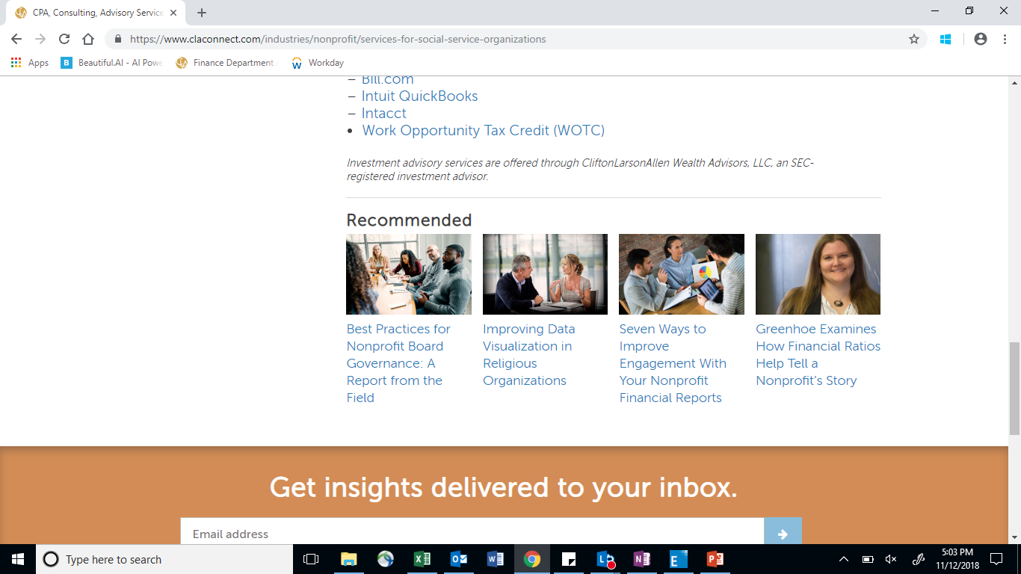
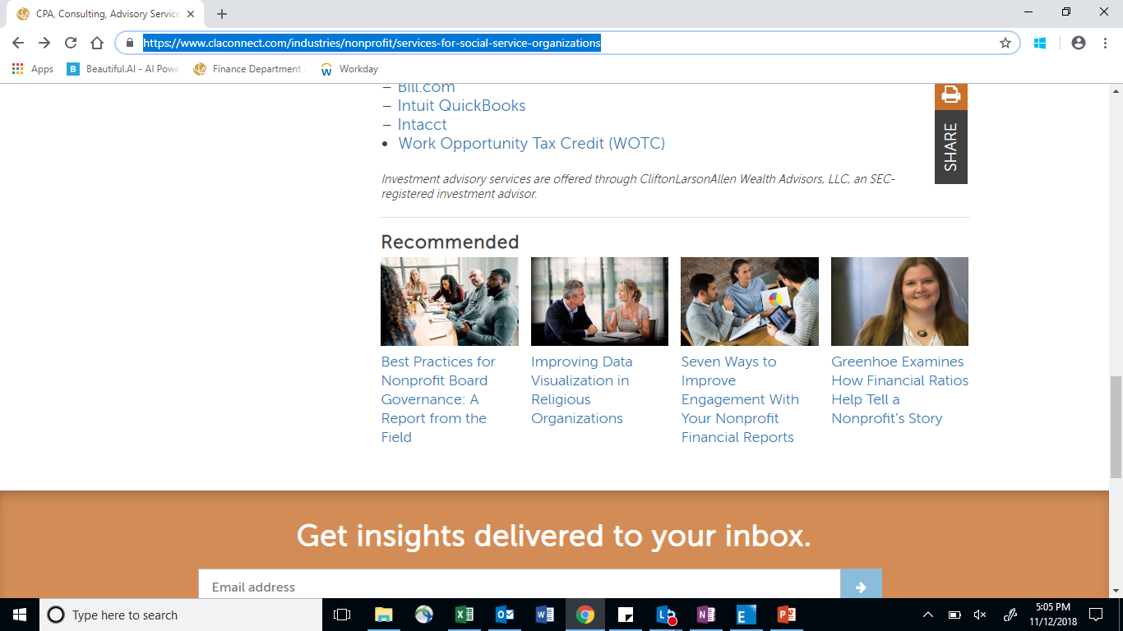


Resources
Other Ways CLA Can Help You Meet Your Goals
Articles, Webinars, and Tools
www.claconnect.com
Assurance Services
Audit
Review
Consulting
Internal control review
Tax Services
Annual tax compliance
Multi-state sales and use tax
Compilations
Agreed-upon procedures
Information security audit
Restructuring
Compensation consulting
Board training
Strategic planning
Membership surveys
Benefit plan compensation
Unrelated business income tax (UBIT)
Intermediate sanctions
International tax

Slide 15
Auditor Tenure
What are the rules?
There are no rules. Only publicly traded companies have rules.
So, what do publicly traded companies do?
  Change audit firms every five years, or
  Change lead audit partner every five years
  Why – competency, fees, independence
Reality - Average tenure for Dow 30 = 66 years (WSJ 4/6/18)

Slide 16
Auditor Tenure
Change in Audit Team Composition
Change in Lead Audit Principal
Change in Audit Manager / Director
Change in Audit Seniors / Associates
Audit Quality and File Review
In-Charge, Director, Principal, Second Principal
Peer Review of CLA

Slide 17
Auditor Tenure
What Makes Nonprofits Uniquely Different
  Competency – Complexity and compliance
  Fees – Client size is not relevant. My largest client ($250M trade association w/900 staff, 17 related entities, $25B in 3 pension funds, owning two 10-story office buildings in Arlington) < 5% of my fee base, and < .2% of the DC office revenue, before we consider CLA, a $1.2B firm.
  Independence – no stock/ownership, no familial relations

Slide 18
Governance Responsibilities
Establishing mission and philosophy
Planning
Selection and supervision of top management
Ensuring adequate resources and managing them effectively
Setting policies to effectively guide operations and programs
Reviewing financial and programmatic performance as compared to objectives

Slide 19
Governance Responsibilities (cont'd)
Organization of the board to work effectively
Recruitment and orientation of new members
Advocacy for the organization in the community
Ensuring legal and ethical integrity

Slide 20
Responsibilities of a Board Member
Ensure the Future
Ensure the Mission
Ensure Effective Governance
Ensure Effective Operations

Slide 21

Executive Responsibilities
Carry out board policy and directives
Administer internal controls
Monitor financial goals & objectives
Process financial information
Prepare budgets and financial information
Provide accurate, timely and meaningful information
Keep the board appropriately informed
Maintain key relationships (sponsor, community, etc.)

Slide 22
Determining Different Roles
Governance is the ultimate responsibility of the board, while the responsibility of the staff is management.
Rather than seeing the nonprofit board’s job as a function of management, it is first and fundamentally a responsibility for ownership.
Board should ask, with respect to programs and initiatives, “Why are we doing this, rather than, how can we do it?”

Slide 23
Nat Bartholomew, CPA
Principal in Charge,
Associations and Membership Organizations
Nat.Bartholomew@CLAconnect.com
Mike Benoudiz, CPA
Director, Nonprofit
Mike.Benoudiz@CLAconnect.com
Thank you!

